Slide 1
Chapter 6, Functions and an Introduction to Recursion
C++ How to Program, 9/e

Slide 2
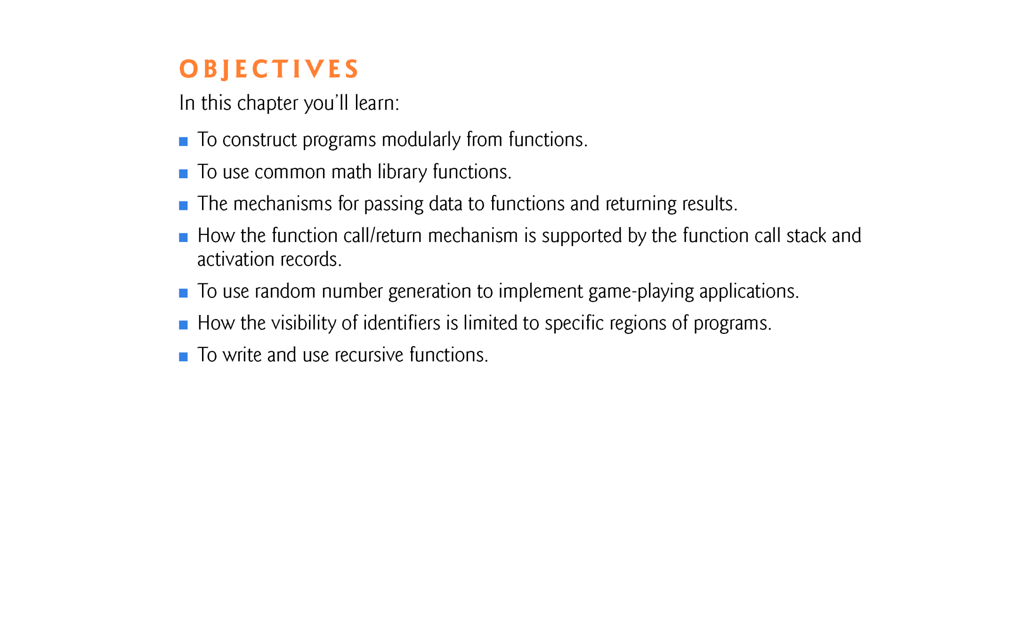

Slide 3
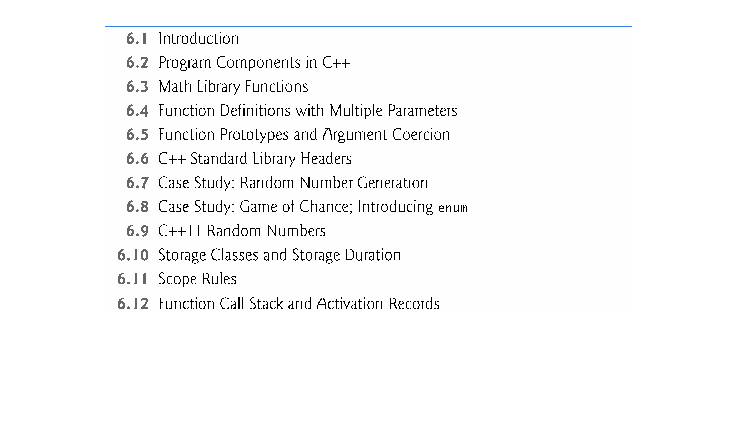

Slide 4
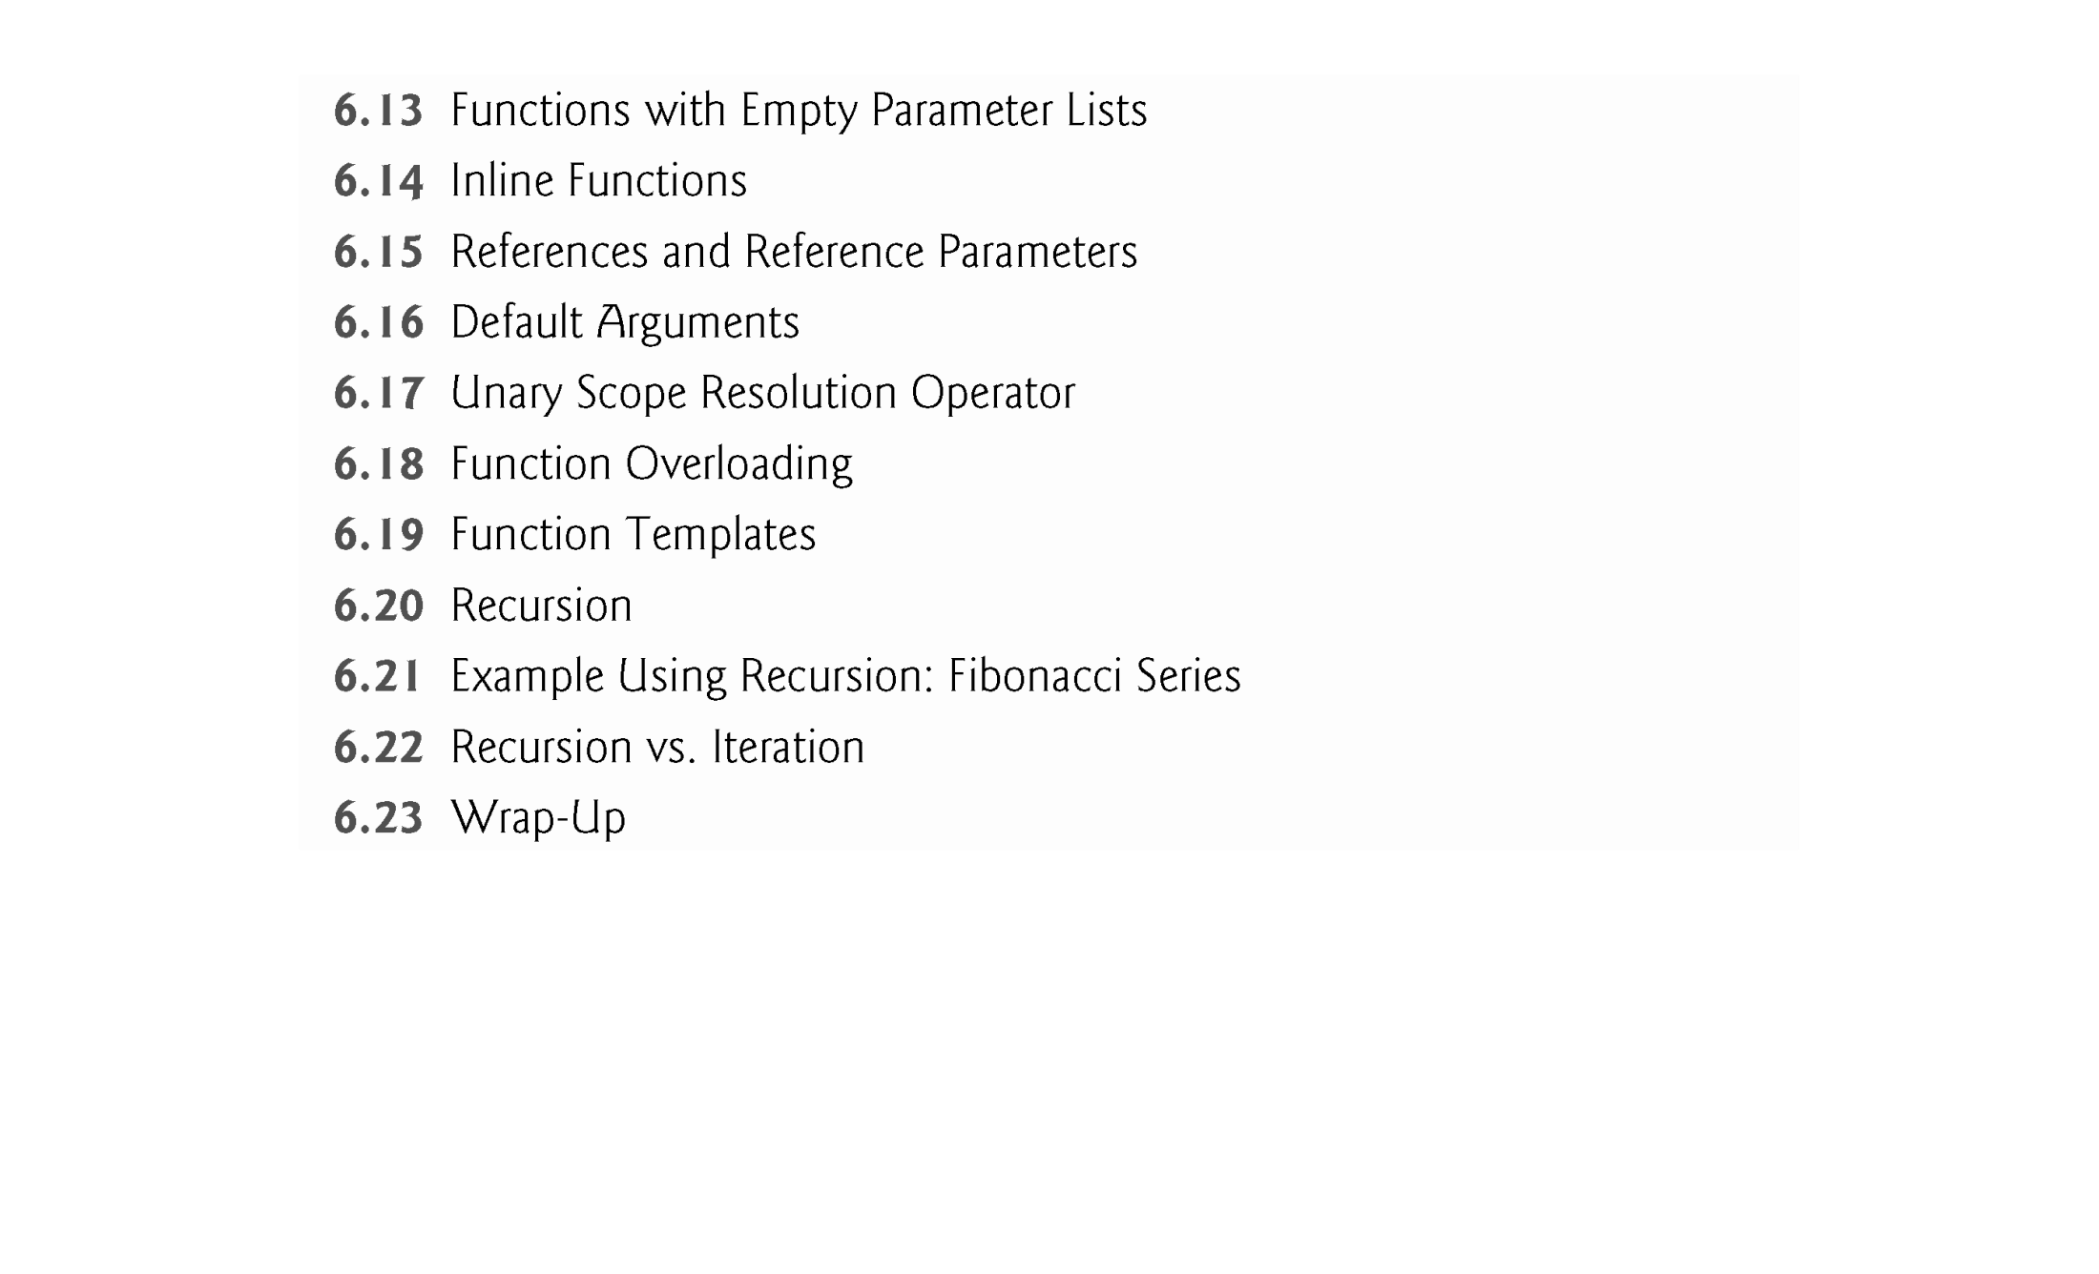

Slide 5
6.1 Introduction
Experience has shown that the best way to develop and maintain a large program is to construct it from small, simple pieces, or components.
This technique is called divide and conquer.
Emphasize how to declare and use functions to facilitate the design, implementation, operation and maintenance of large programs.
Additional information about function prototypes and how the compiler uses them to convert the type of an argument in a function call to the type specified in a function’s parameter list, if necessary.
Simulation techniques with random number generation.
C++’s storage-class specifiers and scope rules.

Slide 6
6.1 Introduction (cont.)
How C++ keeps track of which function is currently executing, how parameters and other local variables of functions are maintained in memory and how a function knows where to return after it completes execution.
Function overloading.
Function templates.
Recursion.

Slide 7
6.2 Program Components in C++
C++ programs are typically written by combining new functions and classes you write with “prepackaged” functions and classes available in the C++ Standard Library.
The C++ Standard Library provides a rich collection of functions.
Functions allow you to modularize a program by separating its tasks into self-contained units.
Functions you write are referred to as user-defined functions.
The statements in function bodies are written only once, are reused from perhaps several locations in a program and are hidden from other functions.

Slide 8
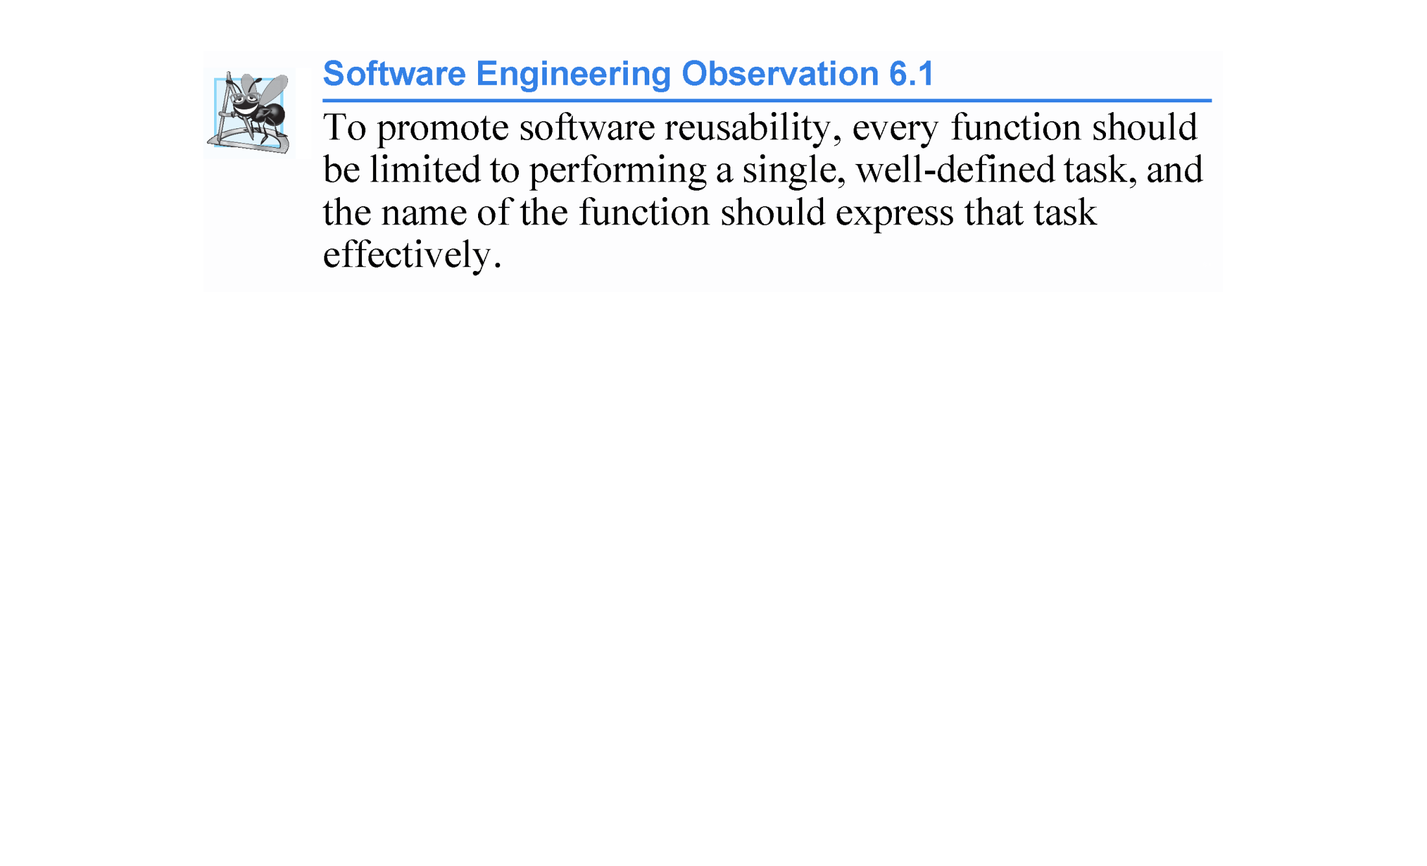

Slide 9
6.2 Program Components in C++ (cont.)
A function is invoked by a function call, and when the called function completes its task, it either returns a result or simply returns control to the caller.
An analogy to this program structure is the hierarchical form of management (Figure 6.1).
A boss (similar to the calling function) asks a worker (similar to the called function) to perform a task and report back (i.e., return) the results after completing the task.
The boss function does not know how the worker function performs its designated tasks.
The worker may also call other worker functions, unbeknownst to the boss.
This hiding of implementation details promotes good software engineering.

Slide 10
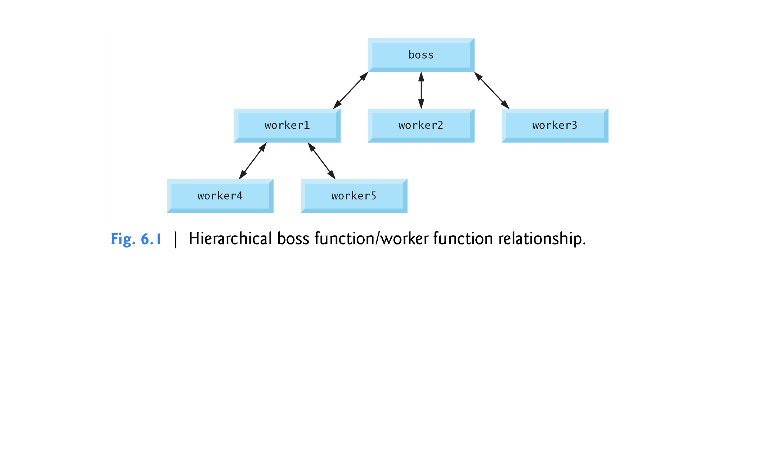

Slide 11
6.3 Math Library Functions
Often functions are not members of a class.
These are called global functions.
Function prototypes for global functions can be placed in header files so that the global functions can be reused in any program that includes the header file and that can link to the function’s object code.
The <cmath> header file provides a collection of functions that enable you to perform common mathematical calculations.
All functions in the <cmath> header file are global functions—therefore, each is called simply by specifying the name of the function followed by parentheses containing the function’s arguments.

Slide 12
6.3 Math Library Functions (cont.)
If you call sqrt with a negative argument, the function sets a global variable named errno to the constant value EDOM. The variable errno and the constant EDOM are defined in the <cerrno> header.
Some math library functions are summarized in Fig. 6.2.
In the figure, the variables x and y are of type double.

Slide 13
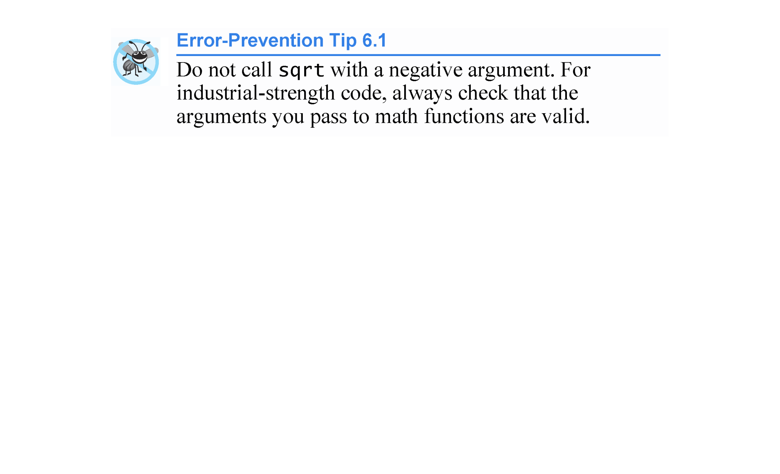

Slide 14
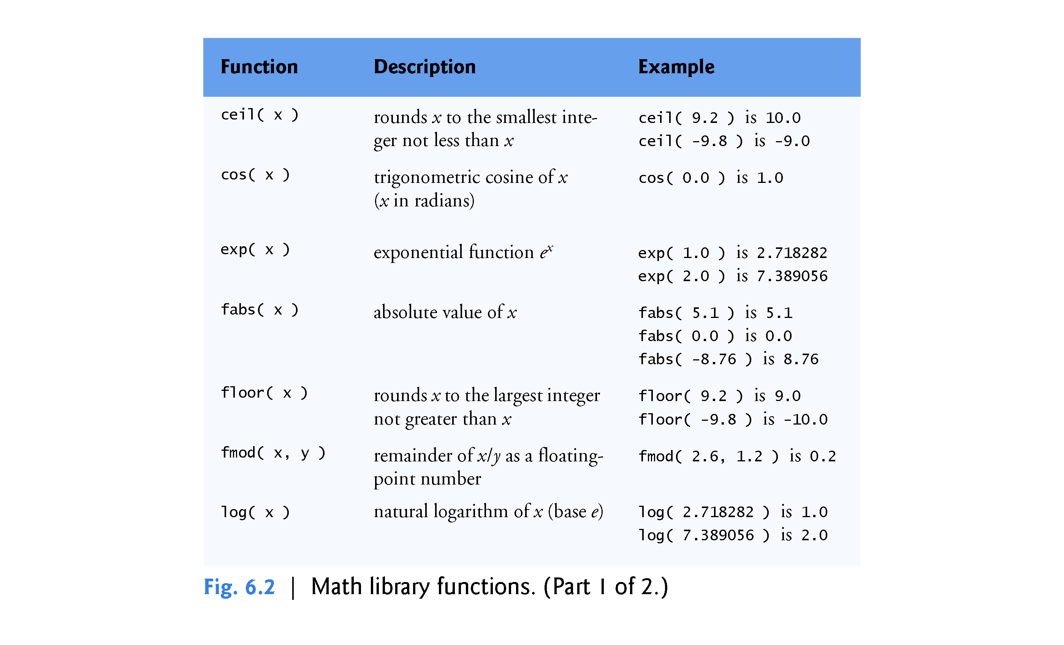

Slide 15
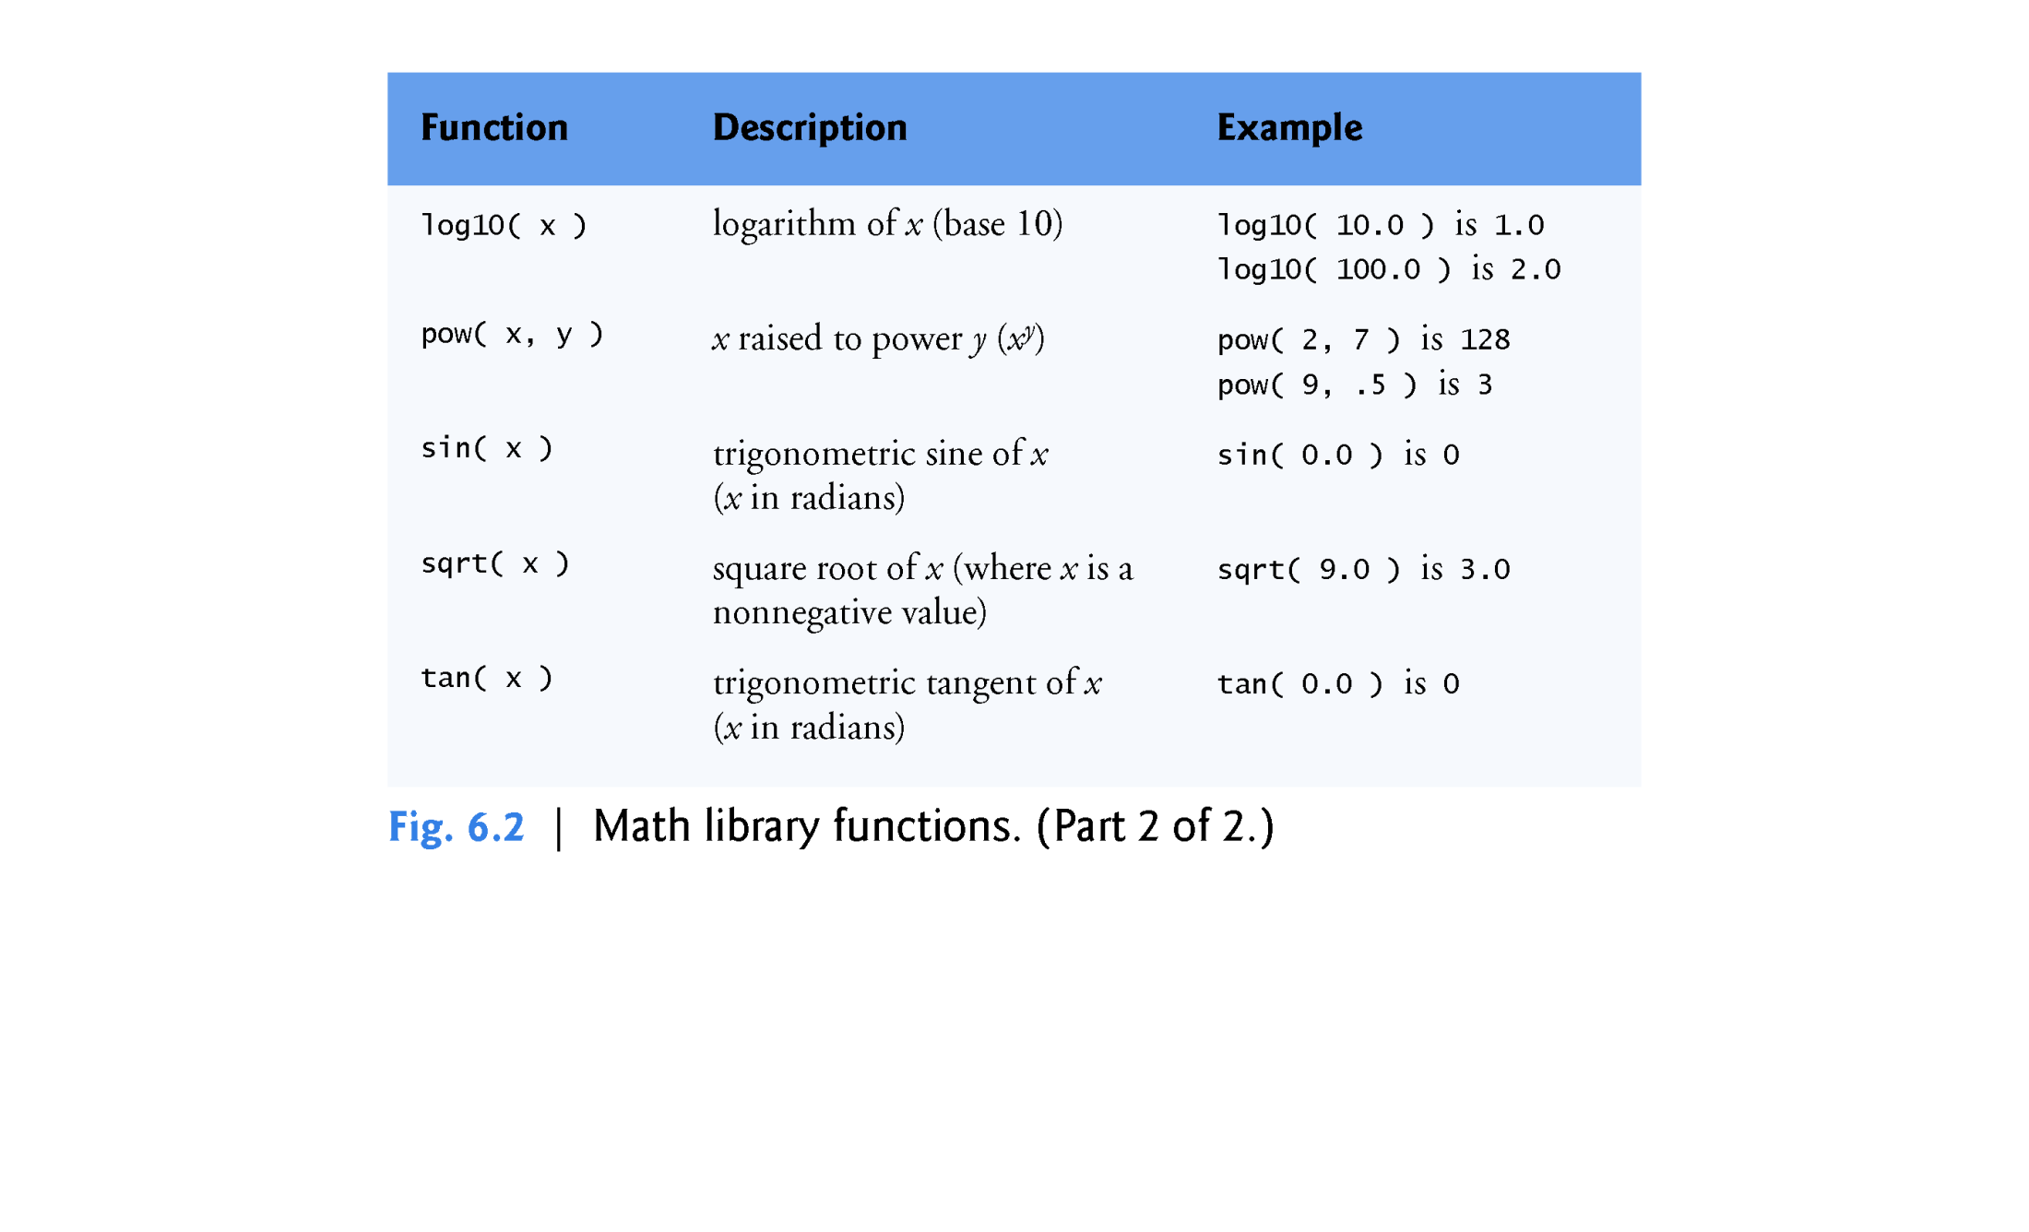

Slide 16
6.4 Function Definitions with Multiple Parameters
Functions often require more than one piece of information to perform their tasks.
Such functions have multiple parameters.
Figures 6.3–6.5 modify class GradeBook by including a user-defined function called maximum that determines and returns the largest of three int grades.
There must be one argument in the function call for each parameter (also called a formal parameter) in the function definition.
Multiple parameters are specified in both the function prototype and the function header as a comma-separated list.

Slide 17
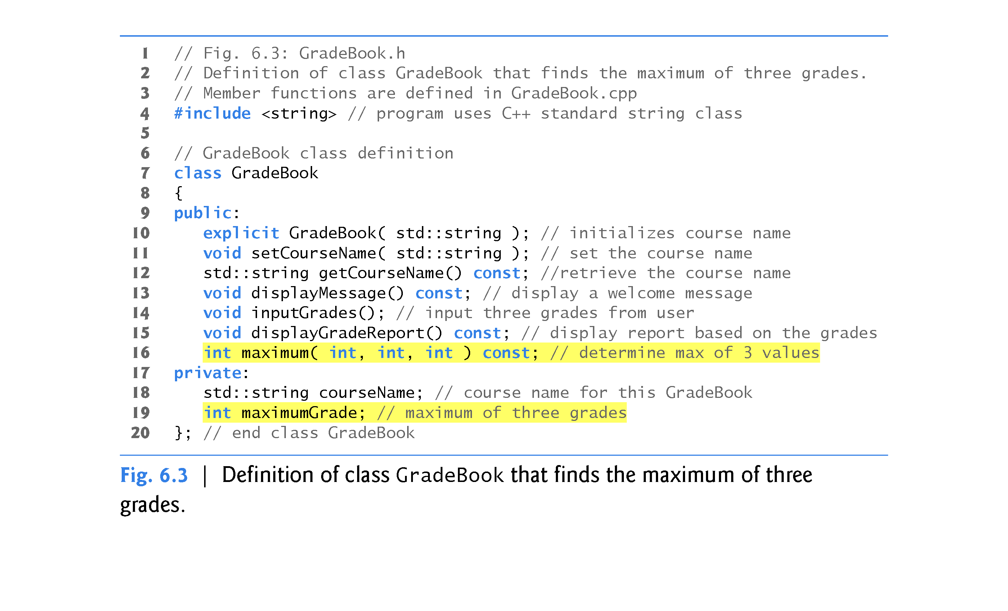

Slide 18
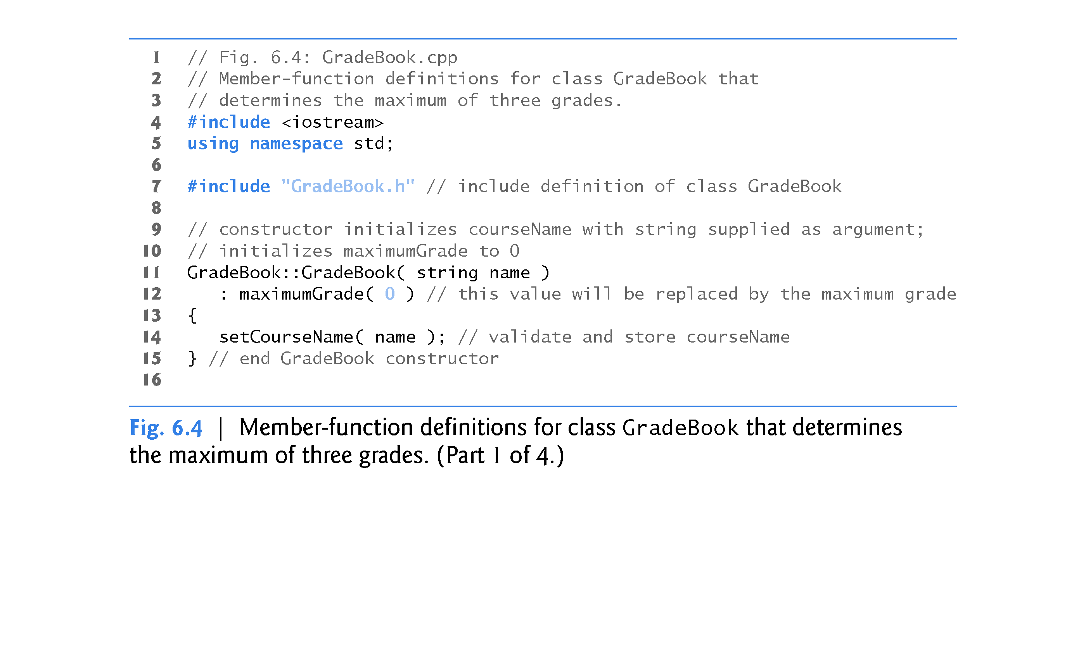

Slide 19
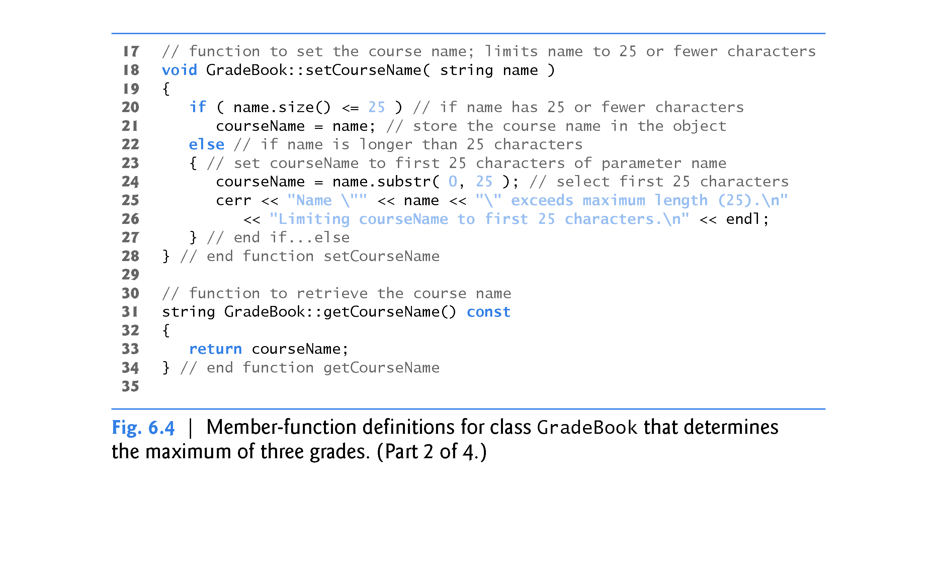

Slide 20
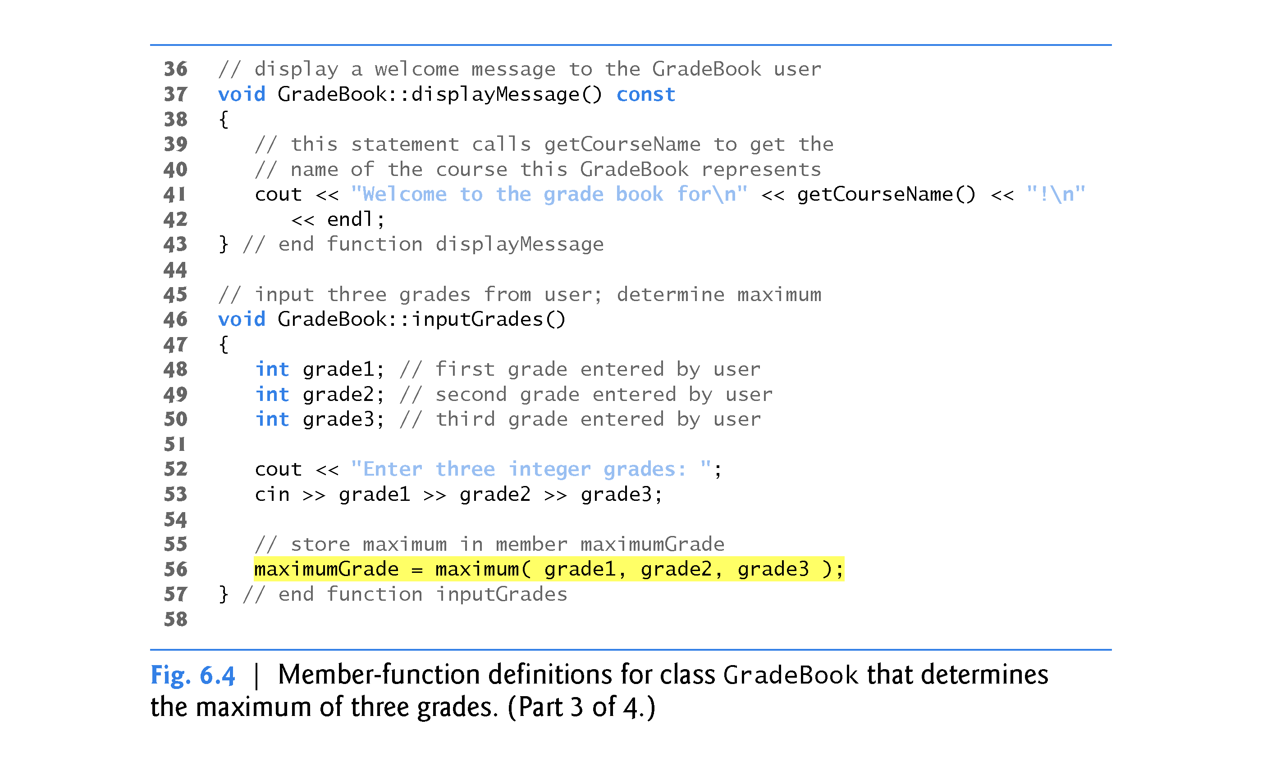

Slide 21
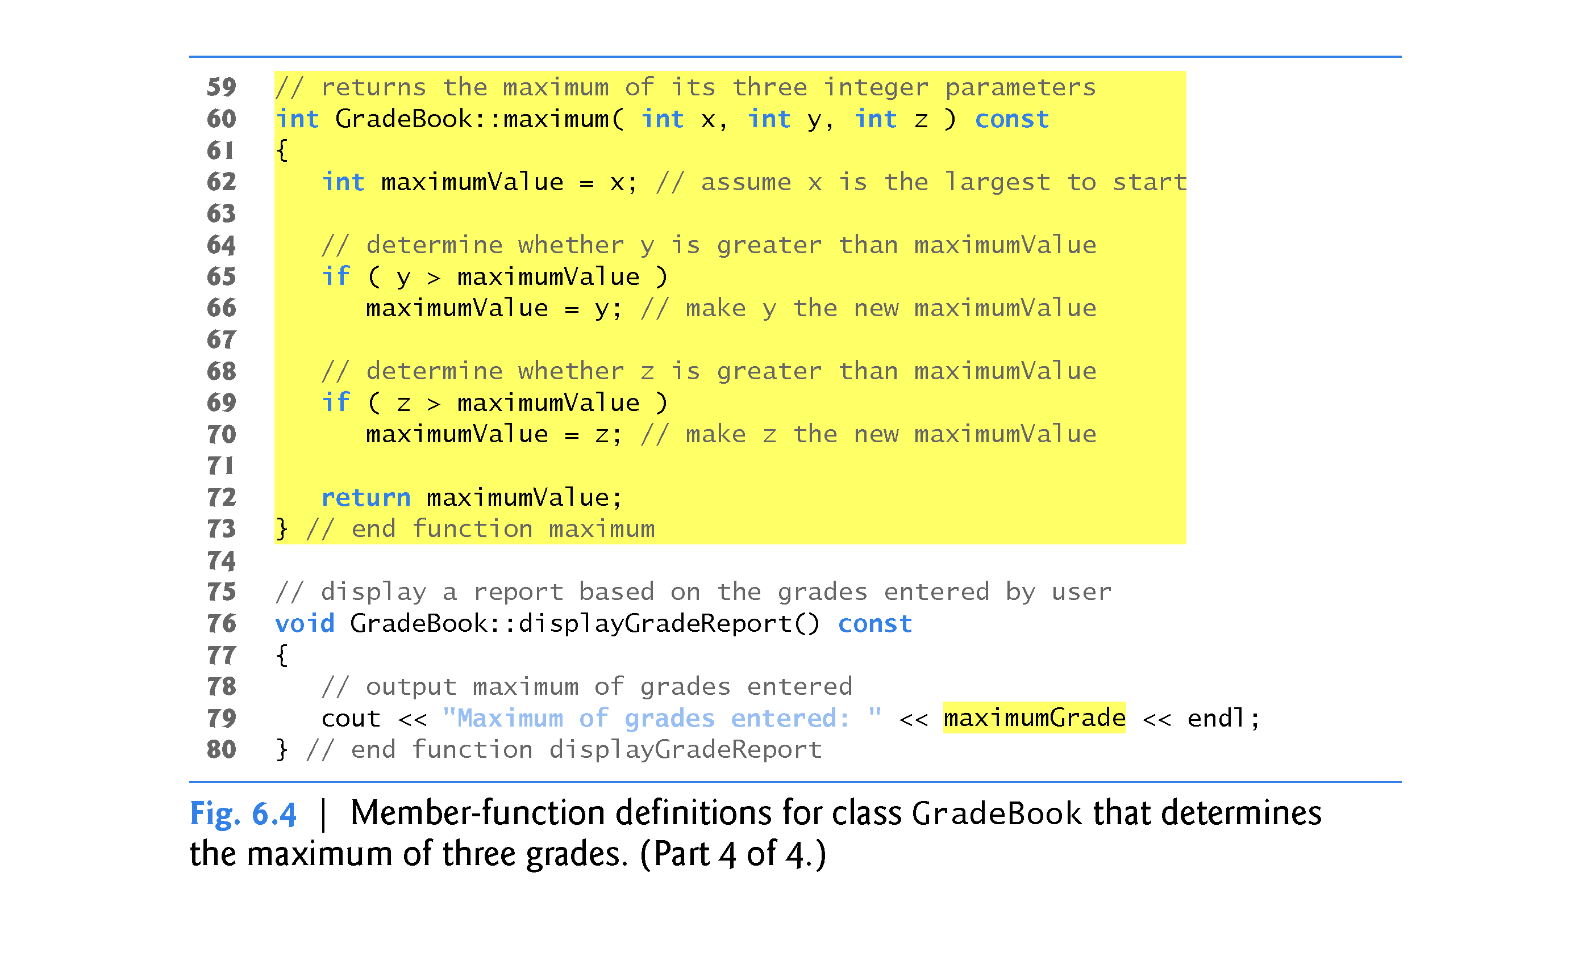

Slide 22
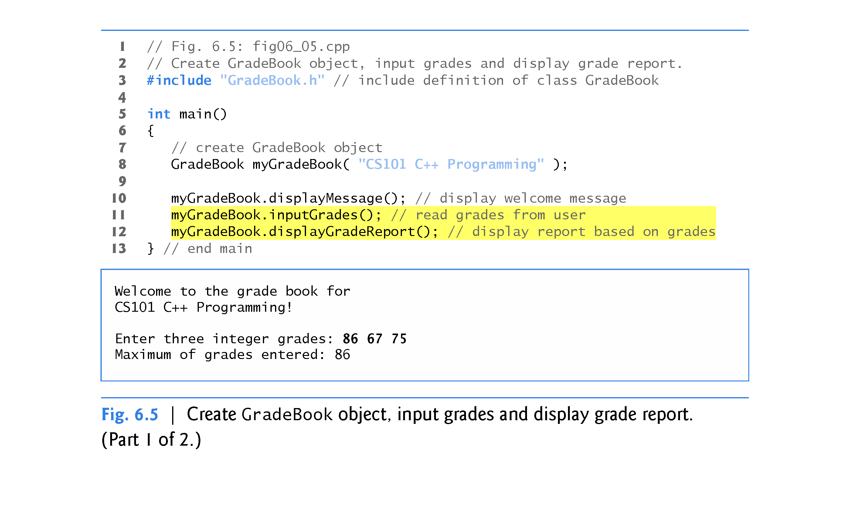

Slide 23
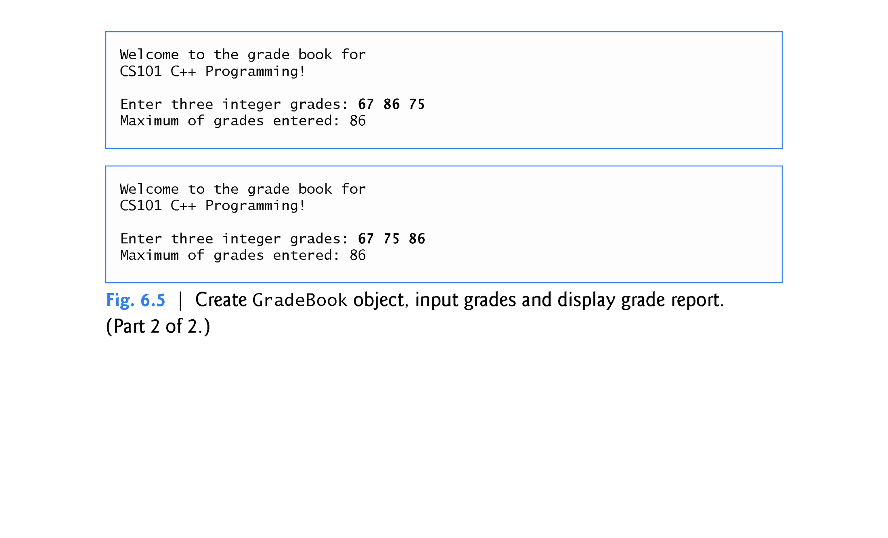

Slide 24
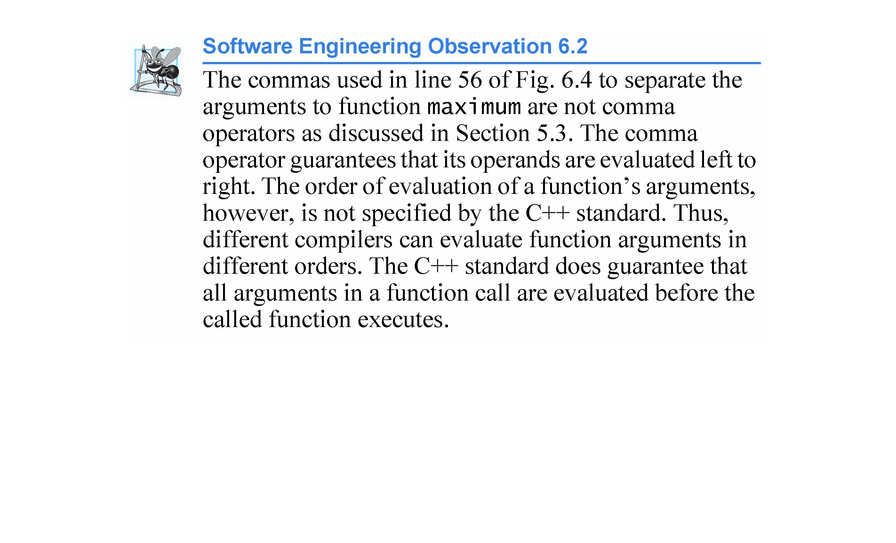

Slide 25
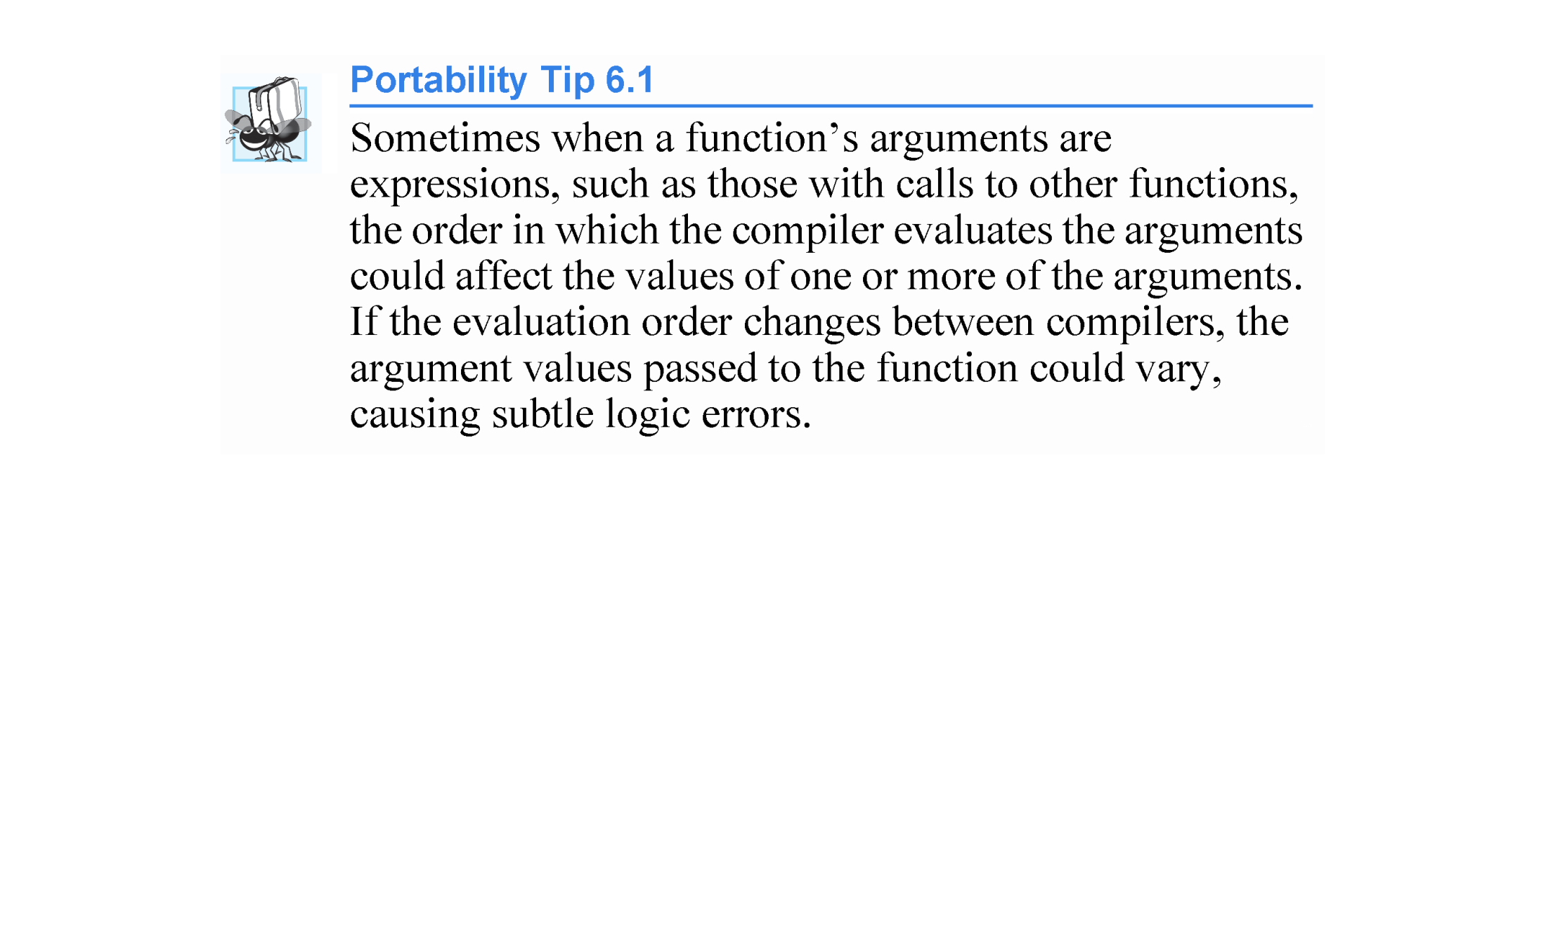

Slide 26
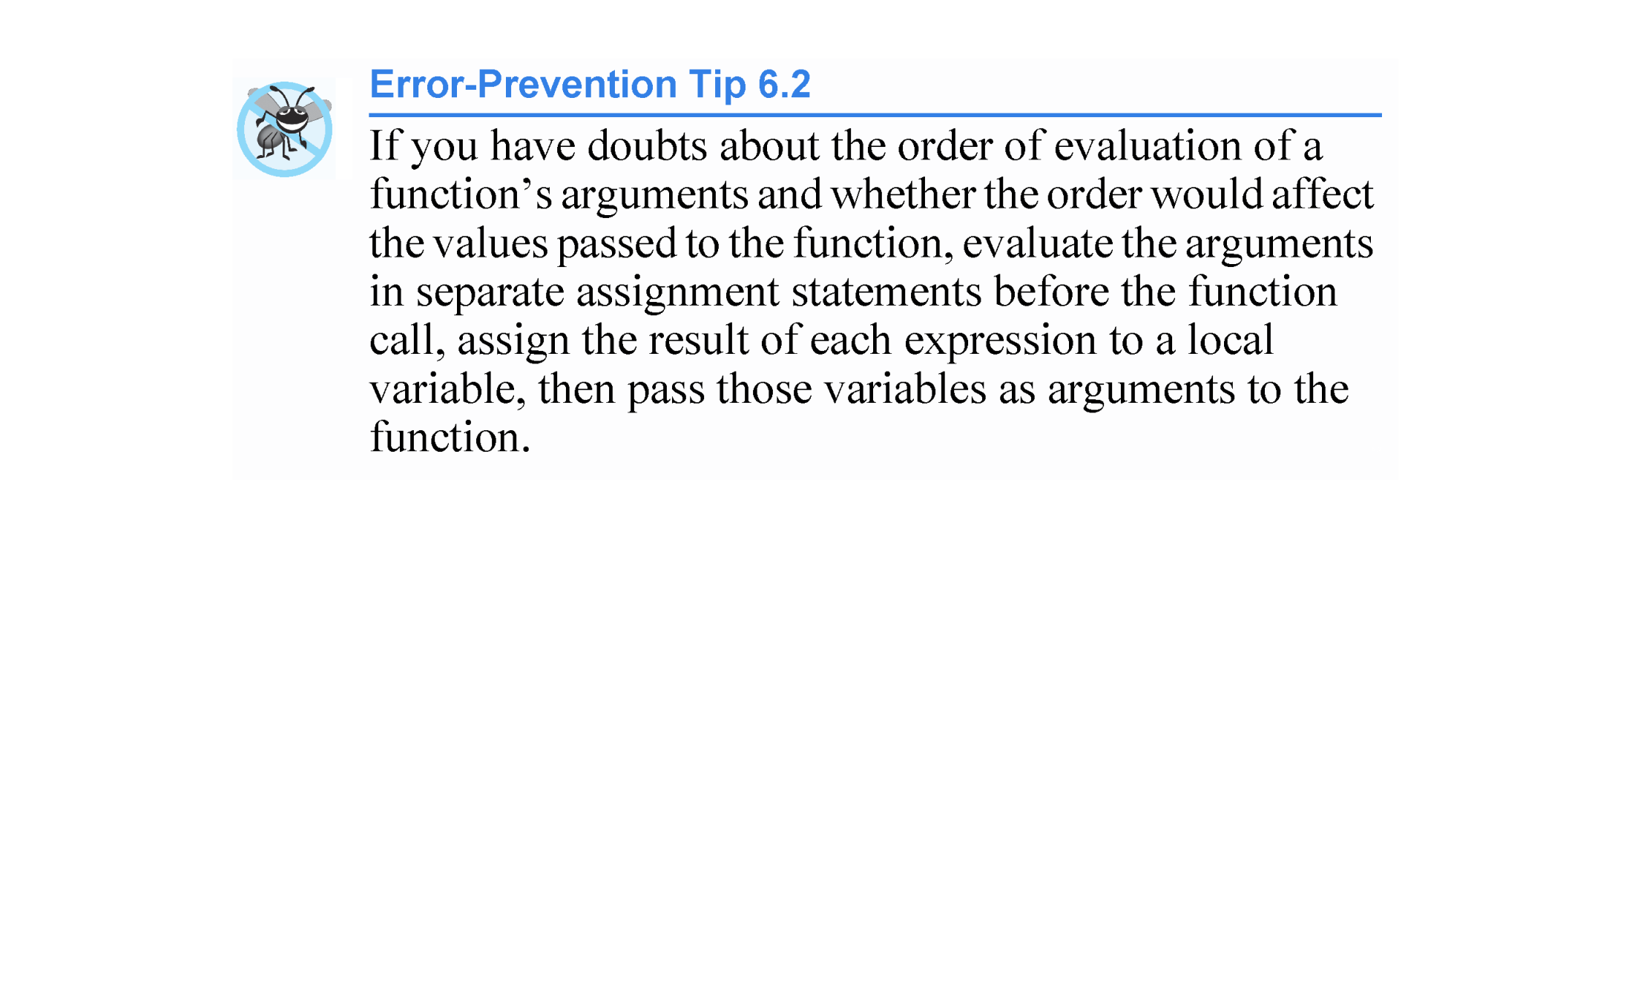

Slide 27
6.4 Function Definitions with Multiple Parameters (cont.)
The compiler refers to the function prototype to check that calls to maximum contain the correct number and types of arguments and that the types of the arguments are in the correct order.
In addition, the compiler uses the prototype to ensure that the value returned by the function can be used correctly in the expression that called the function (e.g., a function call that returns void cannot be used as the right side of an assignment statement).
Each argument must be consistent with the type of the corresponding parameter.
If the arguments passed to a function do not match the types specified in the function’s prototype, the compiler attempts to convert the arguments to those types.

Slide 28
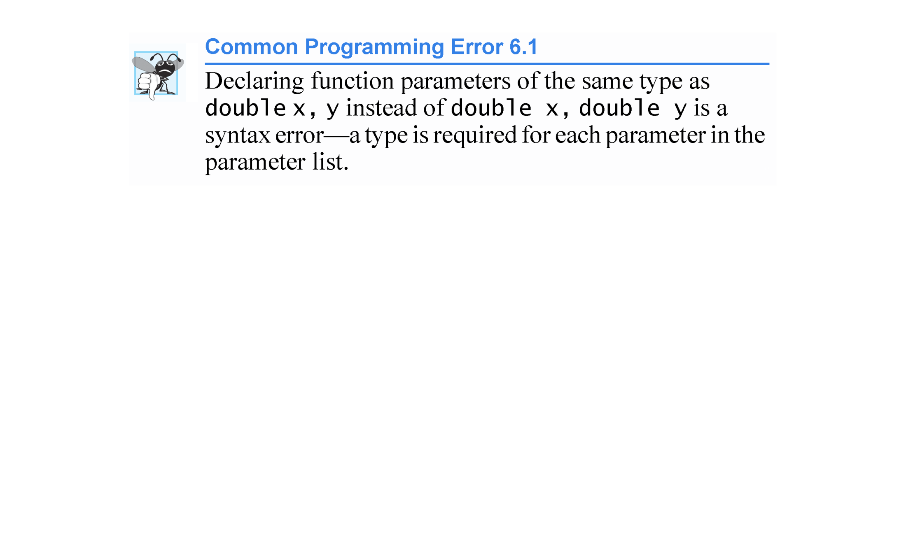

Slide 29
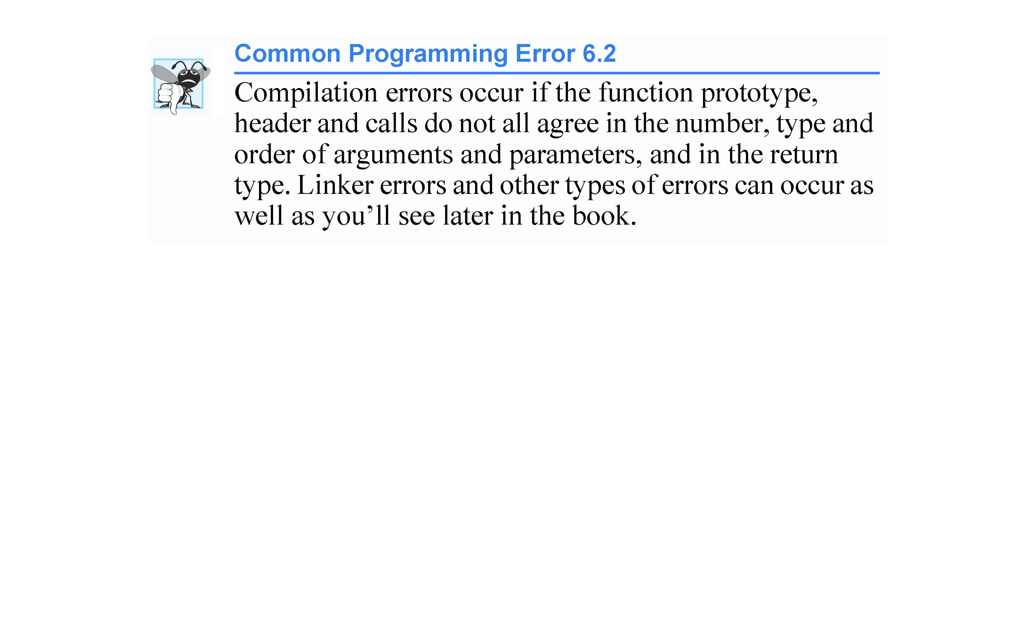

Slide 30
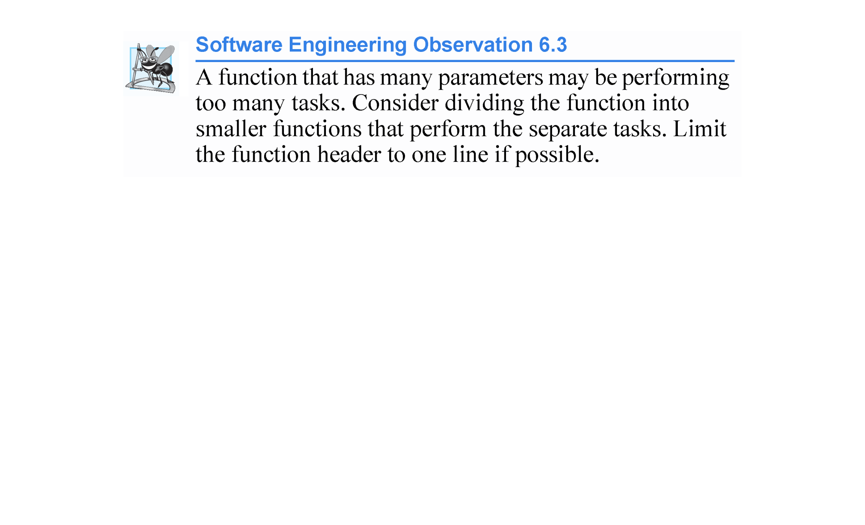

Slide 31
6.4 Function Definitions with Multiple Parameters (cont.)
Returning Control from a Function to Its Caller
There are several ways to return control to the point at which a function was invoked.
If the function does not return a result (i.e., it has a void return type), control returns when the program reaches the function-ending right brace, or by execution of the statement
return;

Slide 32
6.4 Function Definitions with Multiple Parameters (cont.)
If the function does return a result, the statement
return expression;
evaluates expression and returns the value of expression to the caller.
Some compilers issue errors and others issue warnings if you do not provide an appropriate return statement in a function that’s supposed to return a result.

Slide 33
6.5 Function Prototypes and Argument Coercion
A function prototype (also called a function declaration) tells the compiler
the name of a function
the type of data returned by the function
the number of parameters the function expects to receive
the types of those parameters and
the order in which the parameters of those types are expected.

Slide 34
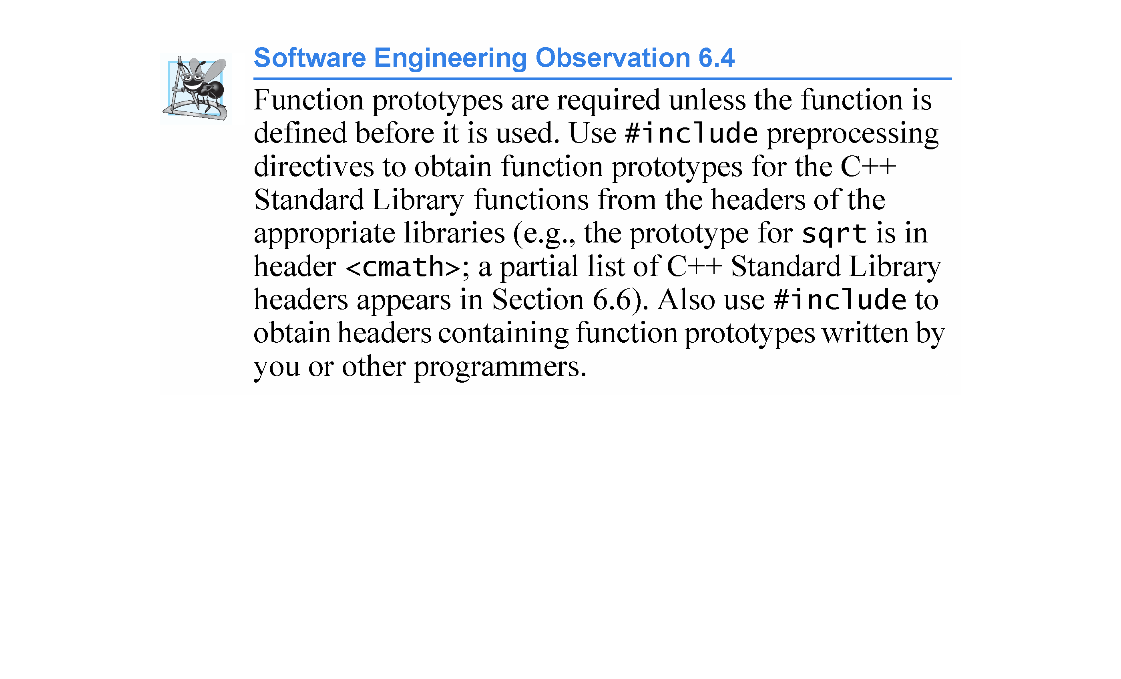

Slide 35
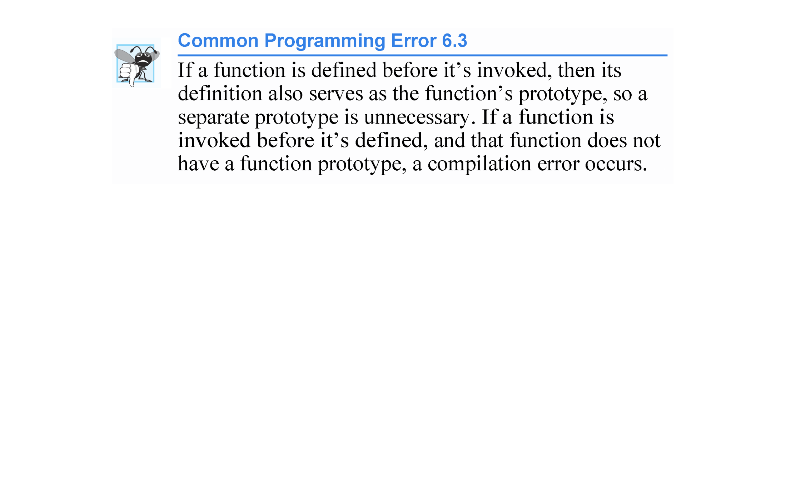

Slide 36
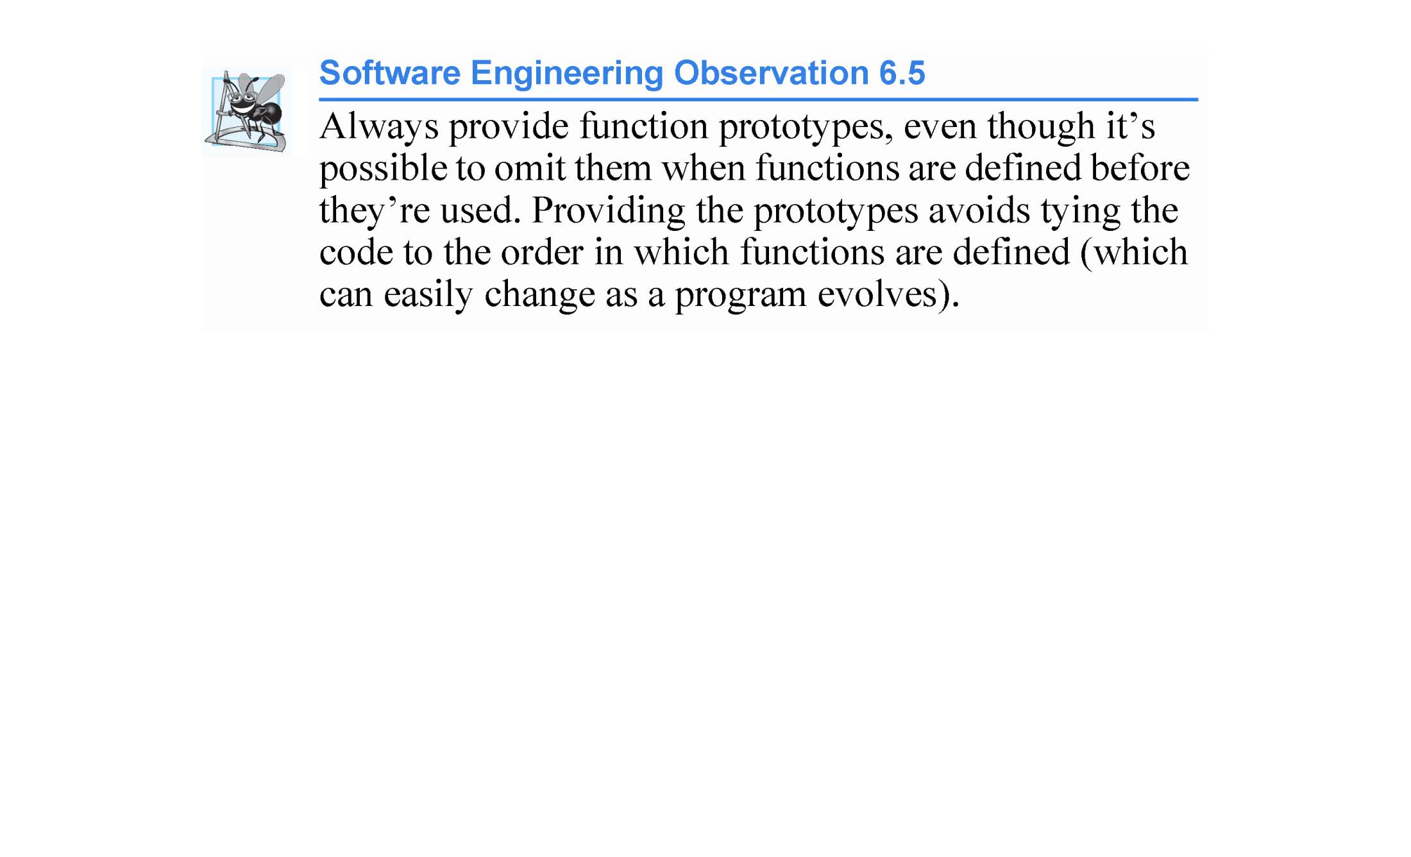

Slide 37
6.5 Function Prototypes and Argument Coercion (cont.)
Function Signature
The portion of a function prototype that includes the name of the function and the types of its arguments is called the function signature or simply the signature.
Signature does not specify the function’s return type.
Functions in the same scope must have unique signatures.
The scope of a function is the region of a program in which the function is known and accessible.

Slide 38
6.5 Function Prototypes and Argument Coercion (cont.)
An important feature of function prototypes is argument coercion
forcing arguments to the appropriate types specified by the parameter declarations.
These conversions occur as specified by C++’s promotion rules.
The promotion rules indicate how to convert between types without losing data.
The promotion rules apply to expressions containing values of two or more data types
also referred to as mixed-type expressions.
The type of each value in a mixed-type expression is promoted to the “highest” type in the expression.

Slide 39
6.5 Function Prototypes and Argument Coercion (cont.)
Promotion also occurs when the type of a function argument does not match the parameter type specified in the function definition or prototype.
Figure 6.6 lists the arithmetic data types in order from “highest type” to “lowest type.”
Converting values to lower fundamental types can result in incorrect values.
Therefore, a value can be converted to a lower fundamental type only by explicitly assigning the value to a variable of lower type or by using a cast operator.

Slide 40
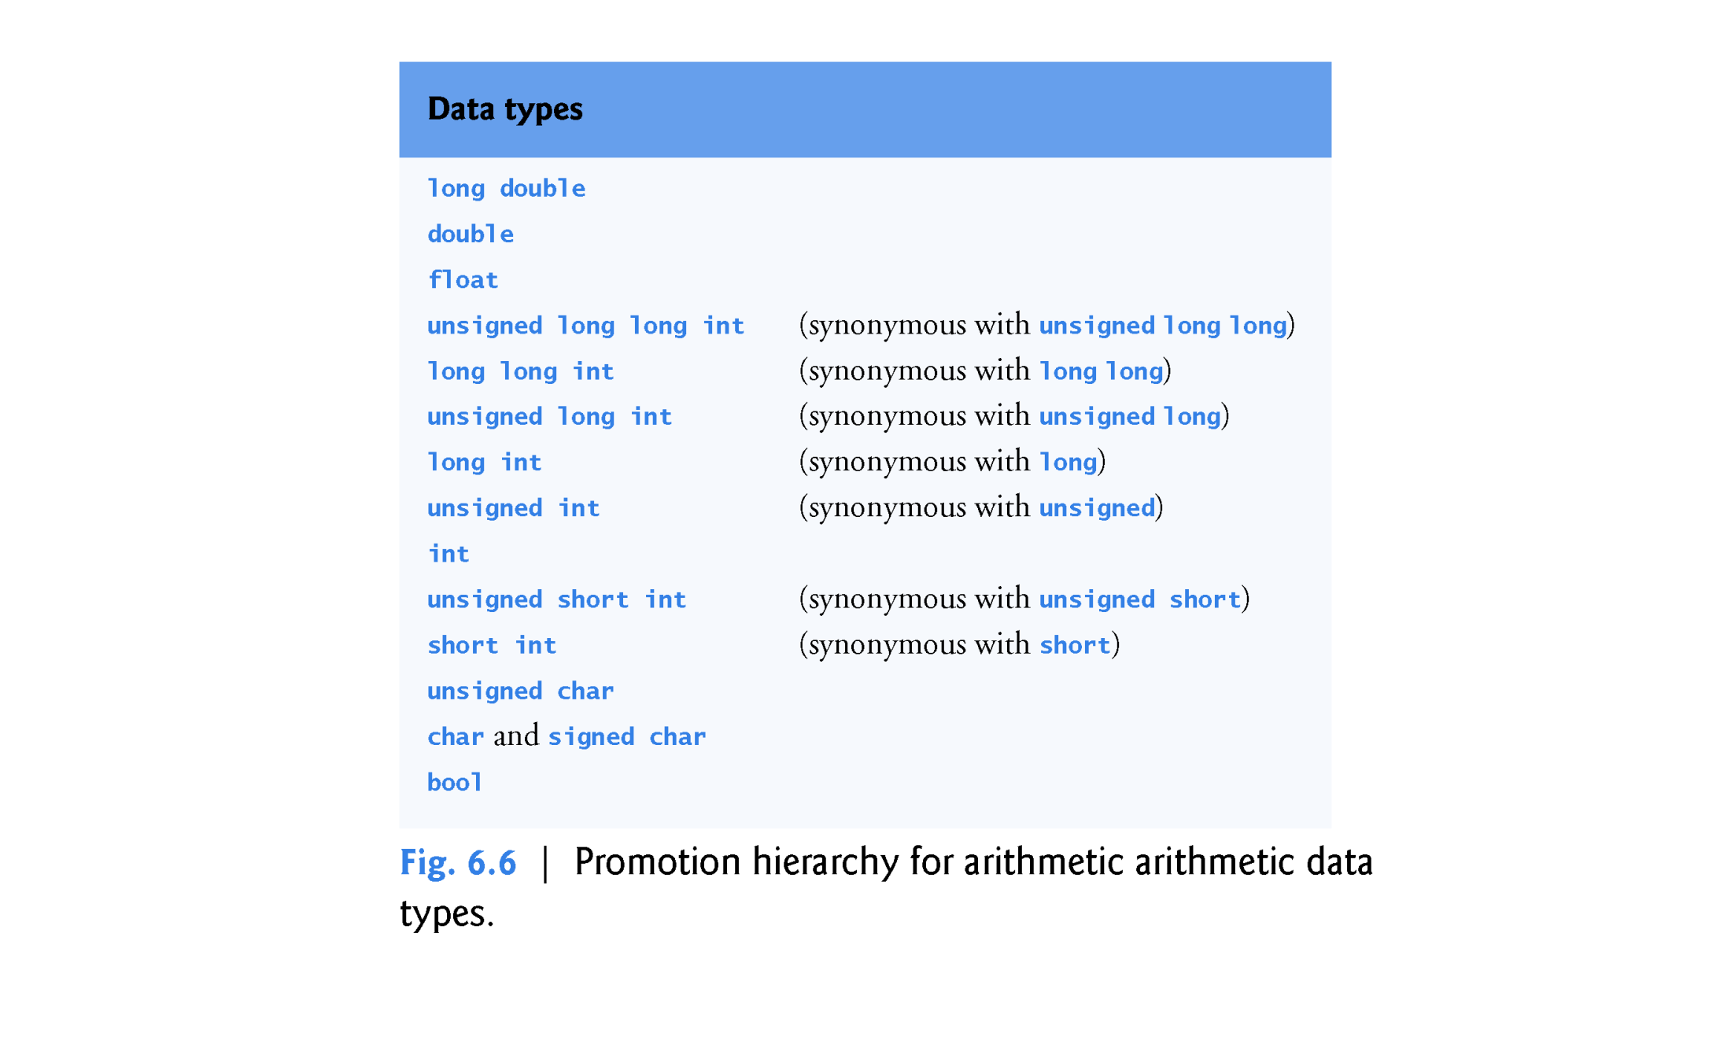

Slide 41
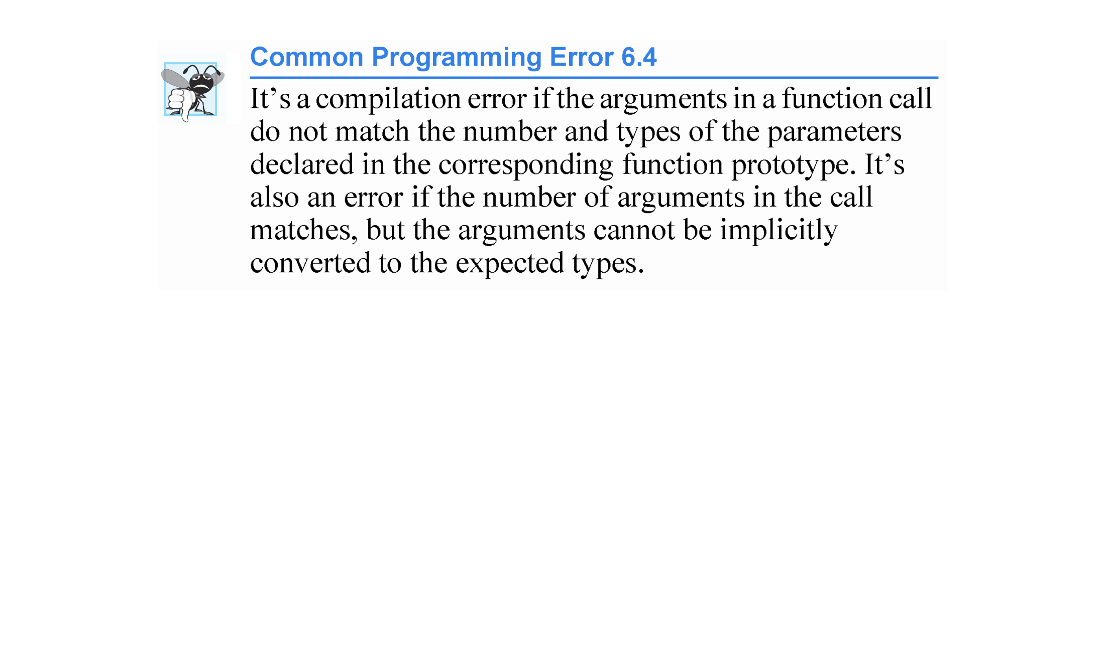

Slide 42
6.6 C++ Standard Library Header Files
The C++ Standard Library is divided into many portions, each with its own header file.
The header files contain the function prototypes for the related functions that form each portion of the library.
The header files also contain definitions of various class types and functions, as well as constants needed by those functions.
A header file “instructs” the compiler on how to interface with library and user-written components.
Figure 6.7 lists some common C++ Standard Library header files, most of which are discussed later in the book.

Slide 43
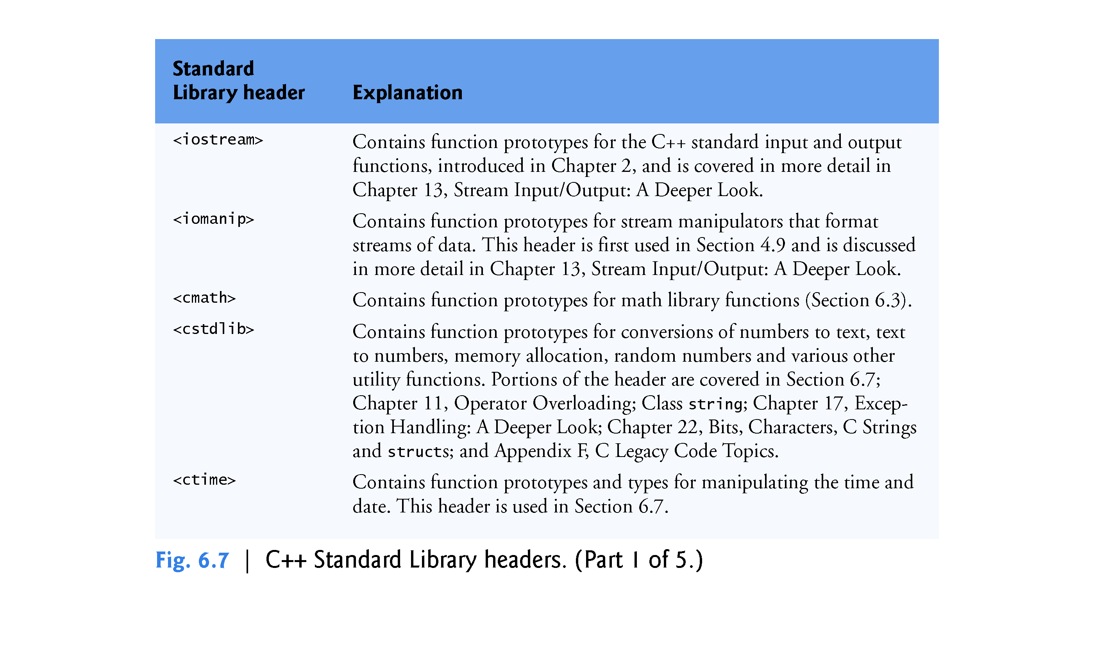

Slide 44
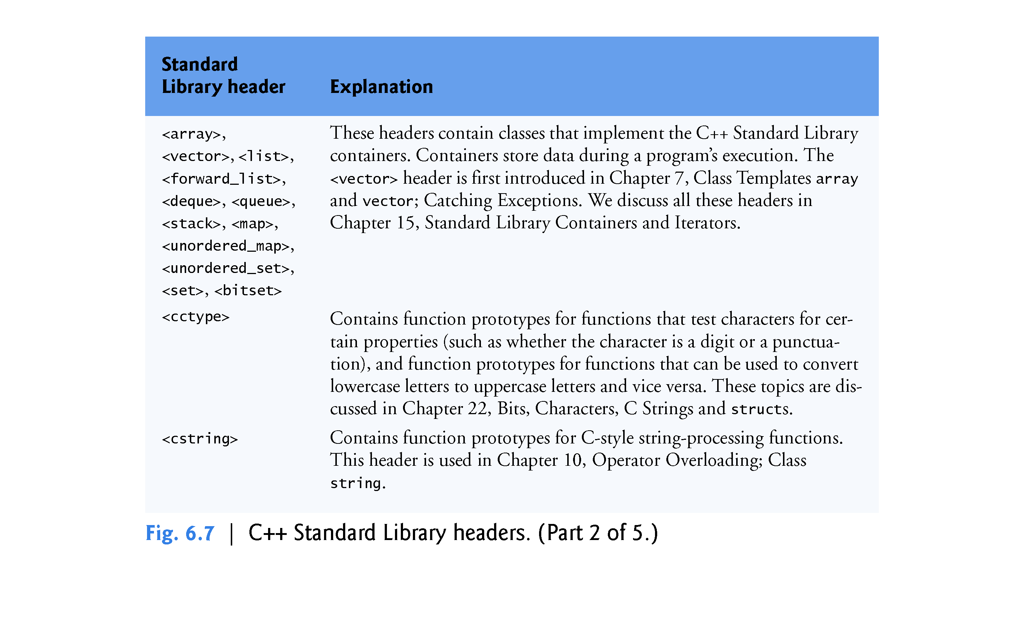

Slide 45
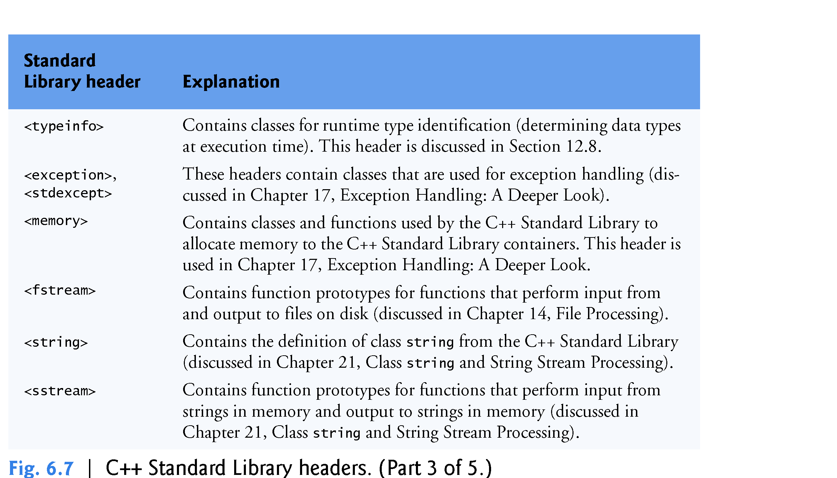

Slide 46
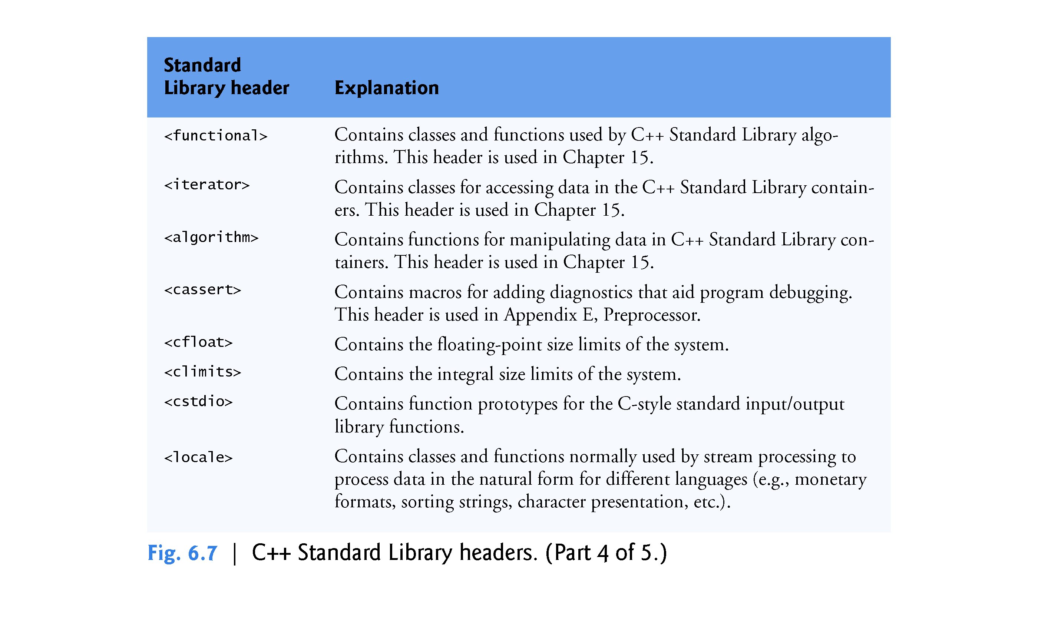

Slide 47
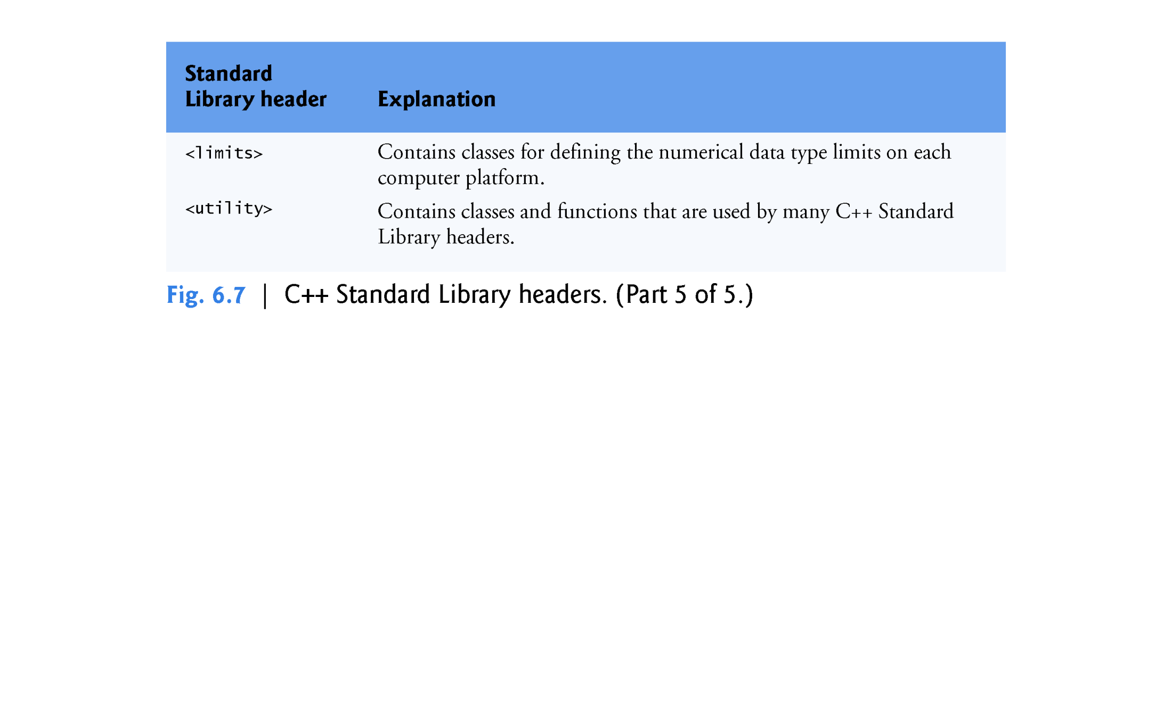

Slide 48
6.7 Case Study: Random Number Generation
[Note: The random-number generation techniques shown in this section and Section 6.8 are included for readers who are not yet using C++11 compilers. In Section 6.9, we’ll present C++11’s improved random-number capabilities.]
The element of chance can be introduced into computer applications by using the C++ Standard Library function rand.
The function rand generates an unsigned integer between 0 and RAND_MAX (a symbolic constant defined in the <cstdlib> header file).

Slide 49
6.7 Case Study: Random Number Generation
The value of RAND_MAX must be at least 32767—the maximum positive value for a two-byte (16-bit) integer.
For GNU C++, the value of RAND_MAX is 2147483647; for Visual Studio, the value of RAND_MAX is 32767.
If rand truly produces integers at random, every number between 0 and RAND_MAX has an equal chance (or probability) of being chosen each time rand is called.

Slide 50
6.7 Case Study: Random Number Generation (cont.)
Rolling a Six-Sided Die
The function prototype for the rand function is in <cstdlib>.
To produce integers in the range 0 to 5, we use the modulus operator (%) with rand:
rand() % 6
This is called the scale.
The number 6 is called the scaling factor. Six values are produced.
We can shift the range of numbers produced by adding a value.
This is called shift.

Slide 51
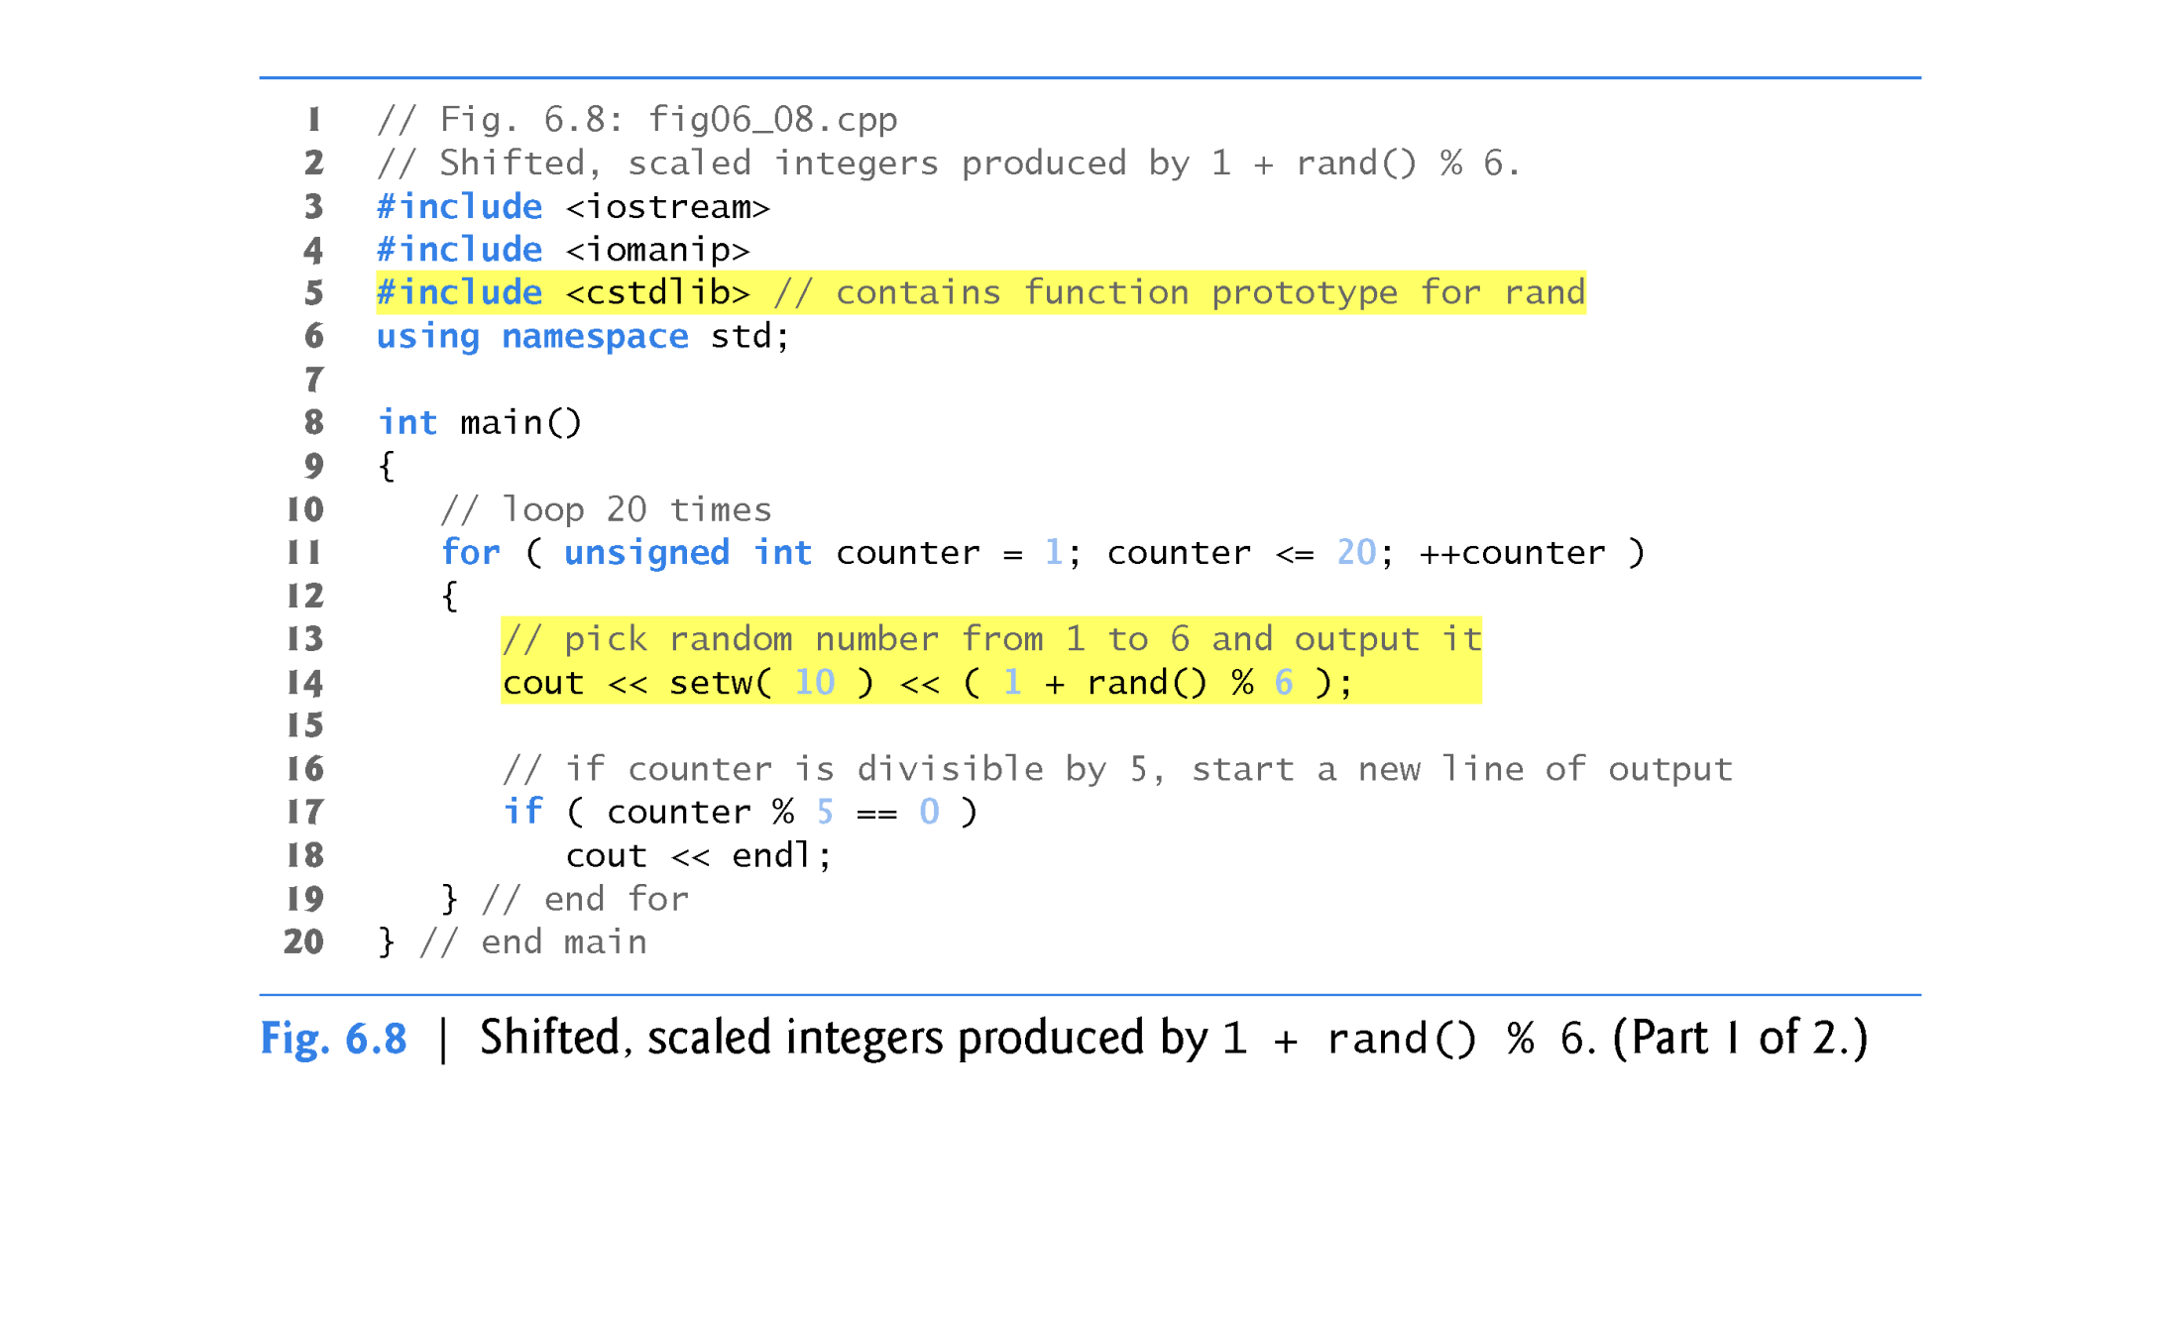

Slide 52
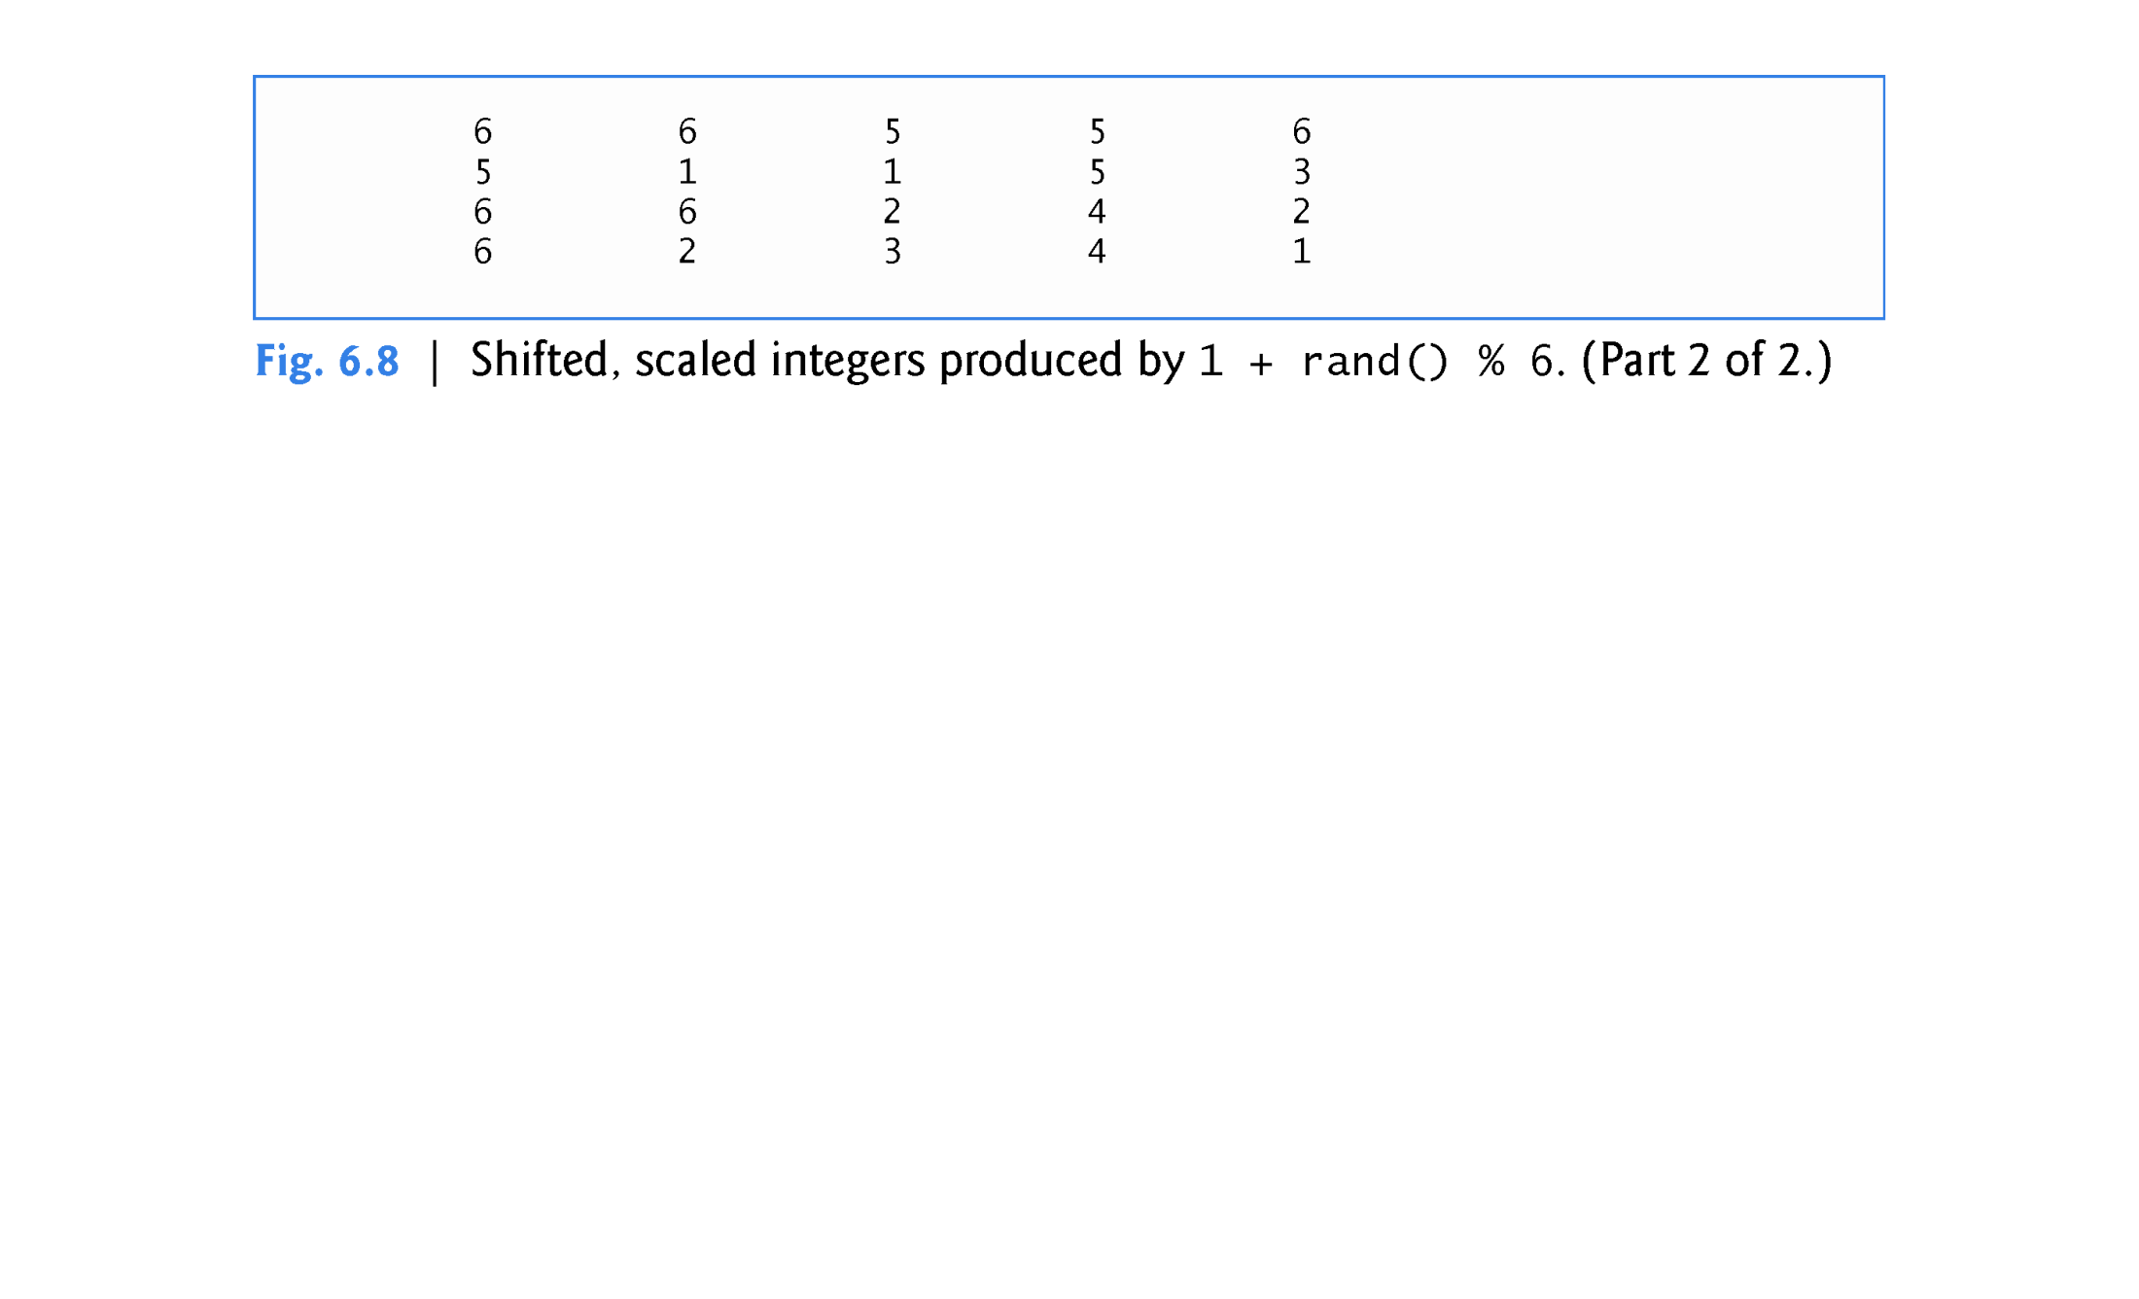

Slide 53
6.7 Case Study: Random Number Generation (cont.)
To show that the numbers produced by rand occur with approximately equal likelihood, Fig. 6.9 simulates 6,000,000 rolls of a die.
Each integer in the range 1 to 6 should appear approximately 1,000,000 times.

Slide 54
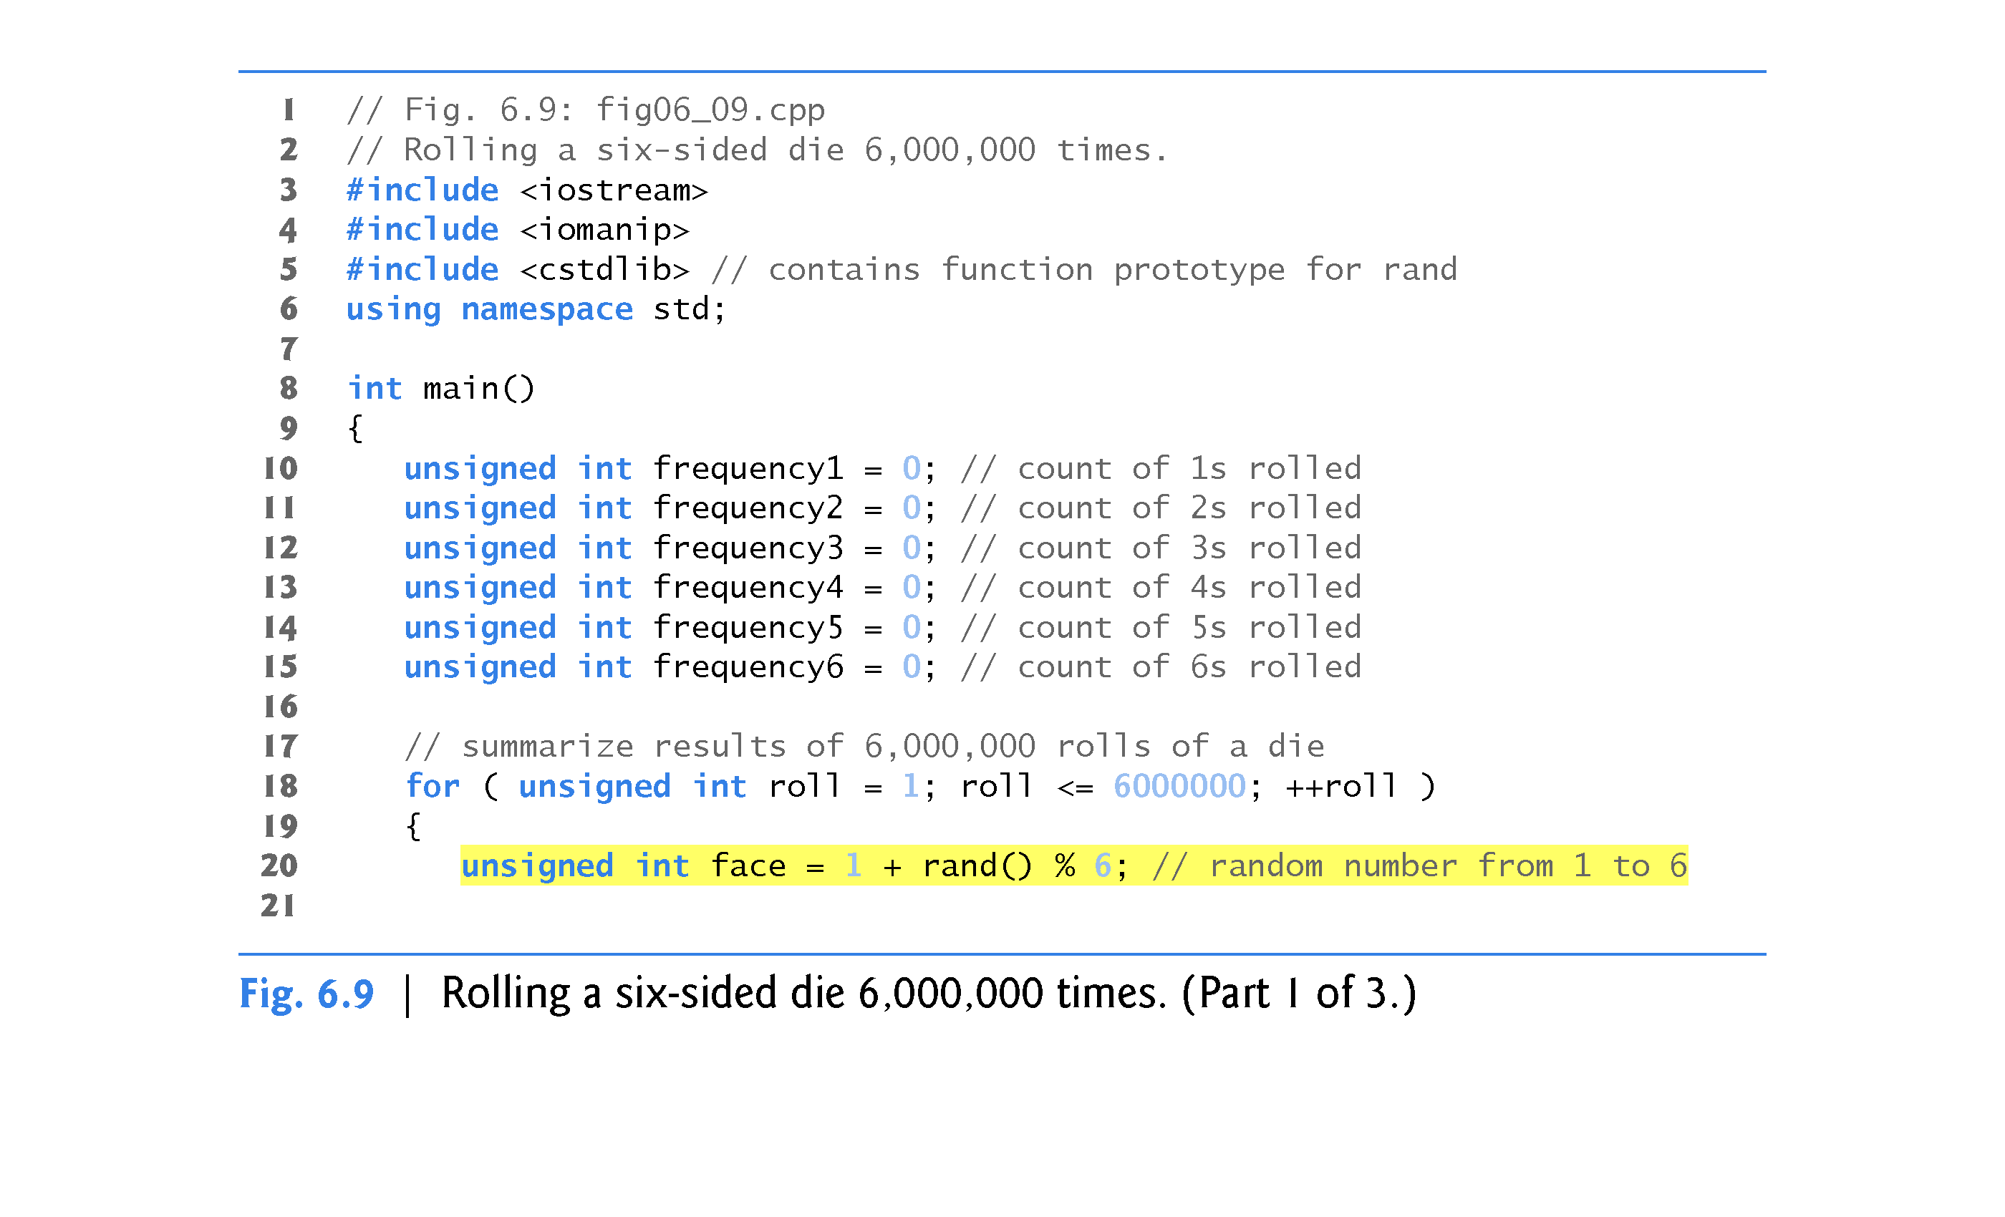

Slide 55
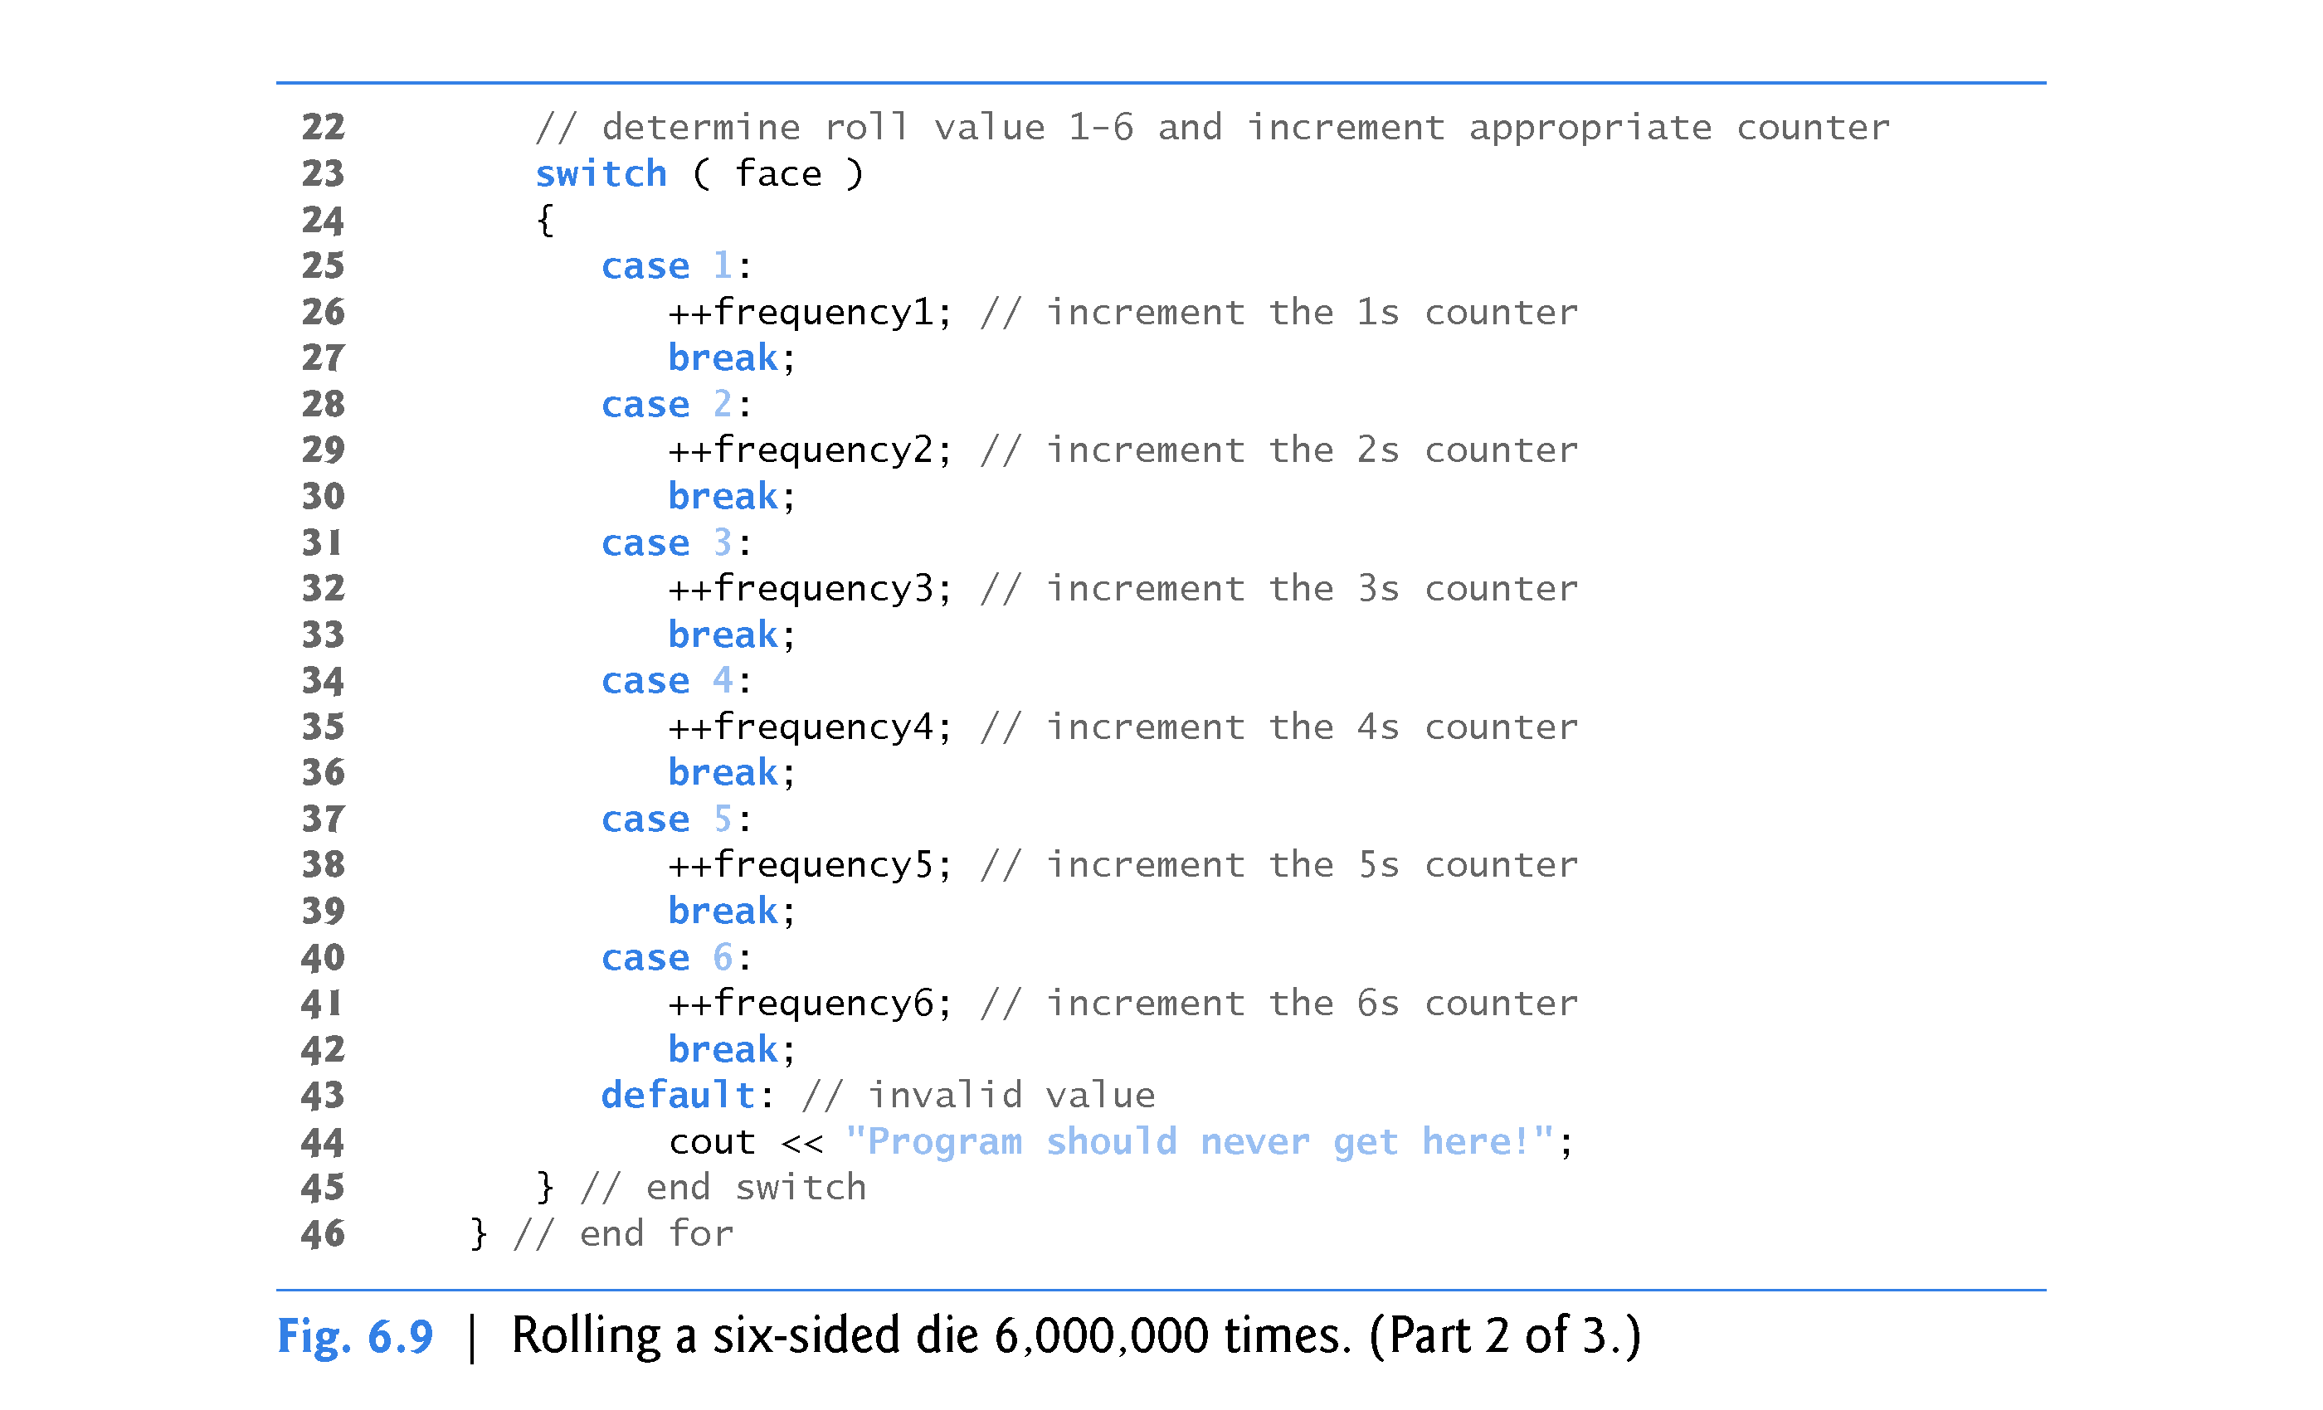

Slide 56
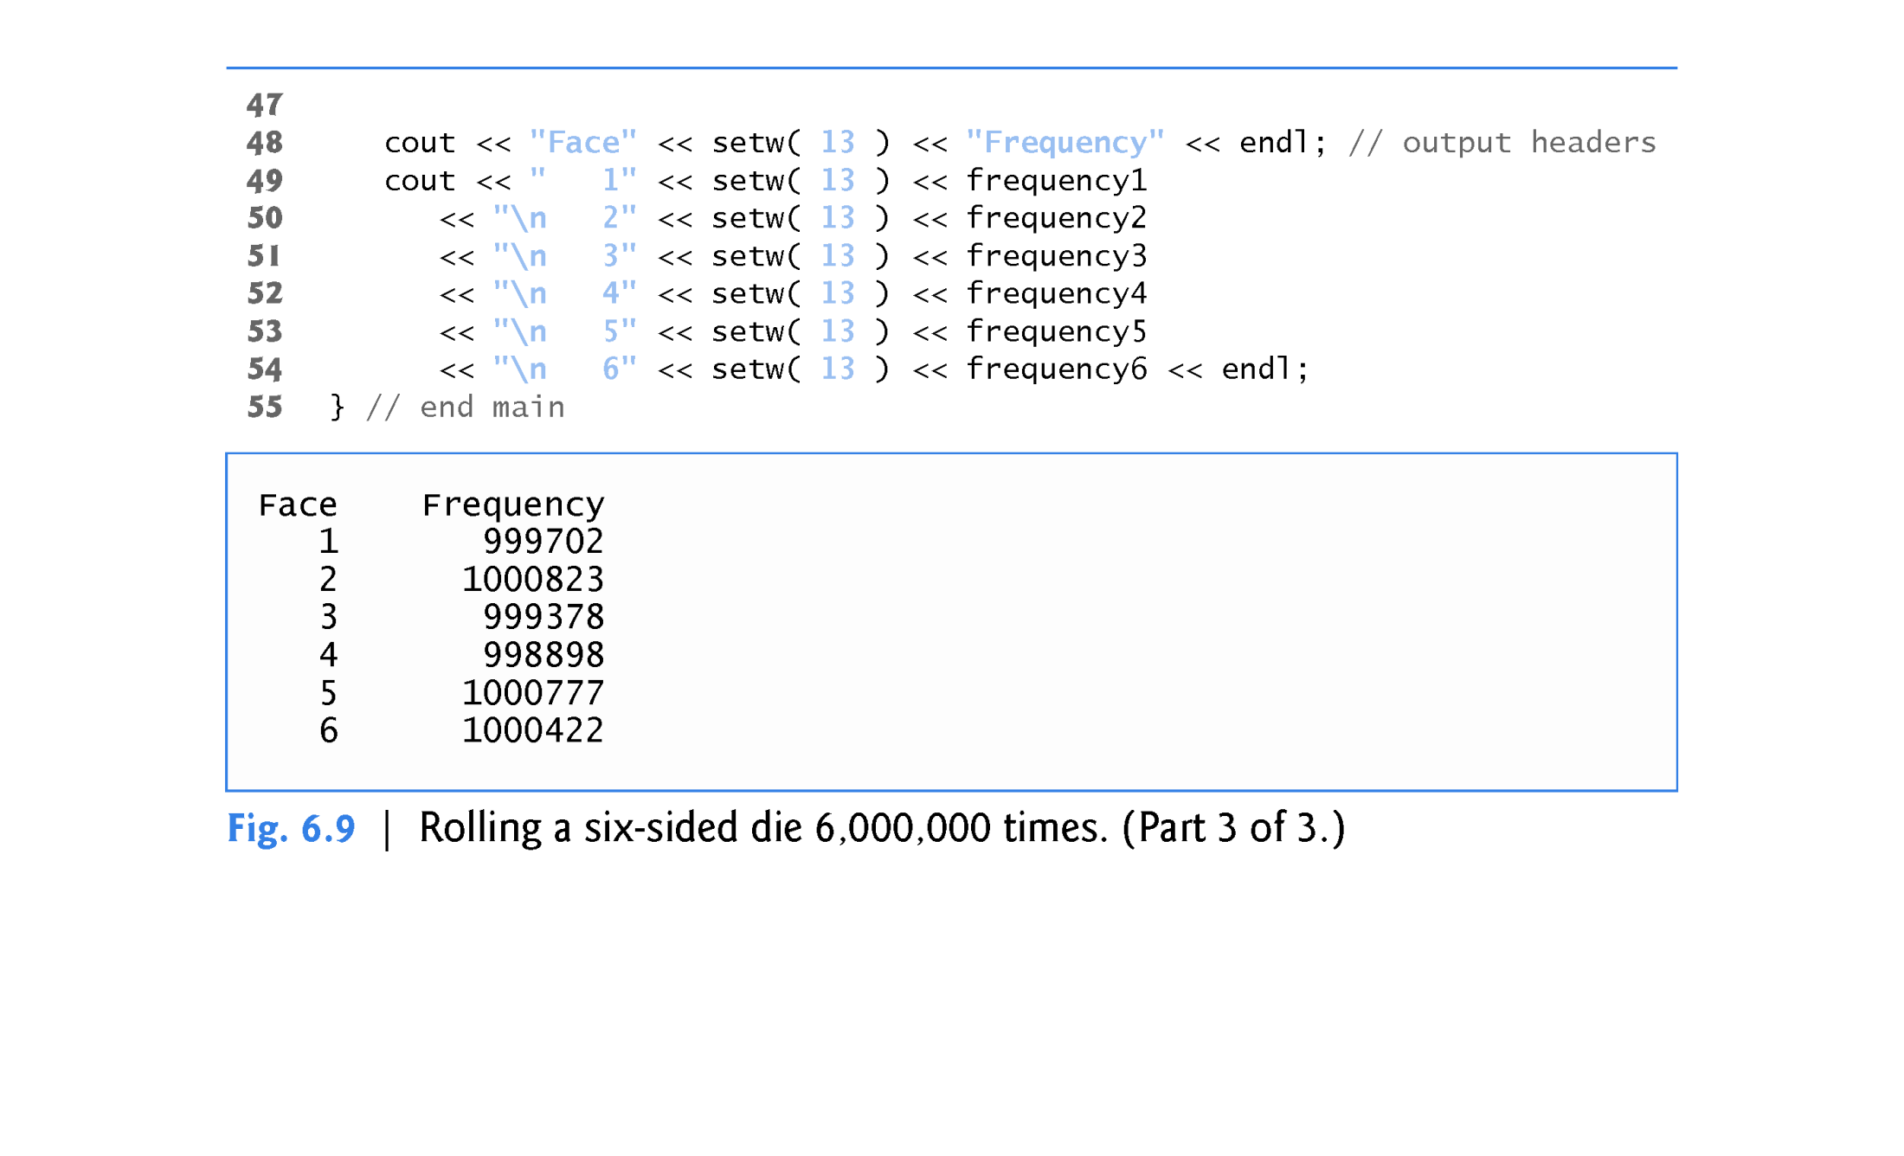

Slide 57
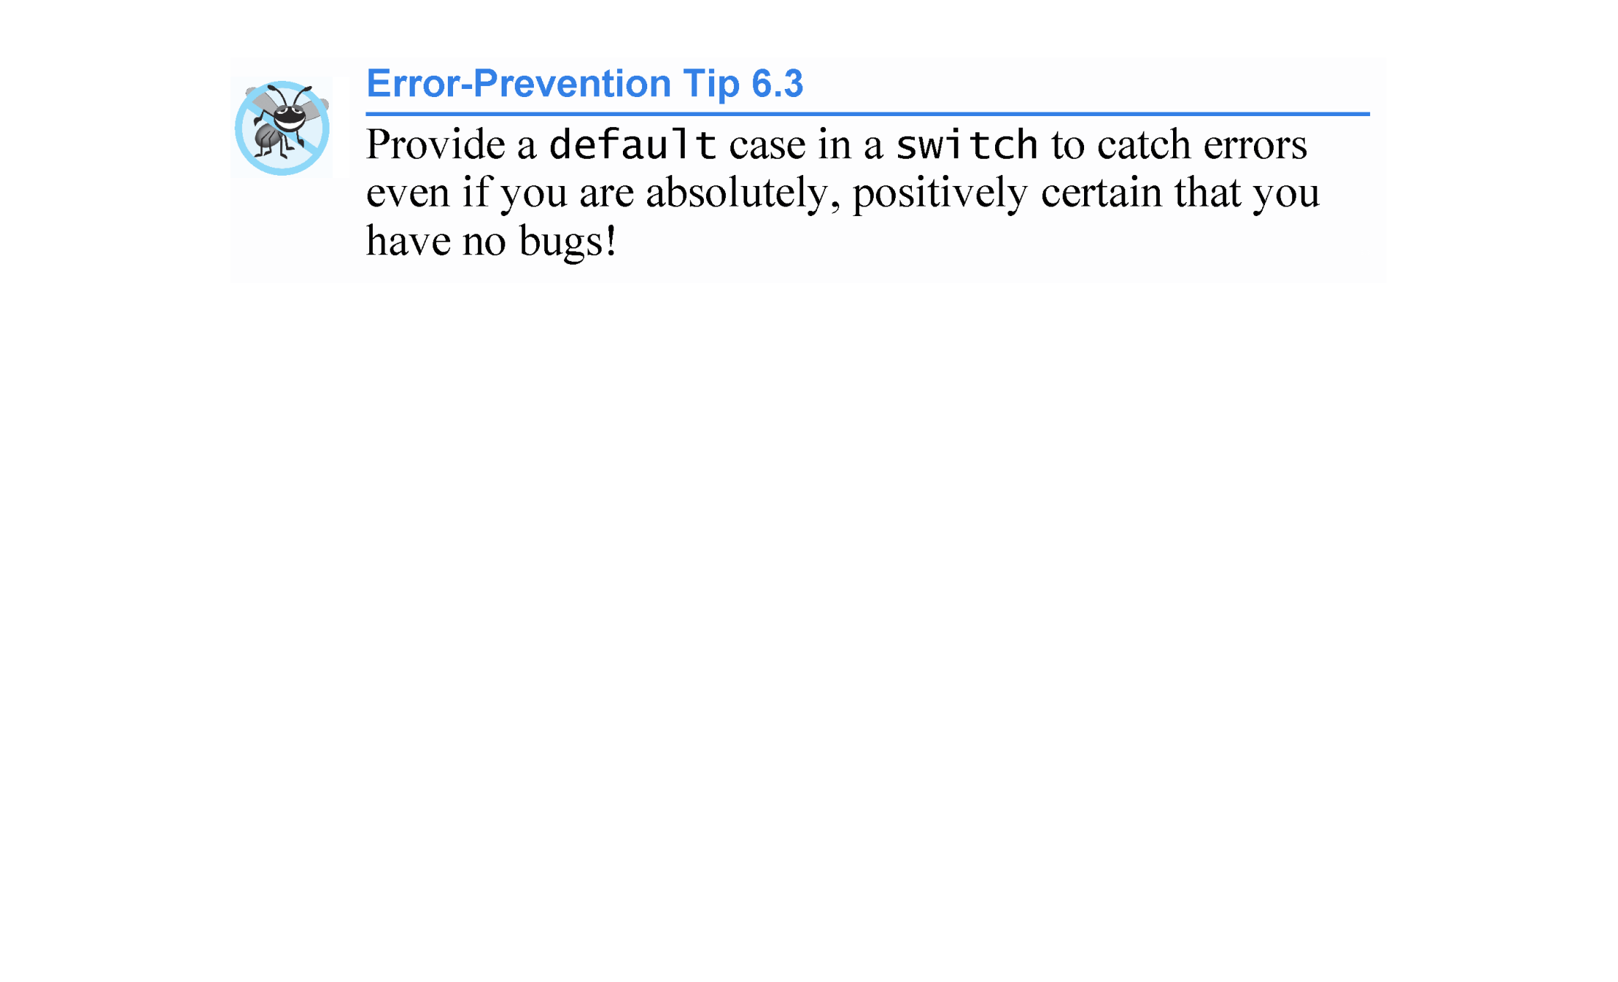

Slide 58
6.7 Case Study: Random Number Generation (cont.)
Executing the program of Fig. 6.8 again produces exactly the same sequence of values.
This repeatability is an important characteristic of function rand.
Essential for proving that program works and for debugging.
Function rand actually generates pseudorandom numbers.
Repeatedly calling rand produces a sequence of numbers that appears to be random.
The sequence repeats itself each time the program executes.

Slide 59
6.7 Case Study: Random Number Generation (cont.)
Once a program has been debugged, it can be conditioned to produce a different sequence of random numbers for each execution.
This is called randomizing and is accomplished with the C++ Standard Library function srand.
Function srand takes an unsigned integer argument and seeds the rand function to produce a different sequence of random numbers for each execution.
C++11 provides additional random number capabilities that can produce nondeterministic random numbers - a set of random numbers that can’t be predicted.
Such random number generators are used in simulations and security scenarios where predictability is undesirable.

Slide 60
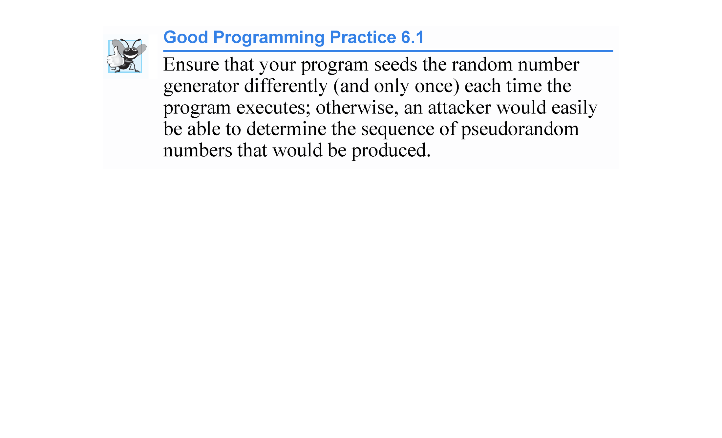

Slide 61
6.7 Case Study: Random Number Generation (cont.)
Seeding the Random Number Generator with srand
Figure 6.10 demonstrates function srand.

Slide 62
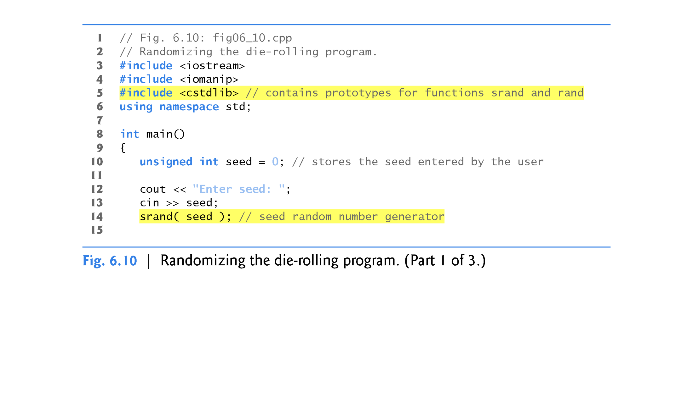

Slide 63
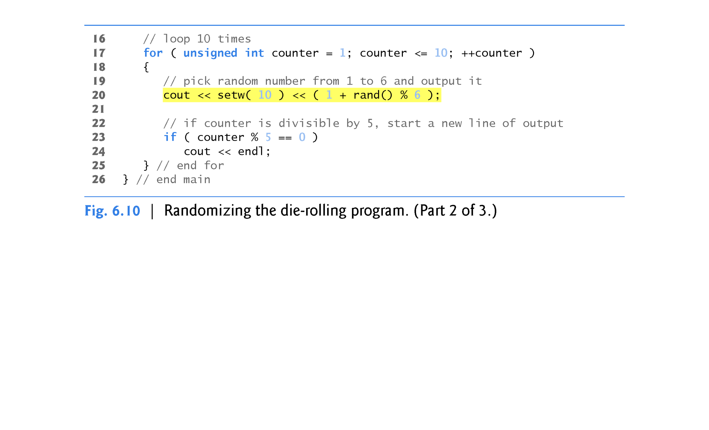

Slide 64
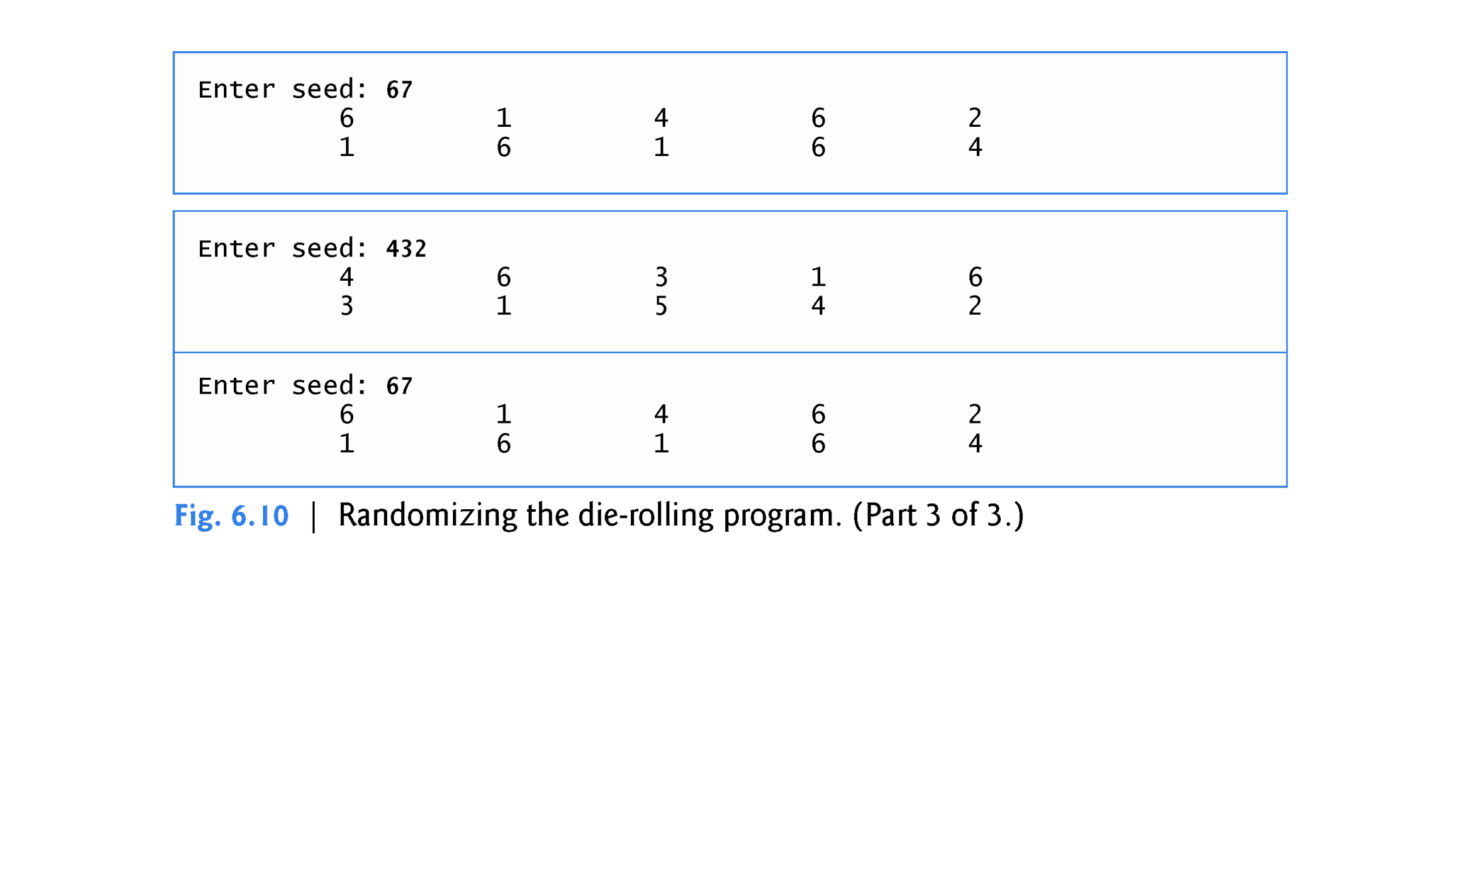

Slide 65
6.7 Case Study: Random Number Generation (cont.)
To randomize without having to enter a seed each time, we may use a statement like
srand( time( 0 ) );
This causes the computer to read its clock to obtain the value for the seed.
Function time (with the argument 0 as written in the preceding statement) typically re-turns the current time as the number of seconds since January 1, 1970, at midnight Greenwich Mean Time (GMT).
The function prototype for time is in <ctime>.

Slide 66
6.7 Case Study: Random Number Generation (cont.)
To produce random numbers in a specific range use:
number = shift + rand() % scale;
where shift is equal to the first number in the desired range of consecutive integers and scale is equal to the number of consecutive integers.

Slide 67
6.8 Case Study: Game of Chance; Introducing enum
Rules of Craps
A player rolls two dice. Each die has six faces. These faces contain 1, 2, 3, 4, 5 and 6 spots. After the dice have come to rest, the sum of the spots on the two upward faces is calculated. If the sum is 7 or 11 on the first roll, the player wins. If the sum is 2, 3 or 12 on the first roll (called “craps”), the player loses (i.e., the “house” wins). If the sum is 4, 5, 6, 8, 9 or 10 on the first roll, then that sum becomes the player’s “point.” To win, you must continue rolling the dice until you “make your point.” The player loses by rolling a 7 before making the point.
The program in Fig. 6.11 simulates the game.

Slide 68
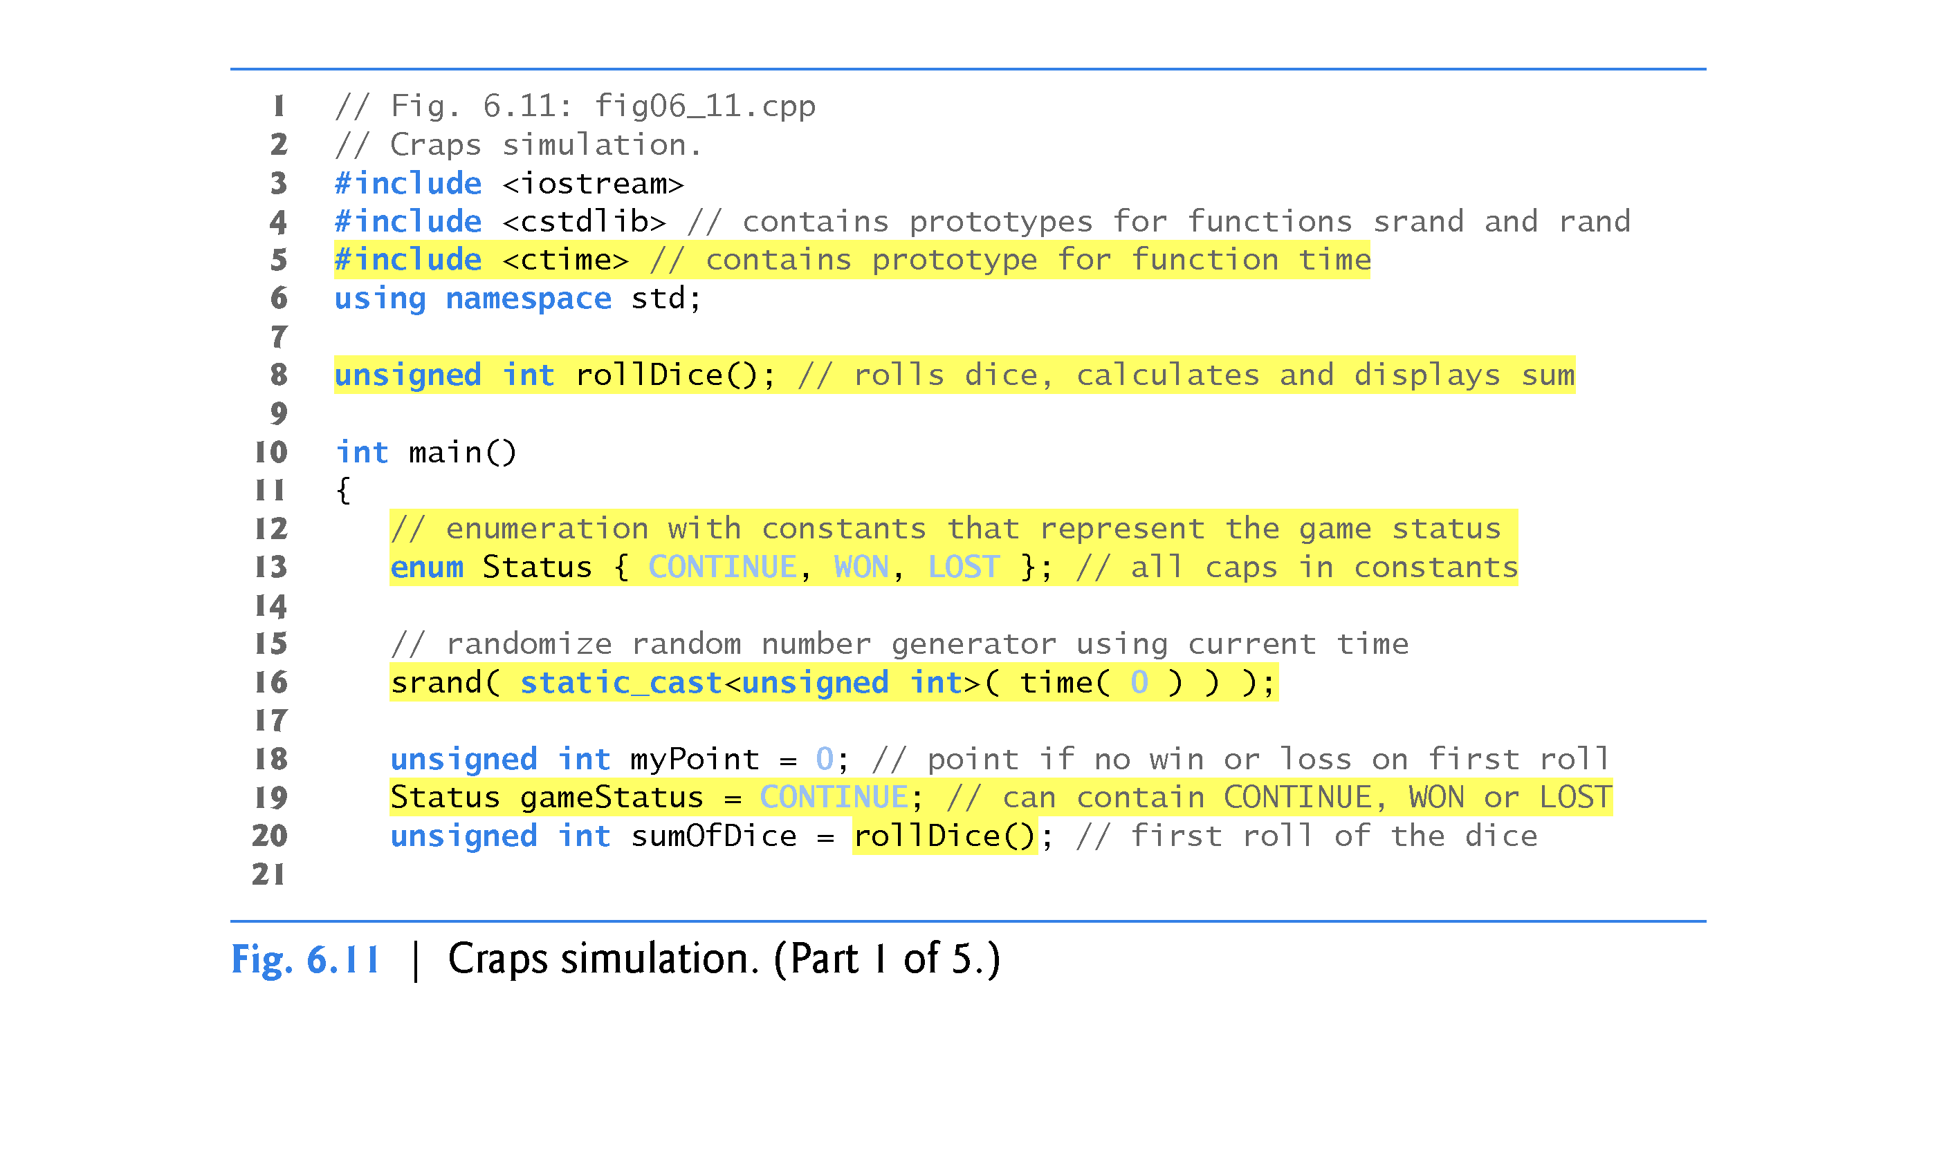

Slide 69
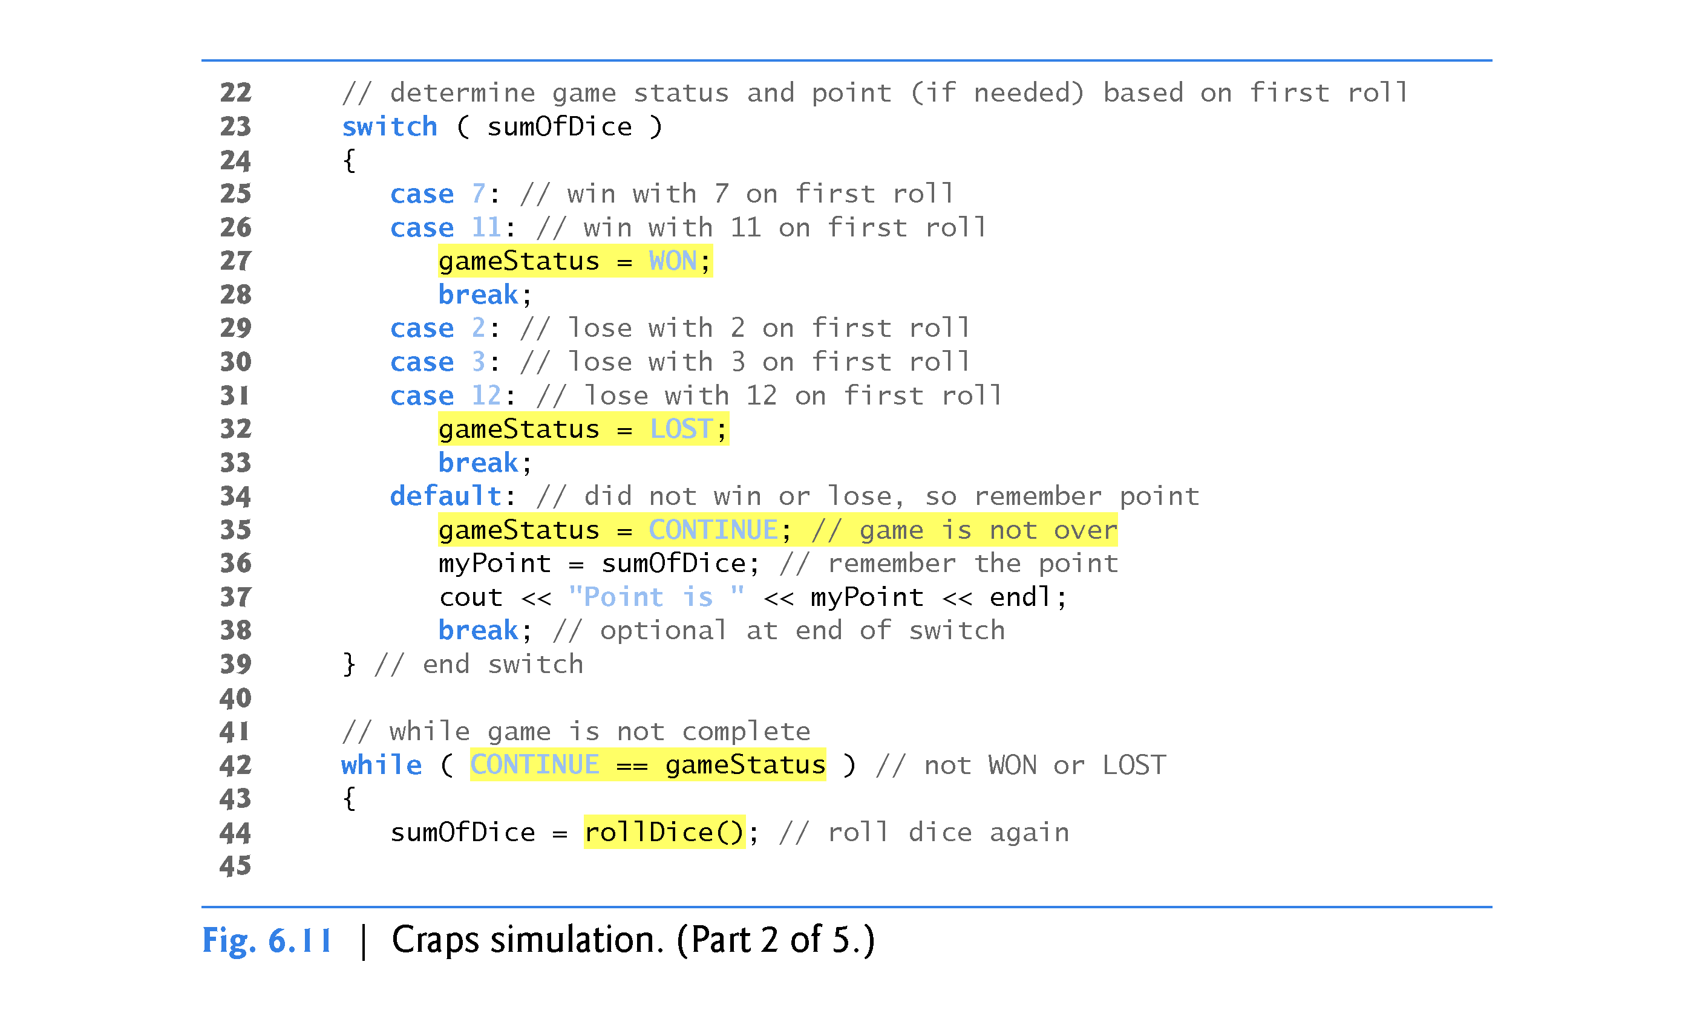

Slide 70
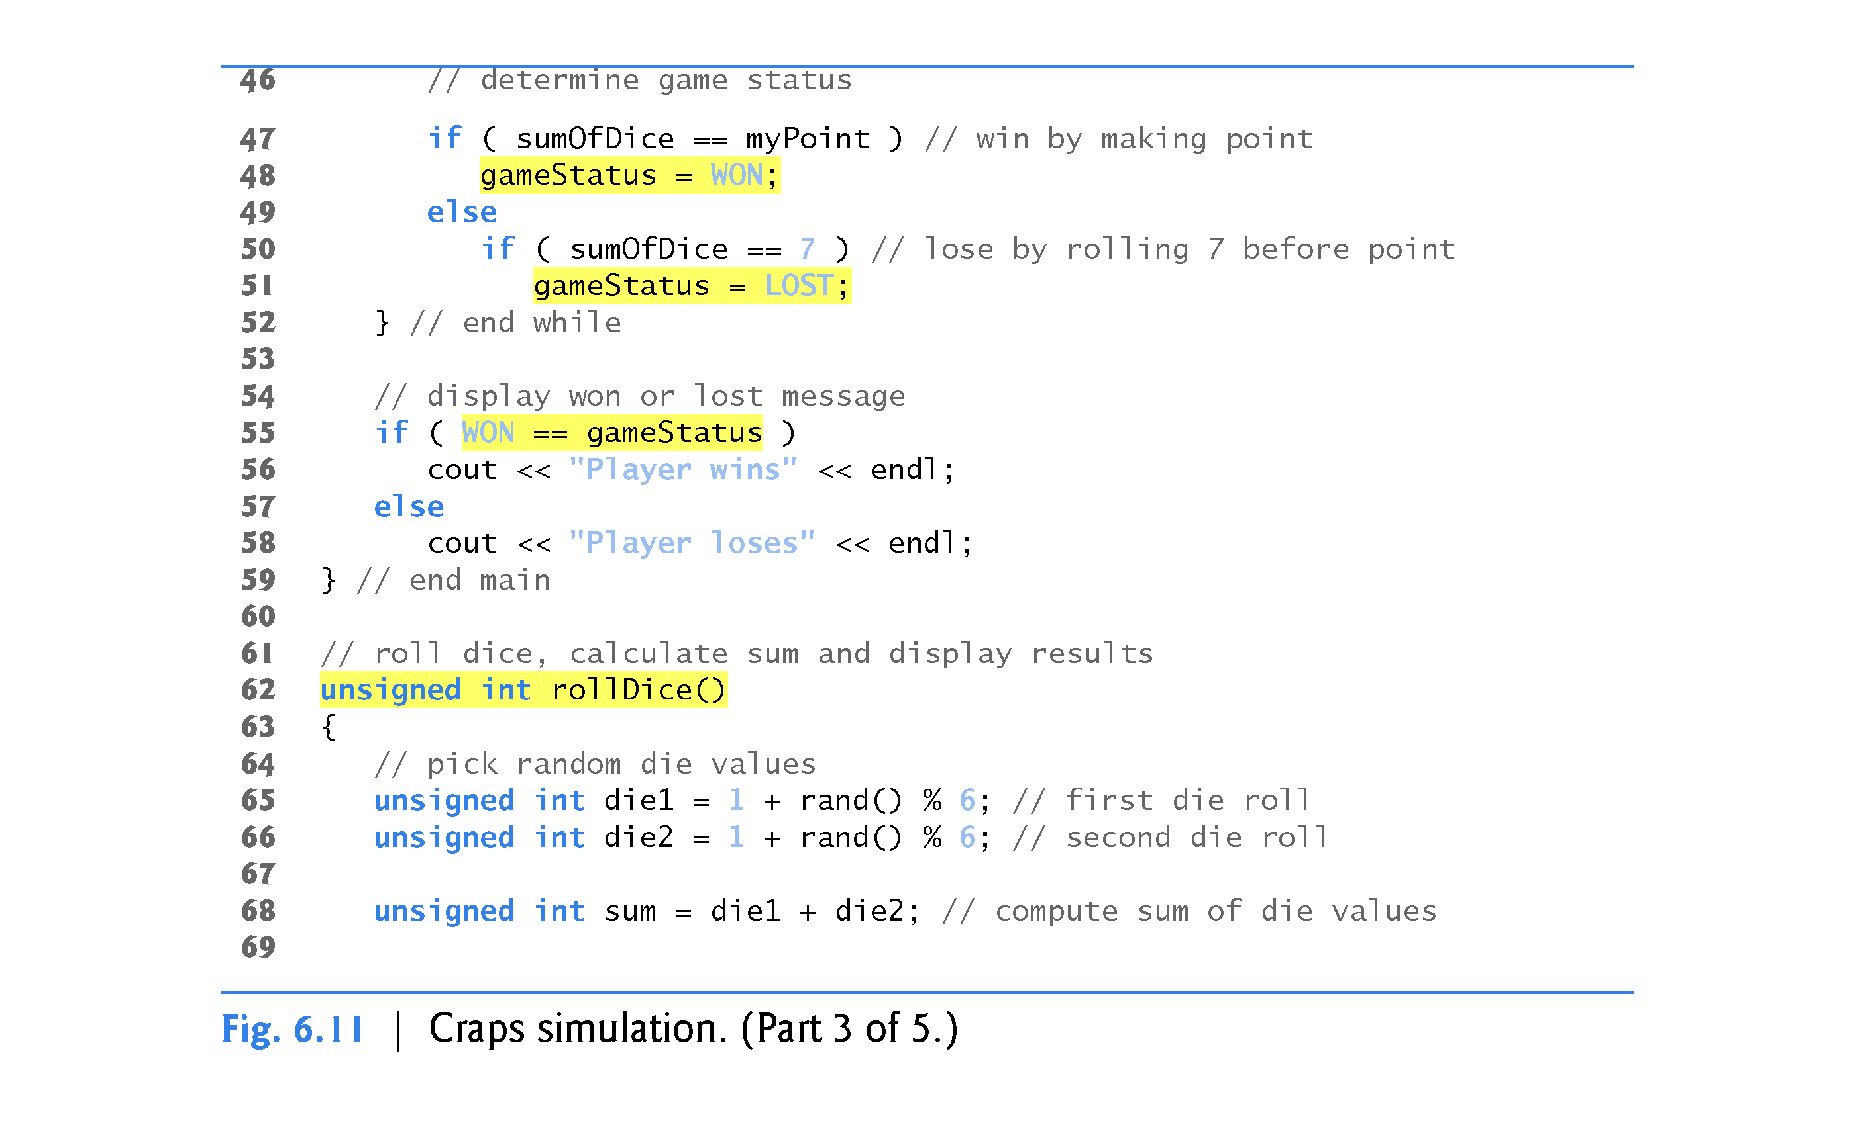

Slide 71
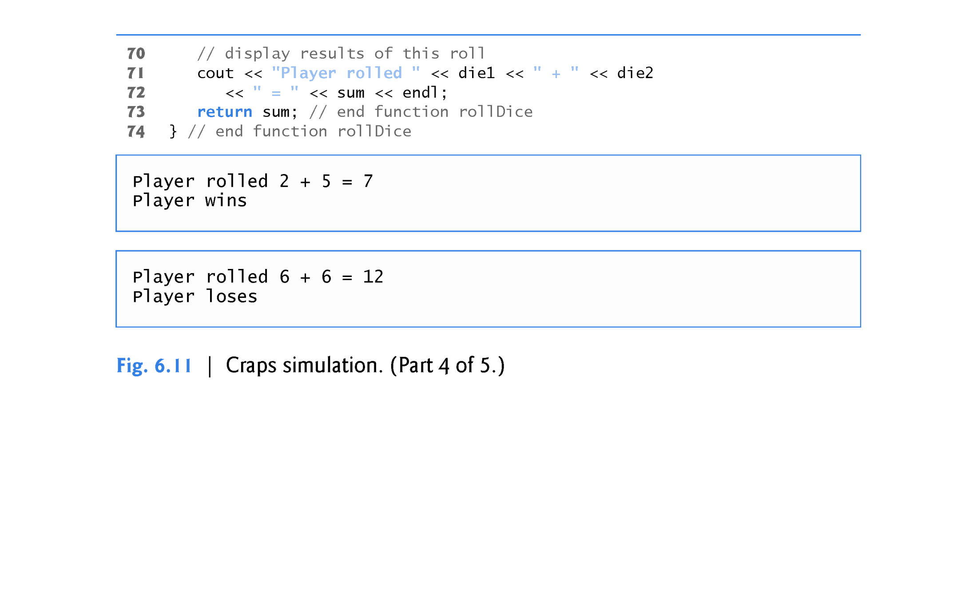

Slide 72
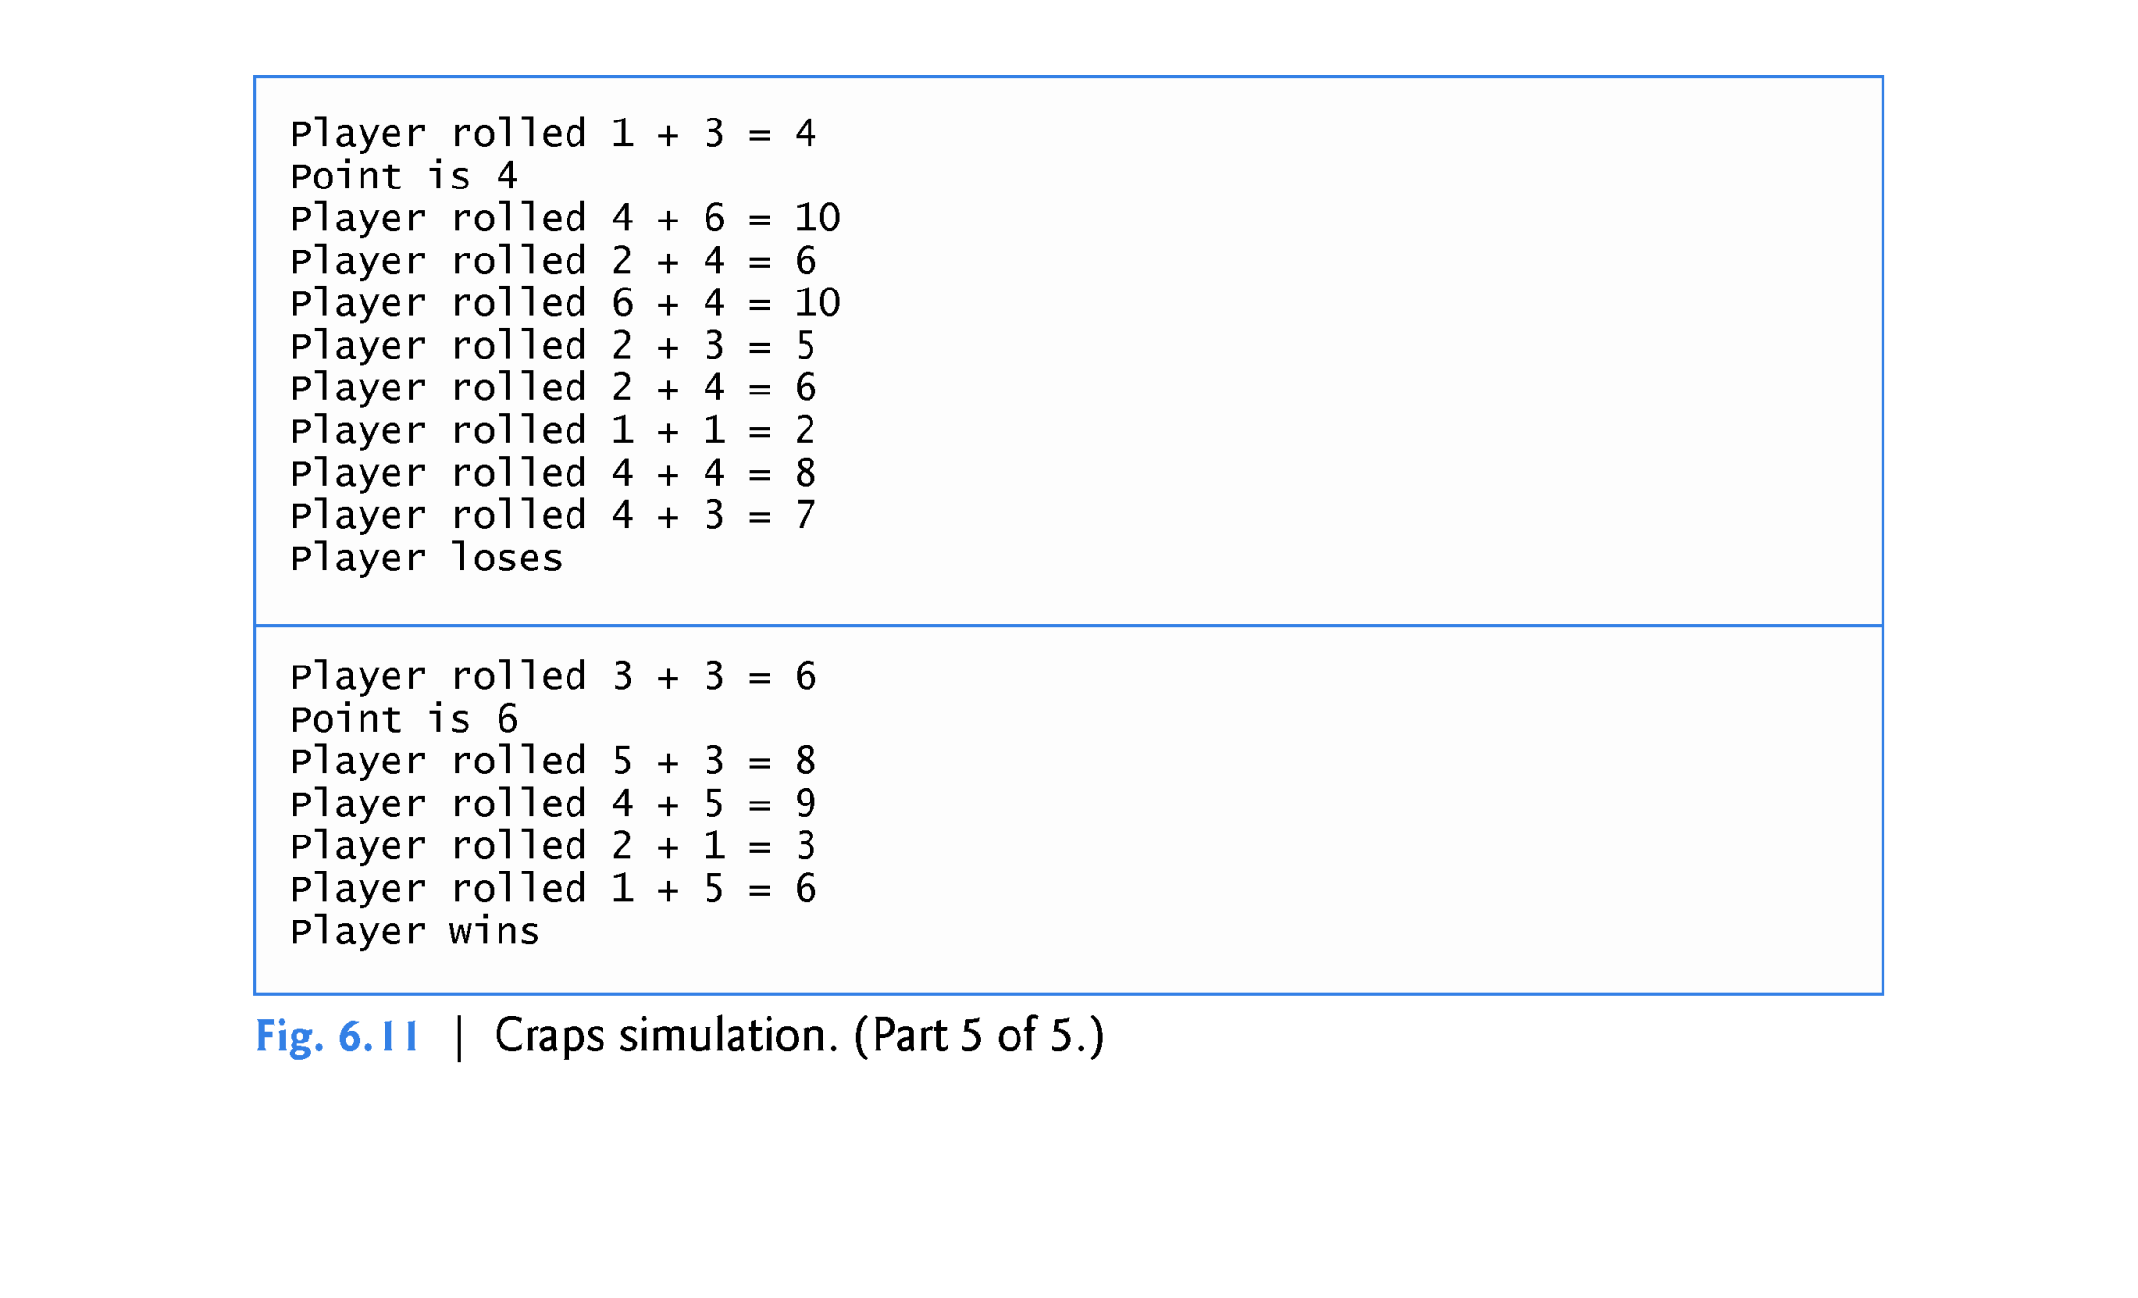

Slide 73
6.8 Case Study: Game of Chance; Introducing enum (cont.)
An enumeration, introduced by the keyword enum and followed by a type name, is a set of integer constants represented by identifiers.
The values of these enumeration constants start at 0, unless specified otherwise, and increment by 1.
The identifiers in an enum must be unique, but separate enumeration constants can have the same integer value.
Variables of an enum type can be assigned only one of the values declared in the enumeration.

Slide 74
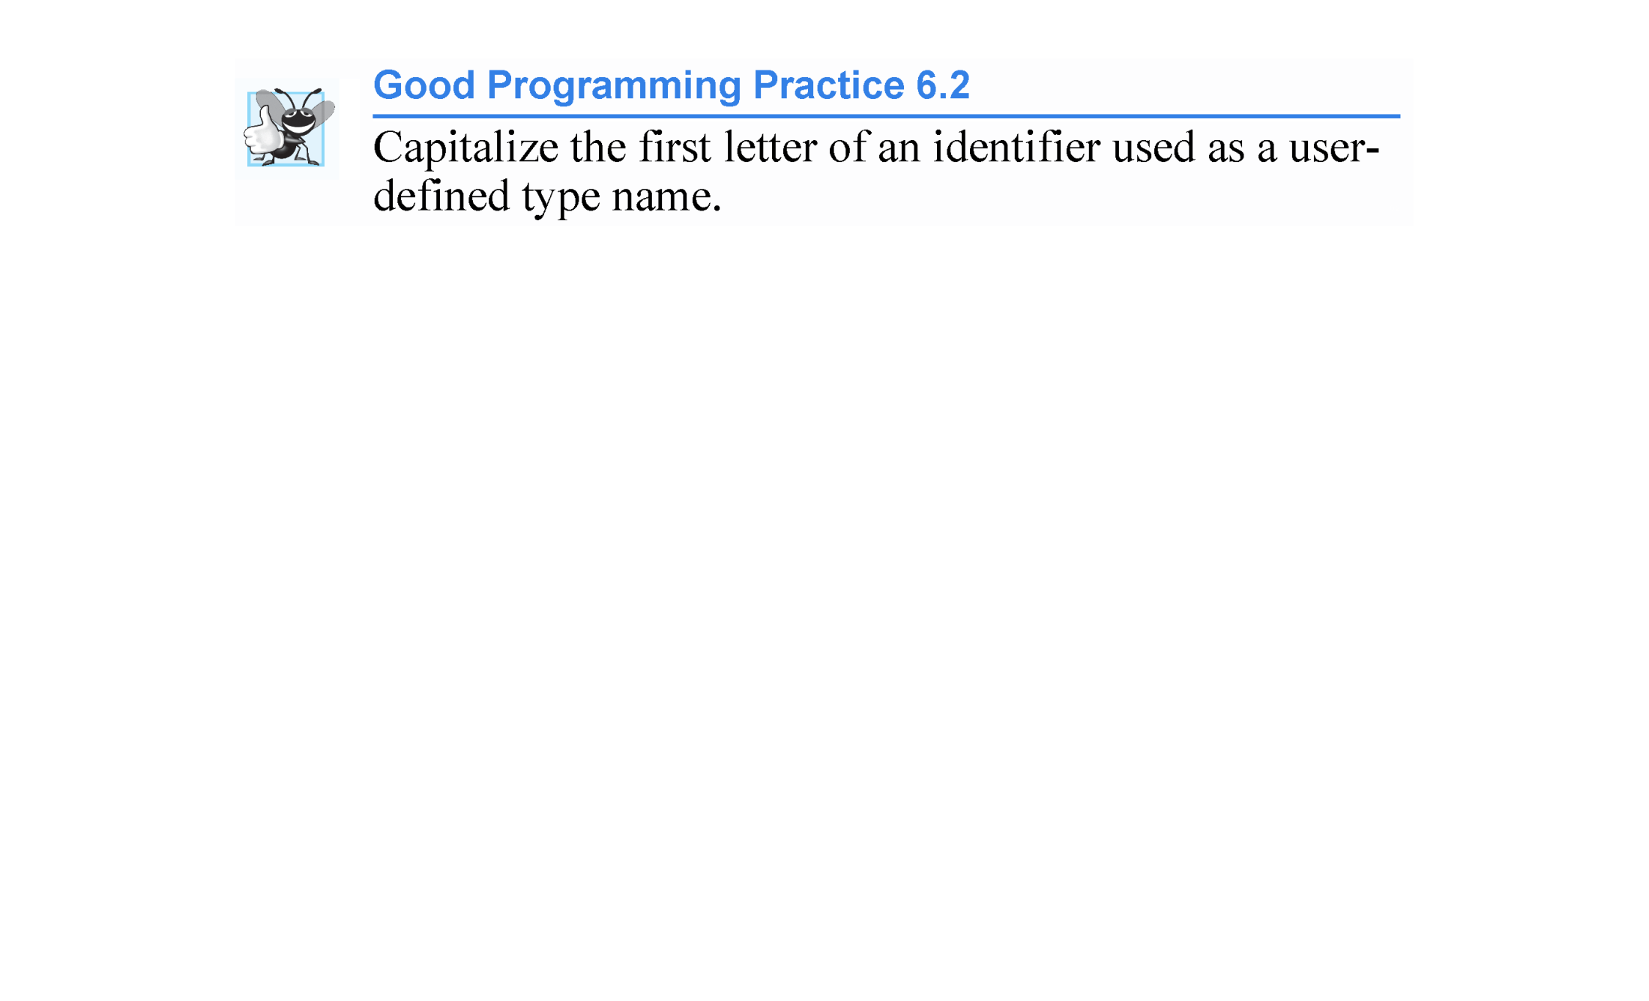

Slide 75


Slide 76
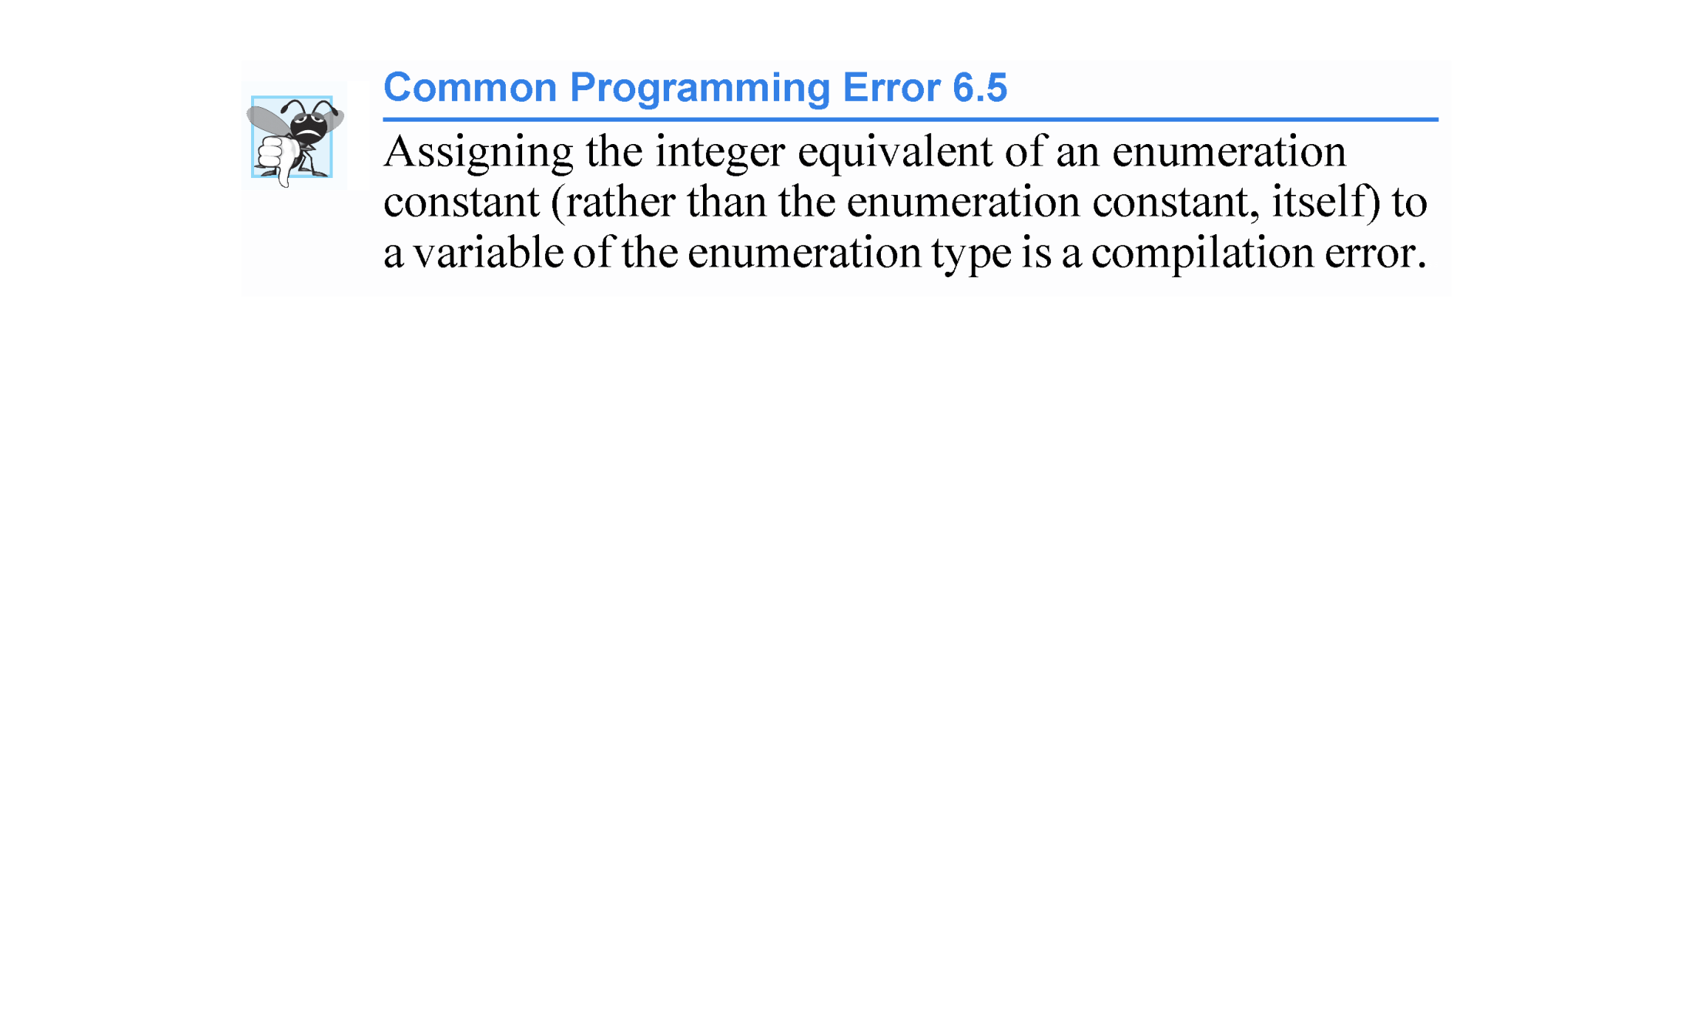

Slide 77
6.8 Case Study: Game of Chance; Introducing enum (cont.)
Another popular enumeration is
enum Months { JAN = 1, FEB, MAR, APR, MAY, JUN, JUL, AUG,
SEP, OCT, NOV, DEC };
creates user-defined type Months with enumeration constants representing the months of the year.
The first value in the preceding enumeration is explicitly set to 1, so the remaining values increment from 1, resulting in the values 1 through 12.
Any enumeration constant can be assigned an integer value in the enumeration definition.

Slide 78
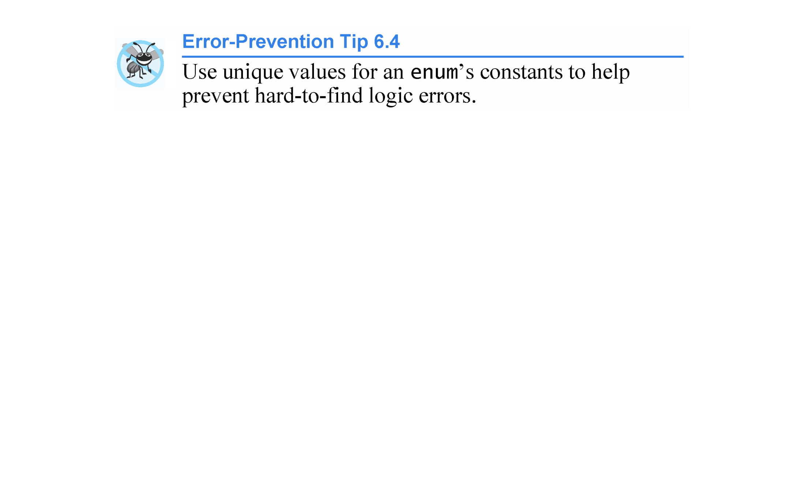

Slide 79
6.8 Case Study: Game of Chance; Introducing enum (cont.)
C++11 - Scoped enums
One problem with enums (also called unscoped enums) is that multiple enums may contain the same identifiers.
Using such enums in the same program can lead to naming collisions and logic errors.
C++11 introduces so-called scoped enums.
Declared with the keywords enum class (or the synonym enum struct).
We can define the Status enum of Fig. 6.11 as:
enum class Status { CONTINUE, WON, LOST };

Slide 80
6.8 Case Study: Game of Chance; Introducing enum (cont.)
To reference a scoped enum constant, you must qualify the constant with the scoped enum’s type name (Status) and the scope-resolution operator (::), as in Status::CONTINUE.
This explicitly identifies CONTINUE as a constant in the scope of enum class Status.
Thus, if another scoped enum contains the same identifier for one of its constants, it’s always clear which version of the constant is being used.

Slide 81
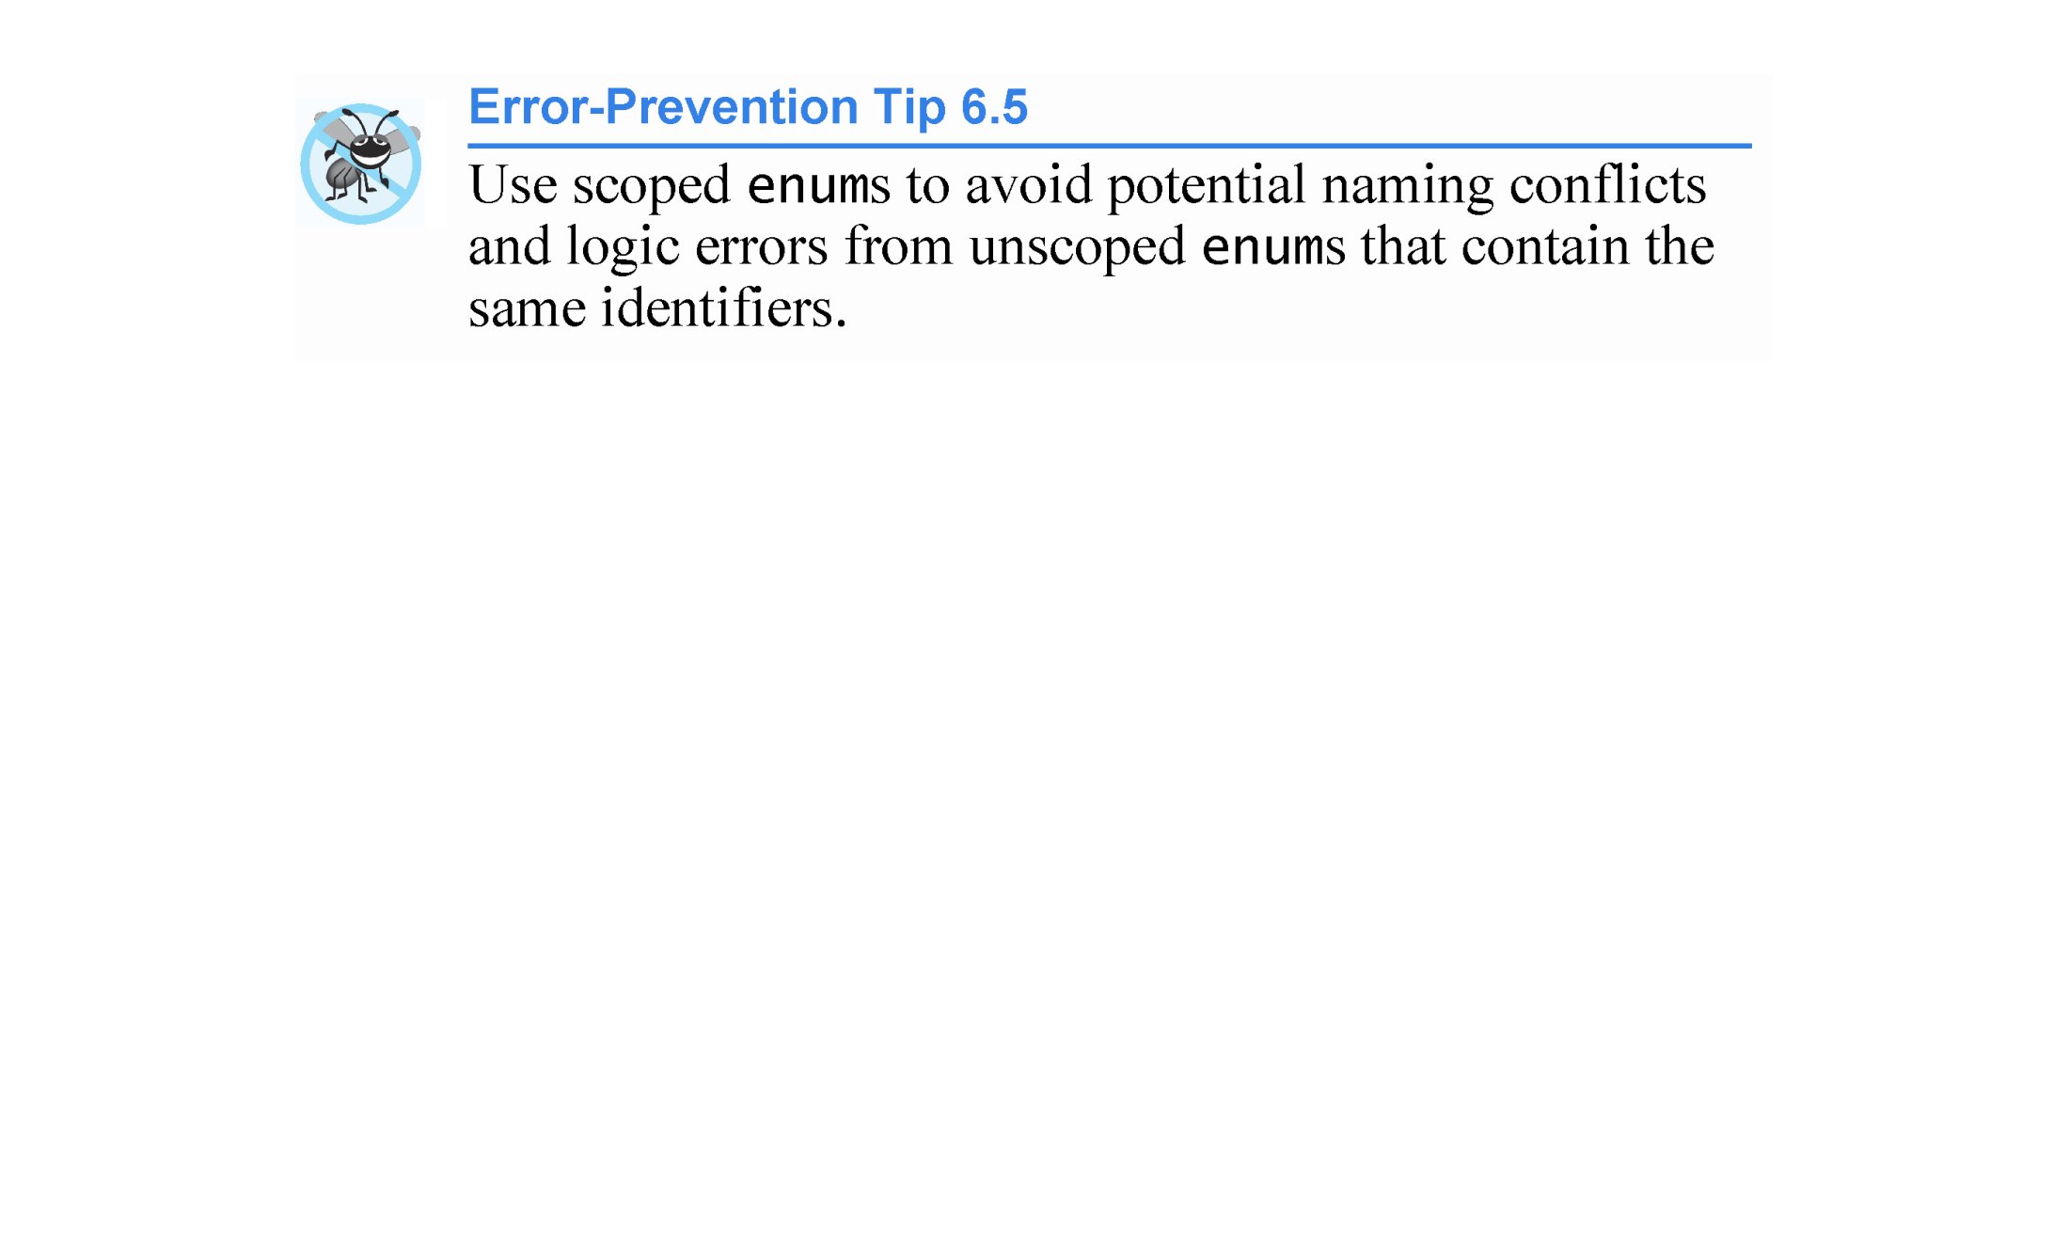

Slide 82
6.8 Case Study: Game of Chance; Introducing enum (cont.)
C++11 - Specifying the Type of an enum’s Constants
The constants in an enum are represented as integers.
By default, an unscoped enum’s underlying integral type depends on its constants’ values—the type is guaranteed to be large enough to store the constant values specified.
By default, a scoped enum’s underlying integral type is int.
C++11 allows you to specify an enum’s underlying integral type by following the enum’s type name with a colon (:) and the integral type.

Slide 83
6.8 Case Study: Game of Chance; Introducing enum (cont.)
We can specify that the constants in the enum class Status should have type unsigned int, as in
enum class Status : unsigned int { CONTINUE, WON, LOST };

Slide 84


Slide 85
6.9 C++11 Random Numbers
According to CERT, function rand does not have “good statistical properties” and can be predictable, which makes programs that use rand less secure (CERT guideline MSC30-CPP).
C++11 provides a new, more secure library of random-number capabilities that can produce nondeterministic random numbers for simulations and security scenarios where predictability is undesirable.
New capabilities are located in the C++ Standard Library’s <random> header.

Slide 86
6.9 C++11 Random Numbers (cont.)
For flexibility based on how random numbers are used in programs, C++11 provides many classes that represent various random-number generation engines and distributions.
An engine implements a random-number generation algorithm that produce pseudorandom numbers.
A distribution controls the range of values produced by an engine, the types of those values (e.g., int, double, etc.) and the statistical properties of the values.
uniform_int_distribution evenly distributes pseudorandom integers over a specified range of values.

Slide 87
6.9 C++11 Random Numbers (cont.)
Rolling a Six-Sided Die
Figure 6.12 uses the default_random_engine and the uniform_int_distribution to roll a six-sided die.
default_random_engine object named engine.
Its constructor argument seeds the random-number generation engine with the current time.
If you don’t pass a value to the constructor, the default seed will be used and the program will produce the same sequence of numbers each time it executes.
randomInt - a uniform_int_distribution object that produces unsigned int values (as specified by <unsigned int>) in the range 1 to 6 (as specified by the constructor arguments).
The expression randomInt(engine) returns one unsigned int value in the range 1 to 6.

Slide 88


Slide 89


Slide 90


Slide 91
6.9 C++11 Random Numbers (cont.)
The notation <unsigned int> indicates that uniform_int_distribution is a class template.
In this case, any integer type can be specified in the angle brackets (< and >). Default (no type) <> is int.
In Chapter 18, we discuss how to create class templates and various other chapters show how to use existing class templates from the C++ Standard Library.
For now, you should feel comfortable using class template uniform_int_distribution by mimicking the syntax shown in the example.

Slide 92
6.10 Storage Classes and Storage Duration
Each identifier in a program also has other attributes, including storage duration, scope and linkage.
C++ provides several storage-class specifiers that determine a variable’s storage duration:
register
extern
mutable
static
auto //auto can NOT be used as a storage class specifier in C++2011
Storage classes are static and automatic

Slide 93
6.10 Storage Classes and Storage Duration (cont.)
Duration
An identifier’s storage duration determines the period during which that identifier exists in memory.
Some exist briefly, some are repeatedly created and destroyed and others exist for a program’s entire execution.
Scope
An identifier’s scope is where the identifier can be referenced in a program.
Some identifiers can be referenced throughout a program; others can be referenced from only limited portions of a program.
Linkage
An identifier’s linkage determines whether it’s known only in the source file where it’s declared or across multiple files that are compiled, then linked together. (use of static and extern storage class specifiers)

Slide 94
6.10 Storage Classes and Storage Duration (cont.)
Storage Duration
The storage-class specifiers can be split into four storage durations:
automatic, static, dynamic and thread.
Local Variables and Automatic Storage Duration
Variables with automatic storage duration include:
local variables declared in functions
function parameters
local variables or function parameters declared with register

Slide 95
6.10 Storage Classes and Storage Duration (cont.)
Variables with automatic storage duration (continued):
Created when program execution enters the block in which they’re defined
Exist while the block is active
Destroyed when the program exits the block.
An automatic variable exists only in the nearest enclosing pair of curly braces within the body of the function in which the definition appears, or for the entire function body in the case of a function parameter.
Local variables are of automatic storage duration by default.
We refer to variables of automatic storage duration simply as automatic variables.

Slide 96


Slide 97


Slide 98


Slide 99
6.10 Storage Classes and Storage Duration (cont.)
Register Variables
Data in the machine-language version of a program is normally loaded into registers for calculations and other processing.
The compiler might ignore register declarations.
The register keyword can be used only with local variables and function parameters.

Slide 100


Slide 101


Slide 102
6.10 Storage Classes and Storage Duration (cont.)
Static Storage Duration
Keywords extern and static declare identifiers for variables with static storage duration and for functions.
Exist from the point at which the program begins execution and until the program terminates.
Such a variable is initialized once when its declaration is encountered.

Slide 103
6.10 Storage Classes and Storage Duration (cont.)
Identifiers with Static Storage Duration
There are two types of identifiers with static storage duration
external identifiers (such as global variables and global function names)
local variables declared with the storage-class specifier static.

Slide 104


Slide 105


Slide 106
6.10 Storage Classes and Storage Duration (cont.)
static Local Variables
Local variables declared static are still known only in the function in which they’re declared, but, unlike automatic variables, static local variables retain their values when the function returns to its caller.
The next time the function is called, the static local variables contain the values they had when the function last completed execution.

Slide 107
6.11 Scope Rules
The portion of the program where an identifier can be used is known as its scope.
This section discusses
block scope
function scope,
global namespace scope
function-prototype scope

Slide 108
6.11 Scope Rules (cont.)
Block Scope
Identifiers declared inside a block have block scope, which begins at the identifier’s declaration and ends at the terminating right brace (}) of the block in which the identifier is declared.
Local variables have block scope, as do function parameters.
Any block can contain variable declarations.
When blocks are nested and an identifier in an outer block has the same name as an identifier in an inner block, the identifier in the outer block is “hidden” until the inner block terminates.

Slide 109
6.11 Scope Rules (cont.)
The inner block “sees” its own local identifier’s value and not that of the enclosing block’s identically named identifier.
Local variables declared static still have block scope, even though they exist from the time the program begins execution.
Storage duration does not affect an identifier’s scope.

Slide 110


Slide 111


Slide 112
6.11 Scope Rules (cont.)
Function Scope
Labels (identifiers followed by a colon such as start: or a case label in a switch statement) are the only identifiers with function scope.
Labels can be used anywhere in the function in which they appear, but cannot be referenced outside the function body.

Slide 113
6.11 Scope Rules (cont.)
Global Namespace Scope
An identifier declared outside any function or class has global namespace scope.
Global variables, function definitions and function prototypes placed outside a function

Slide 114
6.11 Scope Rules (cont.)
Function-Prototype Scope
The only identifiers with function-prototype scope are those used in the parameter list of a function prototype.

Slide 115
6.11 Scope Rules (cont.)
Scope Demonstration
The program of Fig. 6.13 demonstrates scoping issues with global variables, automatic local variables and static local variables.

Slide 116


Slide 117


Slide 118


Slide 119


Slide 120
6.12 Function Call Stack and Activation Records
To understand how C++ performs function calls, we first need to consider a data structure (i.e., collection of related data items) known as a stack.
Analogous to a pile of dishes.
When a dish is placed on the pile, it’s normally placed at the top—referred to as pushing.
Similarly, when a dish is removed from the pile, it’s normally removed from the top—referred to as popping.
Last-in, first-out (LIFO) data structures—the last item pushed (inserted) is the first item popped (removed).

Slide 121
6.12 Function Call Stack and Activation Records (cont.)
Function-Call Stack
One of the most important mechanisms for computer science students to understand is the function call stack (or program execution stack).
supports the function call/return mechanism.
Also supports the creation, maintenance and destruction of each called function’s automatic variables.

Slide 122
6.12 Function Call Stack and Activation Records (cont.)
Stack Frames
Each function eventually must return control to the function that called it.
Each time a function calls another function, an entry is pushed onto the function call stack.
This entry, called a stack frame or an activation record, contains the return address that the called function needs in order to return to the calling function.

Slide 123
6.12 Function Call Stack and Activation Records (cont.)
Automatic Variables and Stack Frames
When a function call returns, the stack frame for the function call is popped, and control transfers to the return address in the popped stack frame.
Stack Overflow
The amount of memory in a computer is finite, so only a certain amount of memory can be used to store activation records on the function call stack.
If more function calls occur than can have their activation records stored on the function call stack, an a fatal error known as stack overflow occurs.

Slide 124
6.12 Function Call Stack and Activation Records (cont.)
Function Call Stack in Action
Now let’s consider how the call stack supports the operation of a square function called by main (Fig. 6.14).
First the operating system calls main - this pushes an activation record onto the stack (shown in Fig. 6.15).
The activation record tells main how to return to the operating system (i.e., transfer to return address R1) and contains the space for main’s automatic variable (i.e., a, which is initialized to 10).

Slide 125


Slide 126


Slide 127


Slide 128
6.12 Function Call Stack and Activation Records (cont.)
Function main -before returning to the operating system—now calls function square in line 13 of Fig. 6.14.
This causes a stack frame for square (lines 17–20) to be pushed onto the function call stack (Fig. 6.16).
This stack frame contains the return address that square needs to return to main (i.e., R2) and the memory for square’s automatic variable (i.e., x).

Slide 129


Slide 130
6.12 Function Call Stack and Activation Records (cont.)
After square calculates the square of its argument, it needs to return to main - and no longer needs the memory for its automatic variable x. So square’s stack frame is popped from the stack - giving square the return location in main (i.e., R2) and losing square’s automatic variable.
Figure 6.17 shows the function call stack after square’s activation record has been popped.

Slide 131


Slide 132
6.13 Functions with Empty Parameter Lists
In C++, an empty parameter list is specified by writing either void or nothing at all in parentheses.
Figure 6.18 shows both ways to declare and use functions with empty parameter lists.

Slide 133


Slide 134


Slide 135
6.14 Inline Functions
C++ provides inline functions to help reduce function call overhead.
Placing the qualifier inline before a function’s return type in the function definition advises the compiler to generate a copy of the function’s code in every place where the function is called (when appropriate) to avoid a function call.
This often makes the program larger.
Reusable inline functions are typically placed in headers, so that their definitions can be included in each source file that uses them.

Slide 136


Slide 137


Slide 138
6.14 Inline Functions
Figure 6.19 uses inline function cube (lines 9–12) to calculate the volume of a cube.
Keyword const in function cube’s parameter list (line 9) tells the compiler that the function does not modify variable side.
This ensures that side’s value is not changed by the function during the calculation.

Slide 139


Slide 140


Slide 141


Slide 142
6.15 References and Reference Parameters
Two ways to pass arguments to functions in many programming languages are pass-by-value and pass-by-reference (or call-by-value and call-by-reference)
When an argument is passed by value, a copy of the argument’s value is made and passed (on the function call stack) to the called function.
Changes to the copy do not affect the original variable’s value in the caller.
To specify a reference to a constant, place the const qualifier before the type specifier in the parameter declaration.

Slide 143


Slide 144
6.15 References and Reference Parameters (cont.)
With pass-by-reference, the caller gives the called function the ability to access the caller’s data directly, and to modify that data.
A reference parameter is an alias for its corresponding argument in a function call.
To indicate that a function parameter is passed by reference, simply follow the parameter’s type in the function prototype by an ampersand (&); use the same convention when listing the parameter’s type in the function header.
Figure 6.20 compares pass-by-value and pass-by-reference with reference parameters.

Slide 145


Slide 146


Slide 147


Slide 148


Slide 149


Slide 150


Slide 151
6.15 References and Reference Parameters (cont.)
References as Aliases within a Function
References can also be used as aliases for other variables within a function.
Reference variables must be initialized in their declarations and cannot be reassigned as aliases to other variables.
Once a reference is declared as an alias for another variable, all operations supposedly performed on the alias are actually performed on the original variable.

Slide 152
6.15 References and Reference Parameters (cont.)
Returning a Reference from a Function
Functions can return references, but this can be dangerous.
When returning a reference to a variable declared in the called function, the variable should be declared static in that function.

Slide 153


Slide 154
6.16 Default Arguments
It isn’t uncommon for a program to invoke a function repeatedly with the same argument value for a particular parameter.
Can specify that such a parameter has a default argument, i.e., a default value to be passed to that parameter.
When a program omits an argument for a parameter with a default argument in a function call, the compiler rewrites the function call and inserts the default value of that argument.
Default arguments must be the rightmost (trailing) arguments in a function’s parameter list.
Figure 6.21 demonstrates using default arguments to calculate a box’s volume.

Slide 155


Slide 156


Slide 157


Slide 158


Slide 159
6.17 Unary Scope Resolution Operator
It’s possible to declare local and global variables of the same name.
C++ provides the unary scope resolution operator (::) to access a global variable when a local variable of the same name is in scope.
Using the unary scope resolution operator (::) with a given variable name is optional when the only variable with that name is a global variable.
Figure 6.22 shows the unary scope resolution operator with local and global variables of the same name.

Slide 160


Slide 161


Slide 162


Slide 163


Slide 164


Slide 165
6.18 Function Overloading
C++ enables several functions of the same name to be defined, as long as they have different signatures.
This is called function overloading.
The C++ compiler selects the proper function to call by examining the number, types and order of the arguments in the call.
Function overloading is used to create several functions of the same name that perform similar tasks, but on different data types.

Slide 166


Slide 167
6.18 Function Overloading (cont.)
Figure 6.23 uses overloaded square functions to calculate the square of an int and the square of a double.

Slide 168


Slide 169


Slide 170
6.17 Function Overloading (cont.)
How the Compiler Differentiates Among Overloaded Functions
Overloaded functions are distinguished by their signatures.
A signature is a combination of a function’s name and its parameter types (in order).
The compiler encodes each function identifier with the types of its parameters (sometimes referred to as name mangling or name decoration) to enable type-safe linkage.
Ensures that the proper overloaded function is called and that the types of the arguments conform to the types of the parameters.
Figure 6.24 was compiled with GNU C++.
Rather than showing the execution output of the program, we show the mangled function names produced in assembly language by GNU C++.

Slide 171


Slide 172


Slide 173


Slide 174


Slide 175
6.19 Function Templates
If the program logic and operations are identical for each data type, overloading may be performed more compactly and conveniently by using function templates.
You write a single function template definition.

Slide 176
6.19 Function Templates (cont.)
Figure 6.25 defines a maximum function template (lines 3–17) that determines the largest of three values.
All function template definitions begin with the template keyword followed by a template parameter list to the function template enclosed in angle brackets (< and >).
Every parameter in the template parameter list (often referred to as a formal type parameter) is preceded by keyword typename or keyword class (which are synonyms).
The formal type parameters are placeholders for fundamental types or user-defined types.
These placeholders are used to specify the types of the function’s parameters, to specify the function’s return type and to declare variables within the body of the function definition.

Slide 177


Slide 178


Slide 179


Slide 180
6.19 Function Templates (cont.)
Figure 6.26 uses the maximum function template to determine the largest of three int values, three double values and three char values, respectively.
Separate functions are created as a result of the calls—expecting three int values, three double values and three char values, respectively.

Slide 181
6.19 Function Templates (cont.)
C++11 - Trailing Return Types for Functions
C++11 introduces trailing return types for functions.
To specify a trailing return type you place the keyword auto before the function name, then follow the function’s parameter list with -> and the return type.
For example, to specify a trailing return type for function template maximum (Fig. 6.25), you’d write
template < typename T >
auto maximum( T x, T y, T z ) -> T
As you build more complex function templates, there are cases for which only trailing return types are allowed.
Such complex function templates are beyond this book’s scope.

Slide 182
6.20 Recursion
A recursive function is a function that calls itself, either directly, or indirectly (through another function).
Recursive problem-solving approaches have a number of elements in common.
A recursive function is called to solve a problem.
The function actually knows how to solve only the simplest case(s), or so-called base case(s).
If the function is called with a base case, the function simply returns a result.
If the function is called with a more complex problem, it typically divides the problem into two conceptual pieces - a piece that the function knows how to do and a piece that it does not know how to do.
This new problem looks like the original, so the function calls a copy of itself to work on the smaller problem—this is referred to as a recursive call and is also called the recursion step.

Slide 183


Slide 184
6.20 Recursion (cont.)
The recursion step often includes the keyword return, because its result will be combined with the portion of the problem the function knew how to solve to form the result passed back to the original caller, possibly main.
The recursion step executes while the original call to the function is still “open,” i.e., it has not yet finished executing.
The recursion step can result in many more such recursive calls.

Slide 185
6.20 Recursion (cont.)
Factorial
The factorial of a nonnegative integer n, written n! (and pronounced “n factorial”), is the product
n · (n – 1) · (n – 2) · … · 1
with 1! equal to 1, and 0! defined to be 1.

Slide 186
6.20 Recursion (cont.)
Iterative Factorial
The factorial of an integer, number, greater than or equal to 0, can be calculated iteratively (nonrecursively) by using a loop.
Recursive Factorial
A recursive definition of the factorial function is arrived at by observing the following algebraic relationship:
n! = n · (n – 1)!

Slide 187
6.20 Recursion (cont.)
Evaluating 5!
The evaluation of 5! would proceed as shown in Fig. 6.27, which illustrates how the succession of recursive calls proceeds until 1! is evaluated to be 1, terminating the recursion.
Figure 6.27(b) shows the values returned from each recursive call to its caller until the final value is calculated and returned.

Slide 188


Slide 189
6.20 Recursion (cont.)
Using a Recursive factorial Function to Calculate Factorials
Figure 6.28 uses recursion to calculate and print the factorials of the integers 0 - 10.

Slide 190


Slide 191


Slide 192
6.20 Recursion (cont.)
C++11 Type unsigned long long int
C++11’s new unsigned long long int type (which can be abbreviated as unsigned long long) on some systems enables you to store values in 8 bytes (64 bits) which can hold numbers as large as 18,446,744,073,709,551,615.

Slide 193
6.21 Example Using Recursion: Fibonacci Series
The Fibonacci series
0, 1, 1, 2, 3, 5, 8, 13, 21, …
begins with 0 and 1 and has the property that each subsequent Fibonacci number is the sum of the previous two Fibonacci numbers.
The series occurs in nature and, in particular, describes a form of spiral.
The ratio of successive Fibonacci numbers converges on a constant value of 1.618….
This frequently occurs in nature and has been called the golden ratio or the golden mean.
Humans tend to find the golden mean aesthetically pleasing.

Slide 194
6.20 Example Using Recursion: Fibonacci Series (cont.)
Recursive Fibonacci Definition
The Fibonacci series can be defined recursively as follows:
fibonacci(0) = 0 fibonacci(1) = 1 fibonacci(n) = fibonacci(n – 1) + fibonacci(n – 2)
The program of Fig. 6.29 calculates the nth Fibonacci number recursively by using function fibonacci.

Slide 195


Slide 196


Slide 197


Slide 198
6.21 Example Using Recursion: Fibonacci Series (cont.)
Figure 6.30 shows how function fibonacci would evaluate fibonacci(3).
This figure raises some interesting issues about the order in which C++ compilers evaluate the operands of operators.
This is a separate issue from the order in which operators are applied to their operands, namely, the order dictated by the rules of operator precedence and associativity.
Most programmers simply assume that operands are evaluated left to right.
C++ does not specify the order in which the operands of most operators (including +) are to be evaluated.
Therefore, you must make no assumption about the order in which these calls execute.

Slide 199


Slide 200


Slide 201


Slide 202


Slide 203


Slide 204


Slide 205
6.22 Recursion vs. Iteration
Both iteration and recursion are based on a control statement:
Iteration uses a repetition structure
recursion uses a selection structure
Both iteration and recursion involve repetition: Iteration explicitly uses a repetition structure; recursion achieves repetition through repeated function calls.
Iteration and recursion each involve a termination test: Iteration terminates when the loop-continuation condition fails; recursion terminates when a base case is recognized.

Slide 206
6.22 Recursion vs. Iteration (cont.)
Iteration with counter-controlled repetition and recursion both gradually approach termination:
Iteration modifies a counter until the counter assumes a value that makes the loop-continuation condition fail;
recursion produces simpler versions of the original problem until the base case is reached.
Both iteration and recursion can occur infinitely: An infinite loop occurs with iteration if the loop-continuation test never becomes false; infinite recursion occurs if the recursion step does not reduce the problem during each recursive call in a manner that converges on the base case.
To illustrate the differences between iteration and recursion, let’s examine an iterative solution to the factorial problem (Fig. 6.31).

Slide 207


Slide 208


Slide 209


Slide 210


Slide 211


Slide 212


Slide 213


Slide 214


